Slide 1
Write down the number sentences:
x
=
25
x
=
80
x
x
45
=
5
=
x
x
55
=
10
=
x
=
0
x
=
20
x
60
x
35
=
=

Slide 2
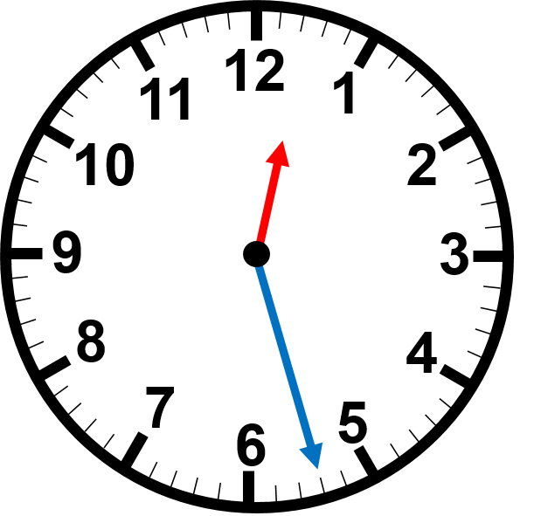
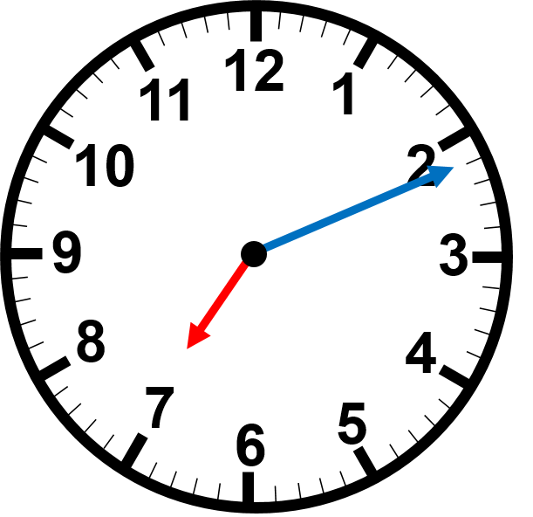
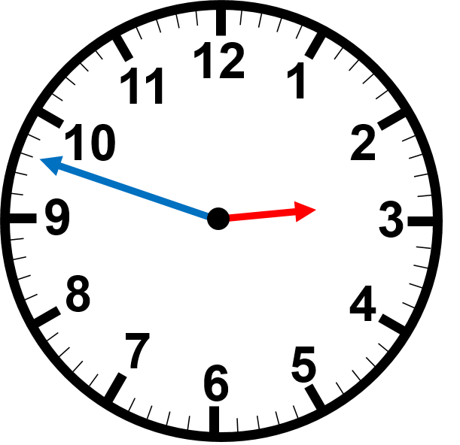
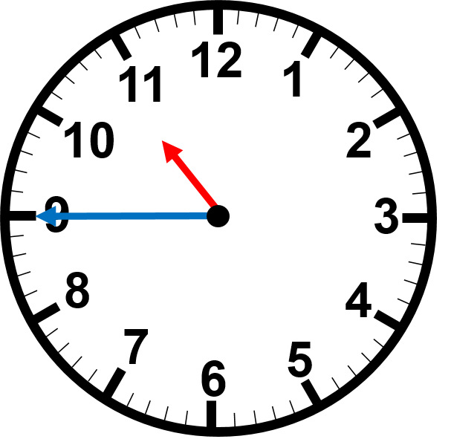
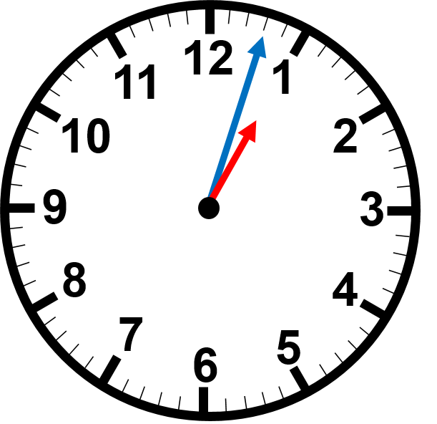
Read the time on the clocks
:
:
:
:
:

Slide 3
Solve the word problem using RUCSAC
Rob made cookies and put 3 cookies in 6 containers.
How many did he make altogether?
Read
Understand
Choose the strategy – look at vocab
Solve
Answer
Check

Slide 4
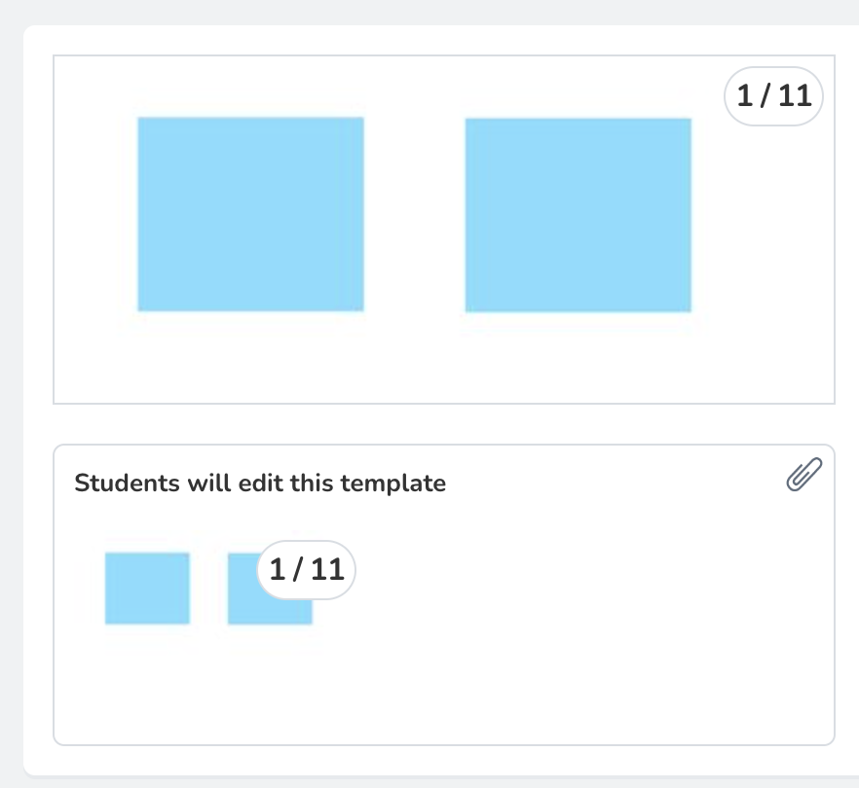
TEACHERS PLEASE NOTE THAT A SEESAW FOLDER HAS BEEN CREATED CALLED FRACTIONS AND ACTIVITIES HAVE BEEN ASSIGNED!
Students can either use whiteboards OR use this seesaw task to
help them with their showing their working out.

Slide 5
1
Fractions
WALT:
Identify fractions of groups
WILF:
Know what a fraction is
Identify common fractions
Find fractions using pictorial and written representations

Slide 6
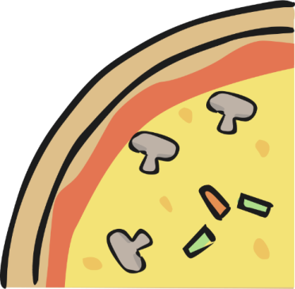
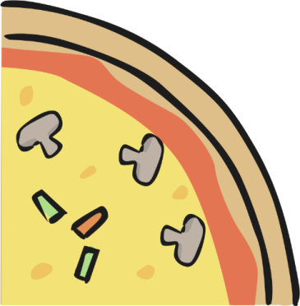
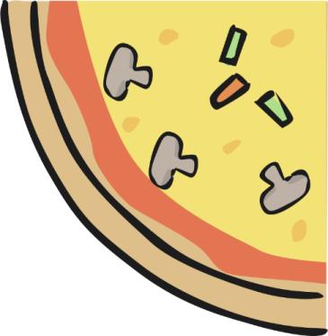
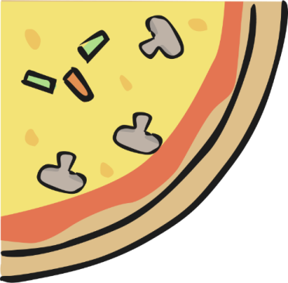
What are fractions?
I ordered 1 whole pizza from Dominos. Yum!
It has been cut into 4 equal slices
I bought 1 whole chocolate bar. Yum!
It as been cut into 6 equal slices.

Slide 7
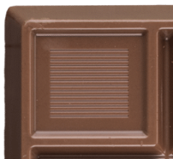
What are fractions?
I ate 1 piece
After eating 1 piece my mum asked me how much pizza I have left.
I can’t say that I have 1 whole pizza because I’ve eaten some of it!

Slide 8
What are fractions?
So how am I meant to work this out?
I’ll use fractions!
A fraction is a PART of whole.
Here, we have a part of a whole pizza and part of a whole chocolate

Slide 9
What are fractions?
I worked out that I still had 3 out of 4 pieces left.
I can write this as a fraction!
It would look like this:
This is how many
pieces I have left
3
__
This is the total
number of pieces
4
This is how many
pieces I have left
5
__
This is the total
number of pieces
6

Slide 10
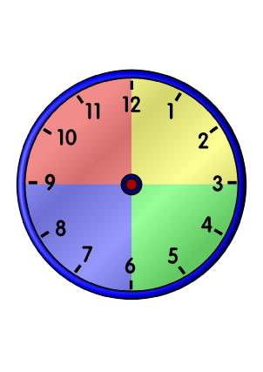
What are fractions?
Now I can tell my mum how much I have left
I would say this as three-quarters
The word ‘quarter’ is similar to the way we describe time
3
__
4

Slide 11
What are fractions?
So then how much of the pizza did I eat?
I ate 1 out of 4 pieces.
So the fraction to describe this would be:
This is how many
pieces I have left
1
__
This is the total
number of pieces
4

Slide 12
What are fractions?
When we write a fraction:
The top number
is called the
numerator
1
The bottom number
is the total
number of parts we
have – in this case,
the total number of
pizza slices
4
The bottom
Number is called
the denominator

Slide 13
What are fractions?
We do
Let’s look at my pizza again:
My mum decided to join me and also ate 1 slice.
How much pizza do I have left now?
This is how many
pieces I have left
2
__
This is the total
number of pieces
4

Slide 14
What are fractions?
We decided to order another pizza for the rest of the family.
This time Dominos cut it into 8 equal slices
My dad ate 3 slices
How much pizza is left?
The denominator is now
8 because the pizza has a
total of 8 slices not 4
This is how many
pieces I have left
5
__
This is the total
number of pieces
So instead of quarters we
would say this as
five-eighths
8

Slide 15
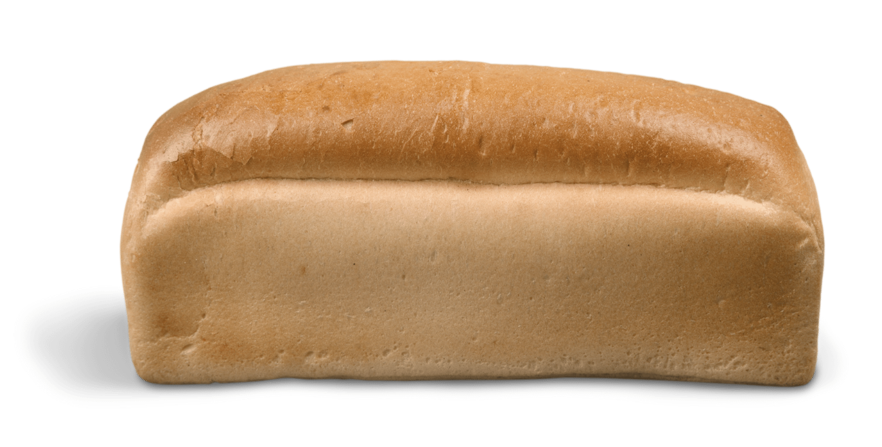
What are fractions?
We decided to order a garlic bread for the rest of the family.
This time mum cut it into 8 equal slices
My brother ate 2 slices
How much garlic bread is left?
The denominator is now
8 because the pizza has a
total of 8 slices not 4
This is how many
pieces I have left
6
__
This is the total
number of pieces
8
So instead of quarters we
would say this as
-eighths

Slide 16
What are fractions?
We do
Our dog then ran into the house and ate another 2 slices!
How much pizza is left?
How would I say this
fraction?
This is how many
pieces I have left
3
__
This is the total
number of pieces
Three-eighths
8

Slide 17
What are fractions?
We do
We didn’t want to eat the rest of the pizza because it had dog slobber all over it! Ew! So we ordered yet another pizza!
This time Dominos only cut it into 2 equal slices!
I was still really hungry so I ate another slice!
How much pizza is left?
The denominator is now 2 because the
pizza has a total of 2 slices
This is how many
pieces I have left
1
__
This is the total
number of pieces
2
How would I say this fraction?
One-half

Slide 18
You do
Use your mini-whiteboards to work out the fraction of pizza I have left in the examples below:
1.
2.
2
4
3
5
3.
4.
4
7
6
9

Slide 19
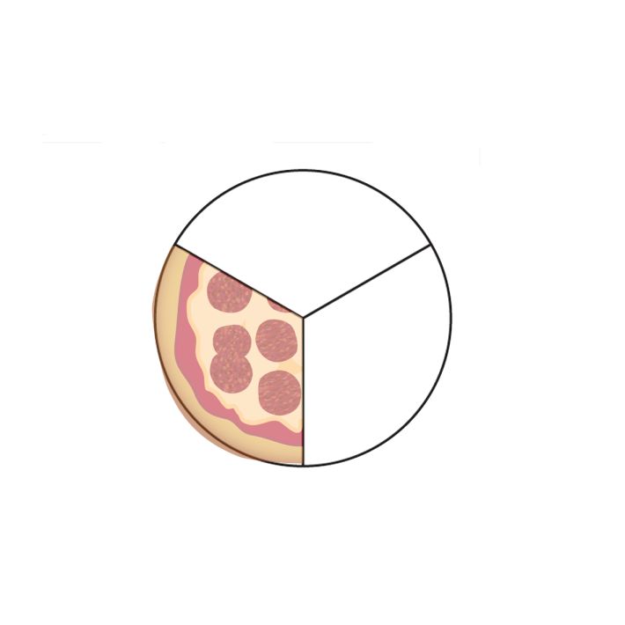
You do
Use your mini-whiteboards to draw the amount of pizza I have left, using these fractions: (the first one has been done for you)
1
4
1.
__
2.
__
3
6
2
2
__
__
3.
4.
8
2

Slide 20
The Magic 1
For the last question, you should have shaded your entire pizza like so:
This means that I ate 1 WHOLE pizza.
So equals 1 whole
Anytime the numerator is the same as the denominator it is a magic 1 (1 whole)
2
__
2
2
__
2

Slide 21
Equal Parts
Remember in order to form a fraction, the parts need to be EQUAL.
Is this one-half?
It is divided into 2 but it’s parts are NOT equal
Is this one-quarter?
It is divided into 4 but it’s parts are NOT equal

Slide 22
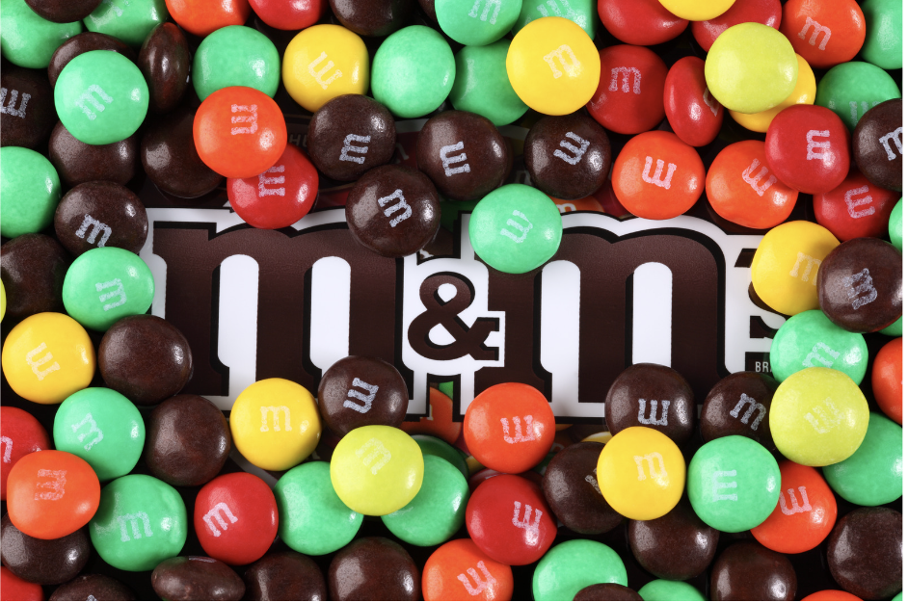
Today’s Activity
We have looked at fractions as part of a whole
But fractions can also be parts of a group
We will be exploring this in today’s activity

Slide 23
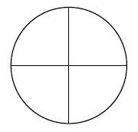
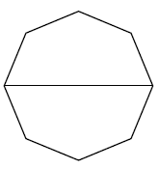
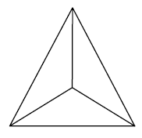
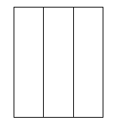
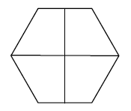
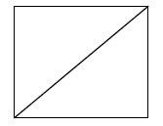
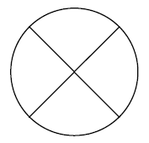
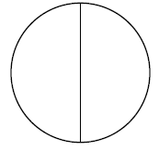
Fraction Sort
Plenary
Halves | Thirds | Quarters/Fourths

