Slide 1
WARM UP

Slide 2
Write these numbers in standard form.
three hundred and sixty nine
forty five thousand, nine hundred and eighty one
seventy one thousand, four hundred and twenty four
six hundred and thirty three thousand, eight hundred and five.

Slide 3
Round these numbers to the nearest 10…
67 98 33 45
123 165 219 413

Slide 4
Complete these division calculations using the split strategy
Level 2 | Level 1 | Level 3
60 ÷ 4 = | 1213 ÷ 4 = | 12 ÷ 4 =
85 ÷ 5 = | 2901 ÷ 5 = | 18 ÷ 3 =
54 ÷ 3 = | 4317 ÷ 6 = | 10 ÷ 2 =

Slide 5
2
Fractions
WALT:
organise fractions on a number line
WILF:
Use the correct terminology to
Write/draw a fraction
Place fractions on a number line
order fractions

Slide 6
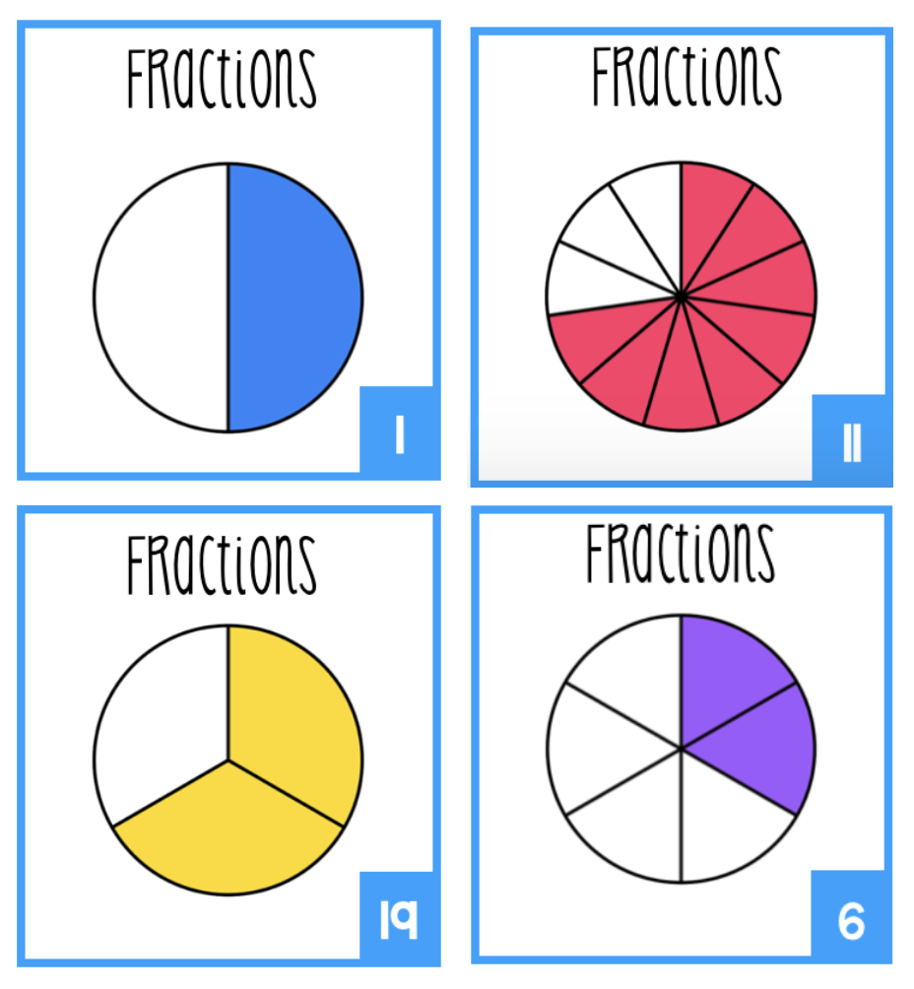
What are fractions?
Quiz, Quiz Trade – Show students a fraction picture and students need to identify the fraction.

Slide 7
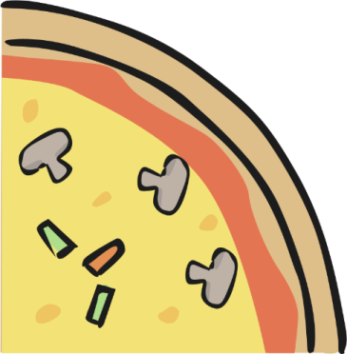
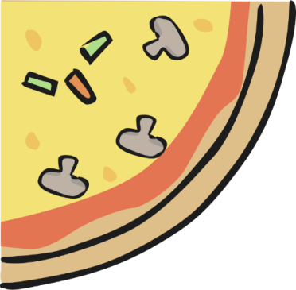
What are fractions?
A fraction is a PART of whole.
Here, we have a part of a whole pizza
What fraction of the pizza did I eat?
What fraction was left over?
1
4
3
4

Slide 8
What are fractions?
When we write a fraction:
What is the top
number called?
1
numerator
The bottom number is the total number of parts we have
4
What is the bottom
number called?
denominator

Slide 9
Magic 1
This pizza has 4 slices. I haven’t eaten any.... yet!
How would I write this pizza as a fraction?
Anytime the numerator is the same as the denominator it is a magic 1 (1 whole)
4
How else can
I write this?
__
1
=
4

Slide 10
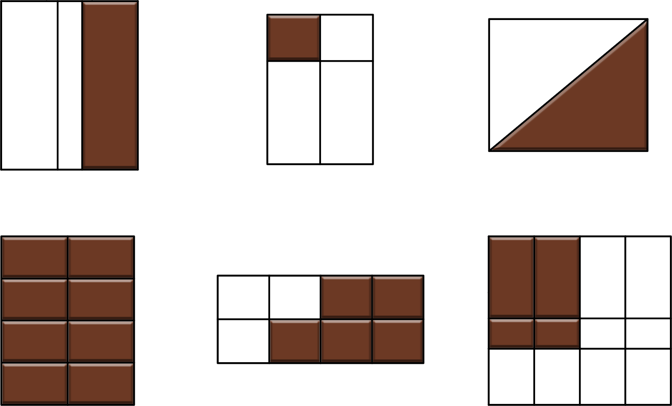
You do
Equal Parts
Use your mini-whiteboards to tell me which of the shapes below have equal parts and can therefore be written as a fraction:
A
B
C
D
E
F

Slide 11
You do
fractions
Use your mini-whiteboards to work out the fraction of chocolate I have left in the examples below:
1.
2.
Remember – the
denominator
(bottom number) is
the total number
of parts we have –
in this case the
total number of
chocolate pieces
8
5
8
8
3.
4.
1
2
2
8

Slide 12
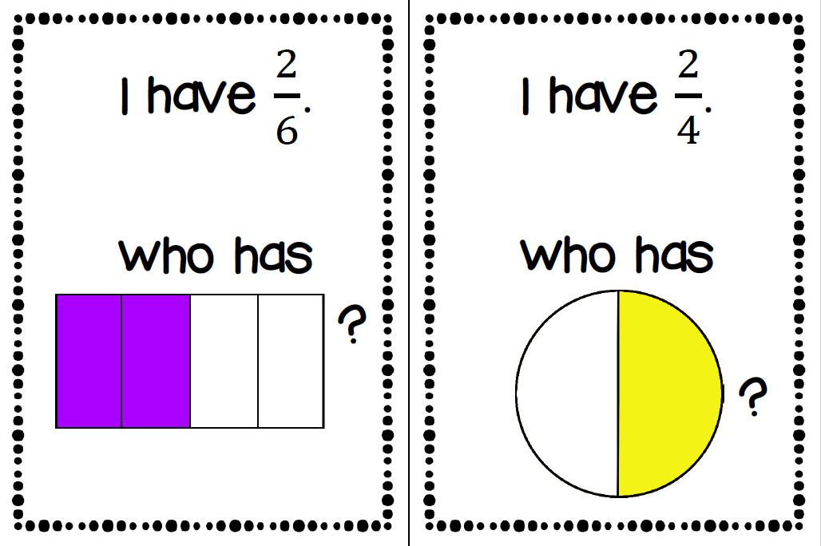
I have, who has…

Slide 13
Ordering Fractions
A unit fraction is any fraction with a numerator of 1. Unit fractions represent one piece of a whole.
One half, one third and one quarter are all examples of unit fractions.
When ordering unit fractions from smallest to largest (or vice versa), there is one simple rule to help you.
The larger the denominator,
the smaller the unit fraction.

Slide 14
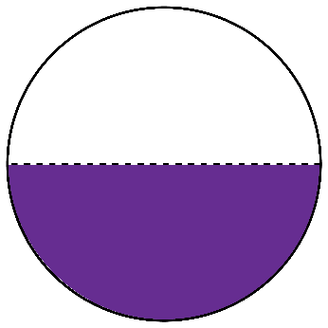
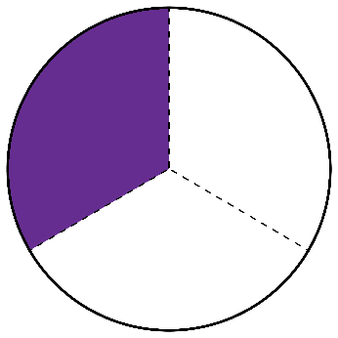
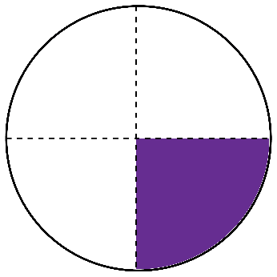
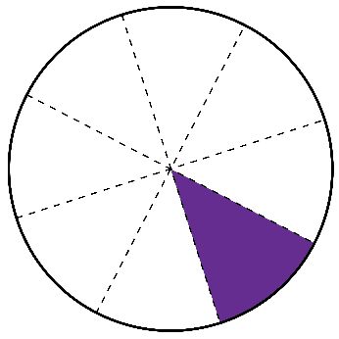
Ordering Fractions
Let’s use these circles to demonstrate this rule.
1 of a circle
2
1 of a circle
3
1 of a circle
4
1 of a circle
8
1
Which fraction is the smallest?
4
The more pieces there are, the smaller the pieces become.

Slide 15
Ordering Fractions
Let’s use these circles to demonstrate this rule.
1 of a bar
3
1 of a bar
5
1 of a bar
2
1 of a circle
4
1
1
1
1
SMALLEST
LARGEST
5
4
3
2

Slide 16
Rally Coach
1
1
1
1
1
10
4
5
2
3

Slide 17
Activity
1
1
1
1
1
1
2
3
4
5
8
10

Slide 18
Activity:
QR Code Task cards

