Slide 1
Day 4

Slide 2
Complete the Fact Families
5 x 4 = 3 x 2 = 6 x 8 =

Slide 3
Round these numbers to the nearest 10…
12 54 87 31 55 92
615 213 2212 7286

Slide 4
Solve the elapsed time:
START
FINISH
2:13 pm
8:55 pm

Slide 5
3
Fractions
WALT:
Identify equivalent fractions
WILF:
Understand what is meant by an equivalent fraction.
Measure the rod and split into different sized parts
Order from largest to smallest.

Slide 6
Ordering fractions
1
1
1
1
1
5
10
4
5
2
3
10

Slide 7
Equivalent Fractions
Take a look at these pizza fractions – what do you notice?
2 slices
4 slices
8 slices
6 slices
10 slices
No matter how you slice it, the amount of pizza you eat is the same!
These are called EQUIVALENT FRACTIONS
They are fractions that look different but show exactly the same amount!

Slide 8
Equivalent Fractions
Take a look at these pizza fractions – what do you notice?
2 slices
4 slices
8 slices
6 slices
10 slices
1
2
4
3
5
2
4
8
6
10
They show the same amount but use different numerators and denominators

Slide 9
Equivalent Fractions
Let’s take a closer look using these examples:
1
The first pizza says
is left over.
The second pizza says
are left over......
2
=
2
4
2 slices
4 slices
1
=
2
2
4
But both pizzas have the
same amount left over!
1
2
So must be EQUIVALENT (the same amount) to
2
4

Slide 10
Equivalent Fractions
Are these chocolate fractions equivalent?
If you said yes, you are correct!
Even though the chocolate is made
up of different pieces, the same
amount is left over on both blocks!
If I ate the first chocolate today and the
second chocolate tomorrow,
I would have eaten the same amount
of chocolate each day!

Slide 11
Equivalent Fractions
What about these chocolate fractions?
Are they equivalent?
If you said yes, you are correct!
Again, even though the chocolates
Are made up of different pieces, the
same amount on both blocks is left
over!
4
1
So we can say: is equivalent to
8
2

Slide 12
Equivalent Fractions
What about these chocolate fractions?
Are they equivalent?
If you said no, you are correct!
The blocks DO NOT have the same amount of chocolate left over!
Which chocolate fraction is BIGGER?
(Which one means you get more chocolate?)
If you said the first block you are correct!
The first chocolate might be made up of less pieces but it’s a bigger
chunk of chocolate .......mmmmmmmmmm chocolate

Slide 13
How do we make Equivalent Fractions
Let’s look back at two of my equivalent pizzas to work this out!
How did I go from to ?
1
2
2
4
x2
1
2
=
=
2
4
2 slices
4 slices
x2
Can you work out what I multiplied both
The numerator and denominator by?
I multiplied BOTH by 2!

Slide 14
How do we make Equivalent Fractions
Hmmm, let’s see what I did with a different pizza
How did I go from to ?
1
3
2
6
x3
1
3
=
=
2
6
2 slices
6 slices
x3
Can you work out what I multiplied both
The numerator and denominator by?
I multiplied BOTH by 2!
I think I see a pattern here...

Slide 15
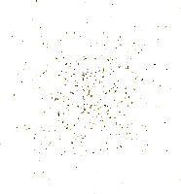
How do we make Equivalent Fractions
THE GOLDEN RULE
Make equivalent fractions by multiplying or dividing both the numerator and the denominator by the same number.
I need to multiply
BOTH!!! the numerator
and denominator
by the SAME!!! amount
I cannot multiply only the numerator or denominator
I cannot multiply the numerator and denominator by different amounts

Slide 16
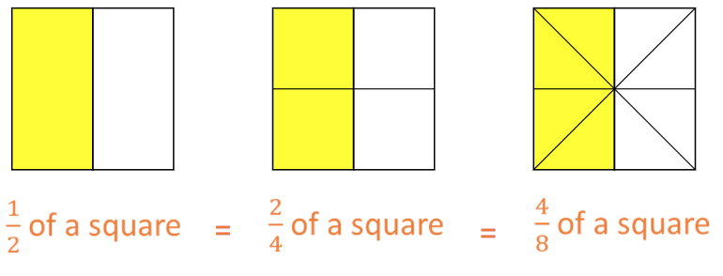
Making Equivalent Fractions
Let’s use these squares to demonstrate this rule
x2
x2
1
2
4
=
=
2
4
8
x2
x2

Slide 17
Making Equivalent Fractions
We can also use division to find equivalent fractions…
÷2
2
1
=
6
3
÷2

Slide 18
Making Equivalent Fractions
We do
Let’s test this out!
Make an equivalent fraction for
1
3
THE GOLDEN RULE
I need to multiply
BOTH!!! the numerator
and denominator
by the SAME!!! amount
x2
1
2
=
Let’s try multiply it by 2
3
6
Is this correct?
YES!
x2

Slide 19
Making Equivalent Fractions
You do
Use your mini-whiteboards to form an equivalent fraction by multiplying the numerator and denominator by 2 in each example:
1
2
1
2
A.
=
B.
=
4
8
6
12
2
4
4
8
C.
=
D.
=
8
16
6
12

Slide 20
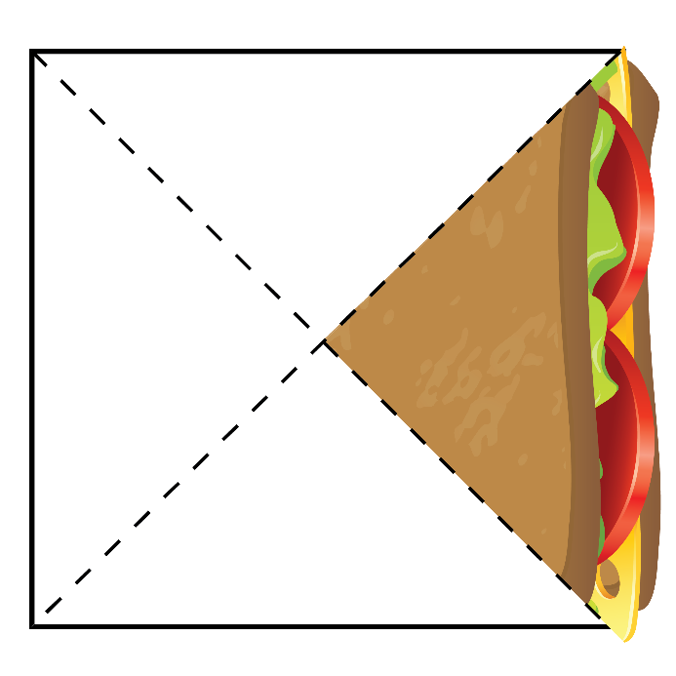
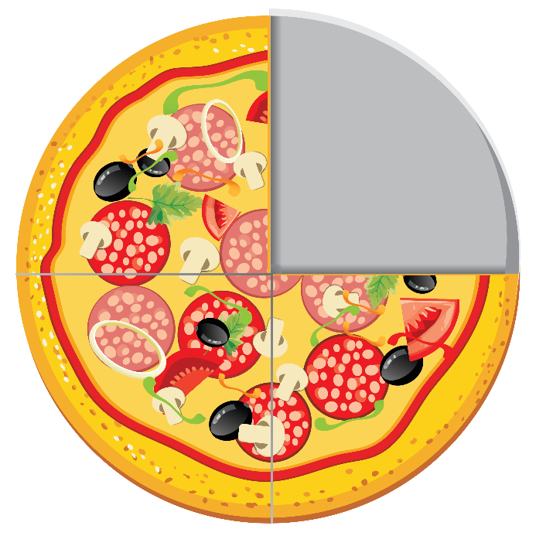
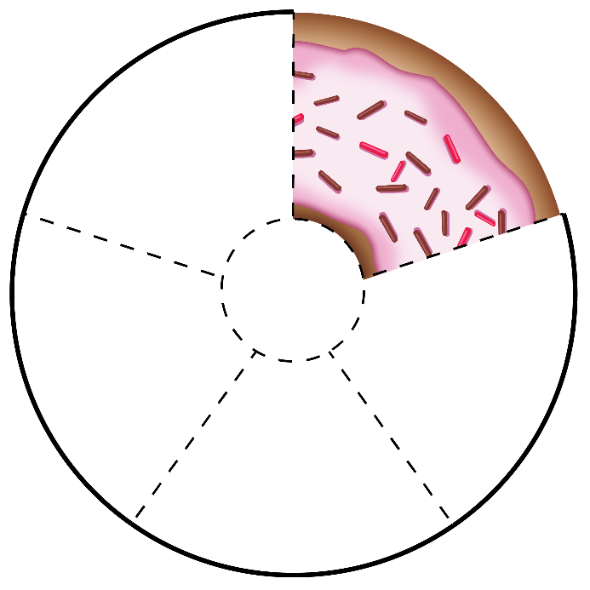
Making Equivalent Fractions
Use multiplication or division to create three equivalent fractions for each of the fractions shown in the images below.

Slide 21
Fraction Wall
We are going to create our own Fraction Wall.
Each strip needs to be split into equal parts and ordered from the least number of parts to the most number of parts.

