Slide 1
7
Fractions
WALT:
Explore mixed numbers using pattern blocks.
WILF:
Identify equivalent fractions
Form at least three equivalent fractions using pattern blocks.
Create and draw a mixed number using pattern blocks.

Slide 2
You do
Equivalent Fractions
Use your mini-whiteboards to write two fractions that are equivalent to : (use the GOLDEN RULE)
1
3
x3
x4
x2
1
2
3
4
=
=
=
3
6
9
12
x2
x3
x4

Slide 3
Equivalent Fractions
You do
Use the Golden Rule to find 3 equivalent fractions for these fractions:
4
1
__
__
8
3
1
3
__
__
4
4
2
2
__
__
3
6

Slide 4
Equivalent Fractions
We do
0
1
6
5
3
1
7
1
3
6
16
10
8
8
14
2
4
8

Slide 5
Equivalent Fractions
We do
1
3
1
0
6
1
8
8
2
8
6
5
3
16
10
4
7
14

Slide 6
Mixed Fractions
Remember that fractions are used to count a part of something.
Mixed numbers are used when you need to count whole things AND parts of things at the same time.
Let’s look at an example:
How many whole pizzas do I have?
2 whole pizzas
So, I have 2 whole pizzas but I also have a part of another pizza.
How would I write the last pizza as a fraction?
1
2

Slide 7
Mixed Fractions
So if someone had to ask me how much pizza I have left,
I would write:
2
1
This is a mixed number
2
pizzas
I have written a BIG 2
because this represents a
whole number.
This is read as two and a half

Slide 8
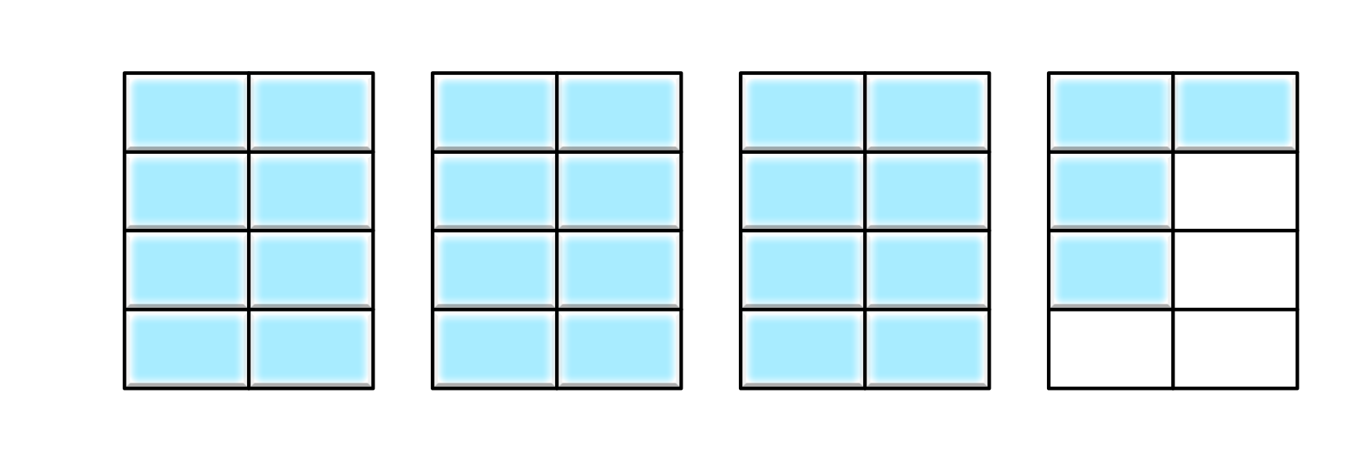
We do
Mixed Fractions
1
4
Let’s try some more examples:
How much cherry pie do I have left?
6
This is read as
one and four-sixths
3
4
How many trays of ice do I have left?
8
This is read as
Three and four-eights
2
2
How many bars of chocolate do I have left?
4
This is read as
Two and two-quarters

Slide 9
We do
Mixed Fractions
Draw picture to represent these mixed fractions:
1
3
4
2
5
8
4
3
6

Slide 10
Fractions on a Number Line
I do
1
Draw a dot to show on the number line.
2
0
1
2

Slide 11
Fractions on a Number Line
We do
Draw a dot to show on the number line.
3
4
0
1
2

Slide 12
Fractions on a Number Line
We do
5
Draw a dot to show on the number line.
8
0
1
2

Slide 13
Fractions on a Number Line
I do
1
Draw a dot to show on the number line.
1
2
0
1
2

Slide 14
Fractions on a Number Line
I do
2
2
Draw a dot to show on the number line.
5
0
1
2
3

Slide 15
Fractions on a Number Line
We do
1
Draw a dot to show on the number line.
3
6
0
1
2
3
4

Slide 16
Fractions on a Number Line
We do
1
Draw a dot to show on the number line.
0
4
4

Slide 17
Fractions on a Number Line
We do
2
1
Draw a dot to show on the number line.
6
0
1
2
3

Slide 18
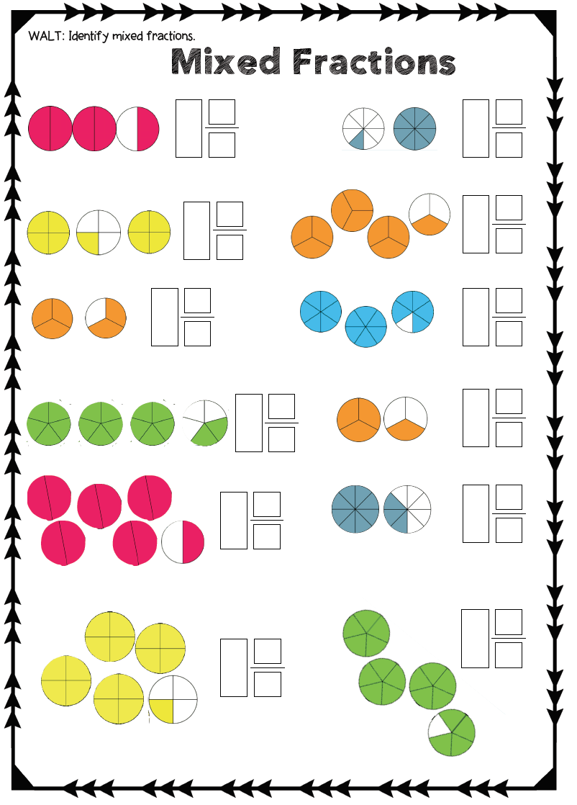
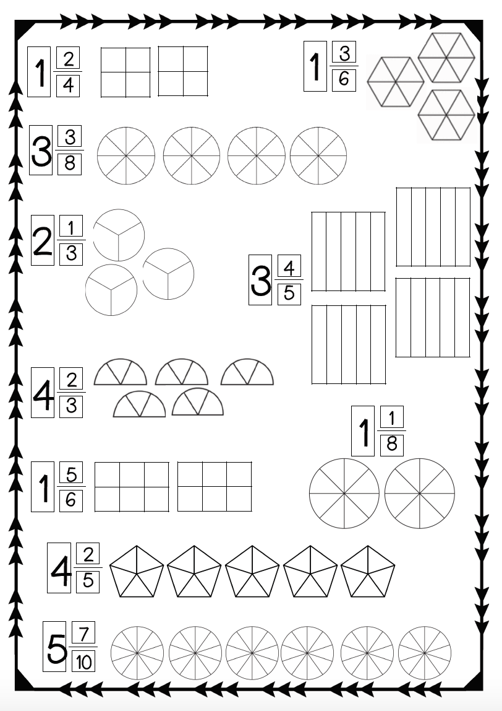
We do
Activity

