Slide 1
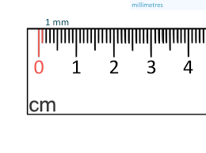
Millimeters

Slide 2
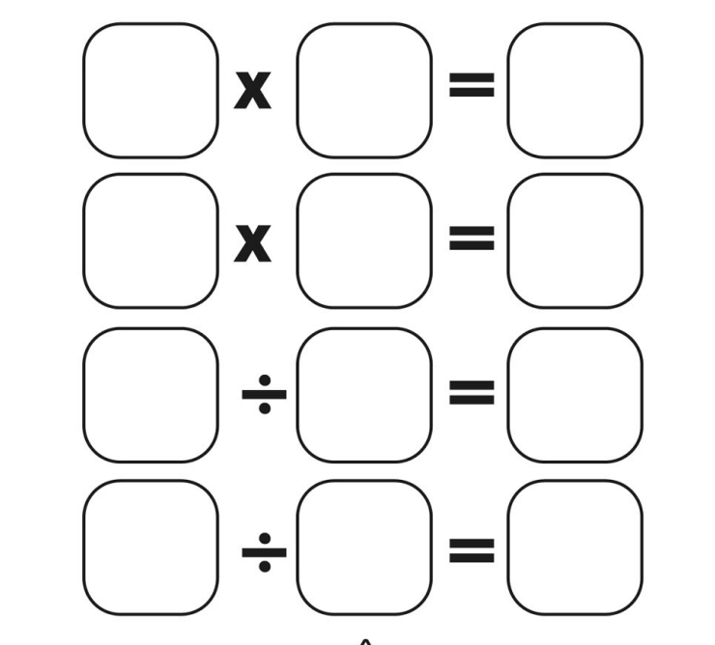
Fact family warm up
With your whiteboards
40
5
8
Notes:
editing

Slide 3
Millimeters
Measure length using millimetres.
Using your ruler to accurately measure an object to the millimeter.

Slide 4
Millimeter
Millimeters are used to measure very small but visible-scale distances and lengths.
10mm=1cm

Slide 5
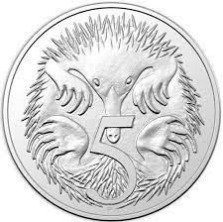
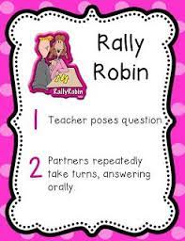
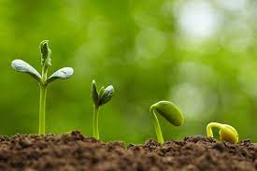
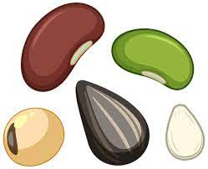
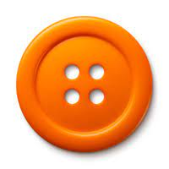
What objects would you measure using millimeters?
30 second think time

Slide 6
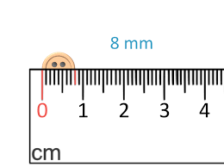
How to measure millimeters
X
The object must be in line from 0mm on the ruler not where the ruler begins.

