Slide 1
6
Location and Direction
WALT:
create a map and directions which lead to a specific location
WILF:
Meet your set criteria
Include a key
Use compass points to direct
Use scale to determine distances

Slide 2
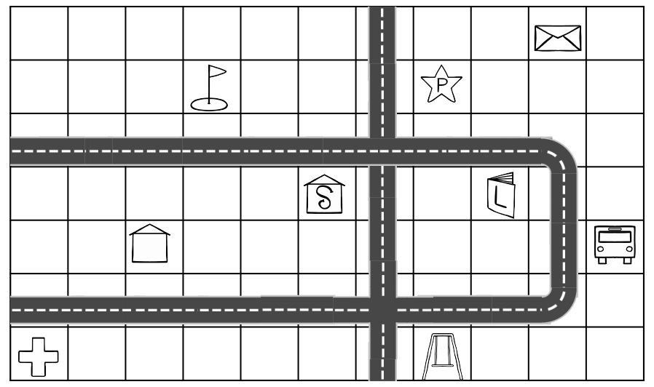
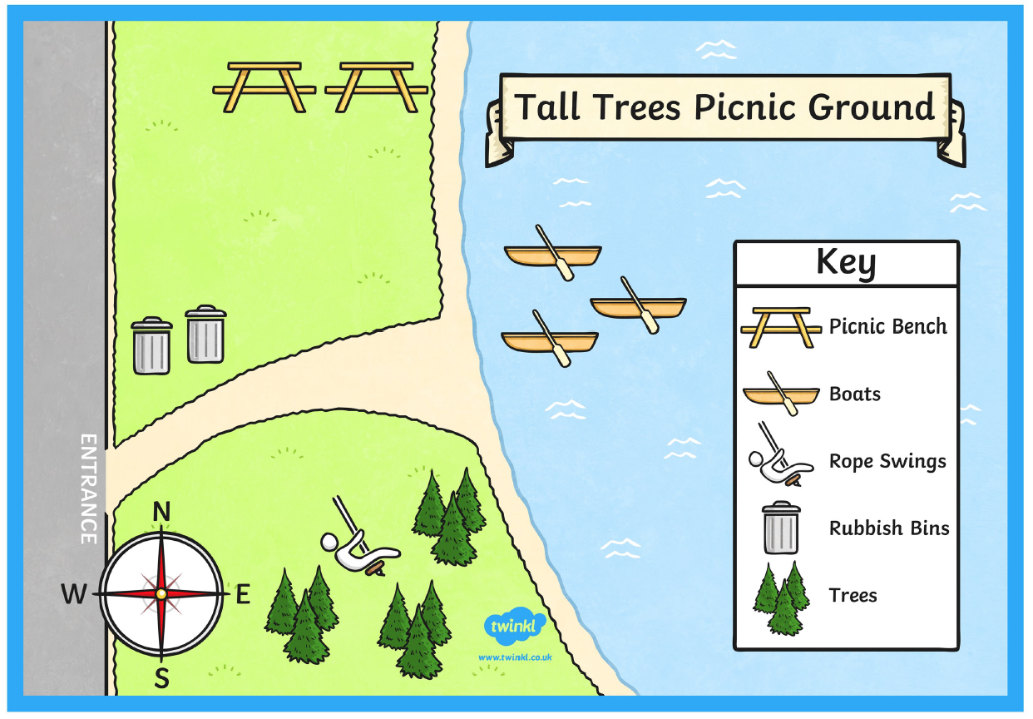
The objects on a map are represented using symbols. A symbol is a picture on the map that represents something in the real world.
Understanding these symbols requires the use of a key. Maps use a key, or legend, to explain the meaning of each of the symbols used in the map.
These keys usually show a small picture of each of the symbols used on the map, along with a written description of the meaning of each of these symbols
The Key
Why is it important that a map includes a key?

Slide 3
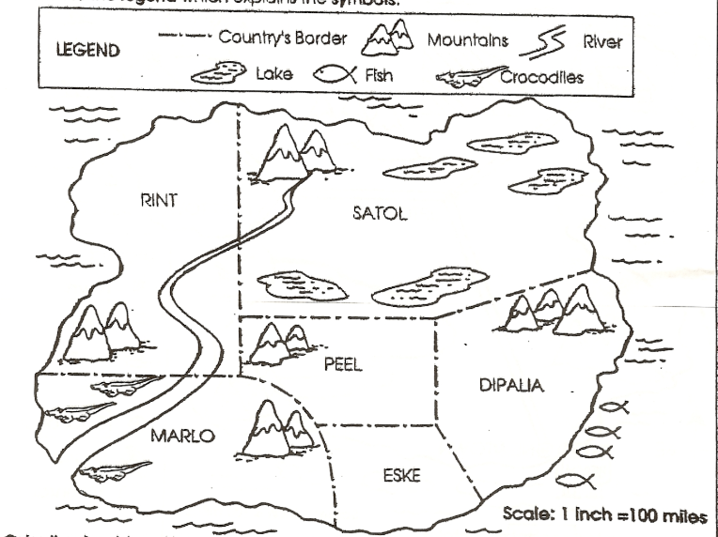
Using a Key
I/We do
Which country has no mountains? _______________
Which country has lakes? _________________________
In which country would walking near the river be dangerous? ____________________________________
Which country has fish near its coast? ________________________________________________________
Which country has mountains in its south? ________________________________________________________
Eske
Satol
Marlo
Diplia
Rint

Slide 4
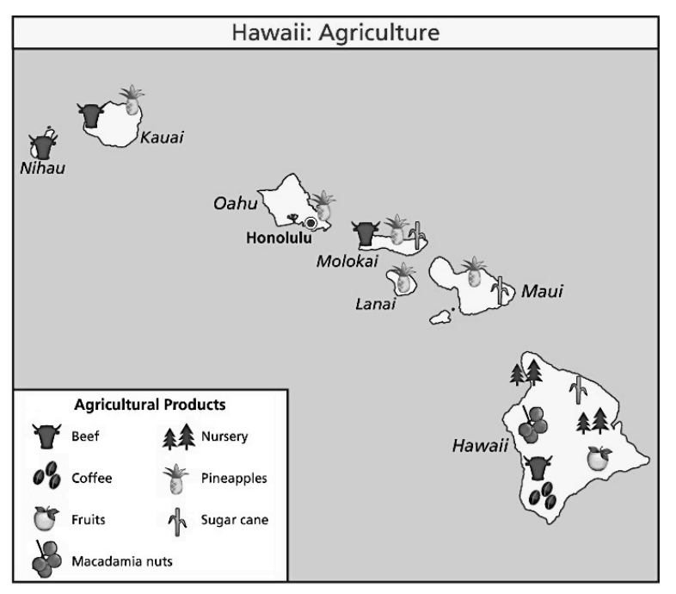
You do
Using a Key
On which island can you find a nursery? ________________________________________________________
Which agricultural product can be found on Kauai, Oahu, Molokai, Lanai and Maui? ________________________________________________________
Which products can you find on the island Molokai? _____________________________________________
Which agricultural products can be found on the island of Hawaii?? _____________________________
_________________________________________________________
5. Which island(s) can you find sugar cane?
__________________________________________________________
Hawaii
Pineapple
Pineapple, Beef, Sugar Cane
Nursery, Sugar Cane
Macadamia Nuts, Fruits and Coffee
Molokai, Maui, Hawaii

Slide 5
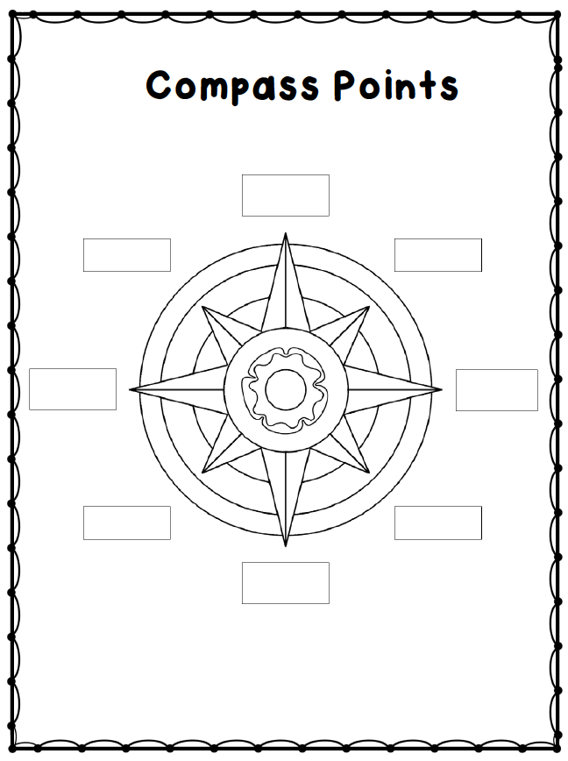
What are the four main compass points?
What were some of the rhymes that we can use to remember the 4 compass points?
Never Eat Soggy Weetbix’
Naughty Elephants Squirt Water
Where is north, south, east, west in relation to us?
What are the other points still missing?
North
North West
North East
West
East
South West
South East
South
Play - Direction Game

Slide 6
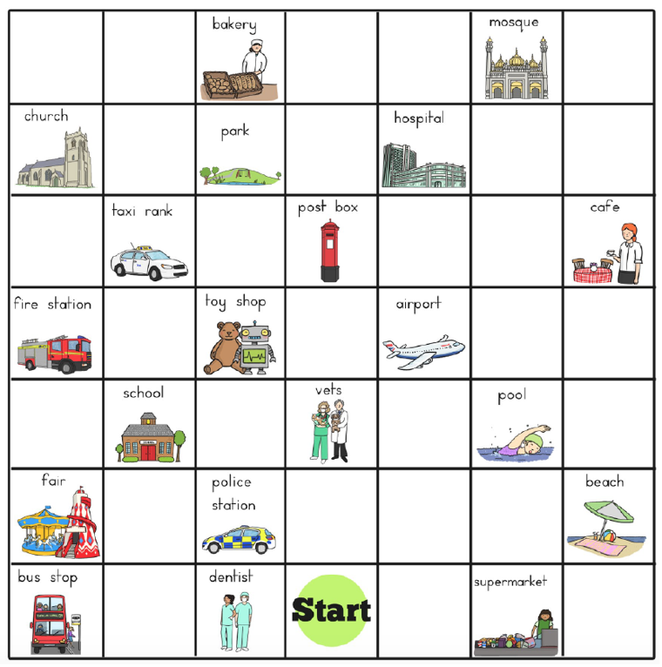
I/We do
Giving Directions:
1. From start, go 2 squares East. Where are you now? ________________________________________________________________
2. Go 6 squares North. Where are you now? ________________________________________________________________
3. Go 3 squares South West. Where are you now? ________________________________________________________________
4. Go 2 squares North West. Where are you now? _______________________________________________________________
5. Go East 4 squares. Where are you now? _______________________________________________________________
6. Start at the School. How do you get to the Fair?
____________________________________________________________________________________________________________________________________
7. Direct someone from there Fair to the Hospital.
____________________________________________________________________________________________________________________________________
I do / we do

Slide 7
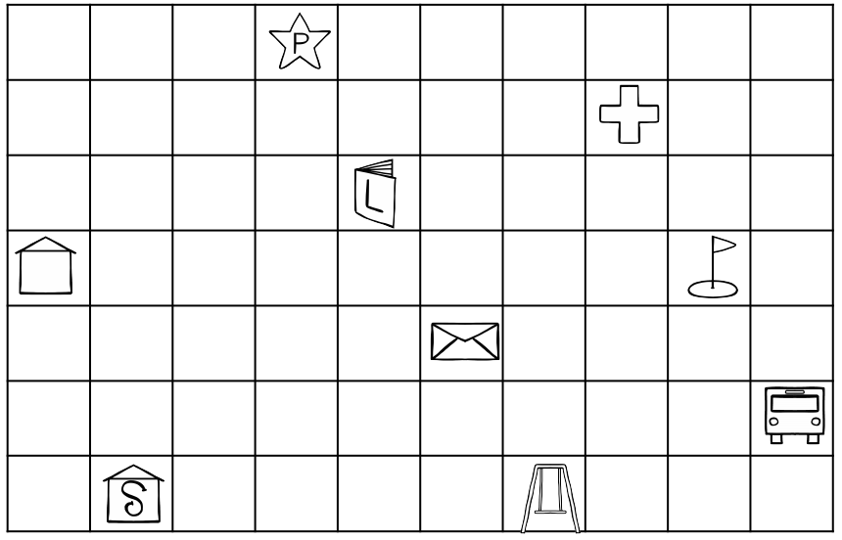
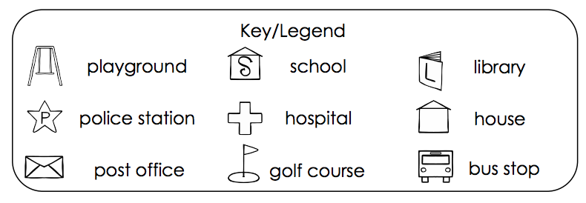
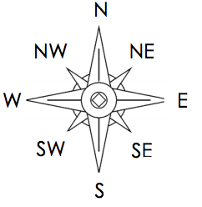
You do
Start at the school. Go 3 squares east and 4 North.
Where are you ? ________________________________________
Start at the Golf course. Go 5 squares West and 3 squares North. Where are you now? _________________________________
Start at the hospital. Go 5 squares South West.
Where are you now? ______________________________________________________
Start at the bus stop. Go 4 squares west and 1 square South east. Where are you now?_______________________________________________________
Start at the playground 3 squares west and 3 North west.
Where are you now?_______________________________________________________
Start at the police station. Go 4 squares South and 3 North East. Where are you now? ___________________________________________________
Library
Police station
School
Playground
House
Hospital

Slide 8
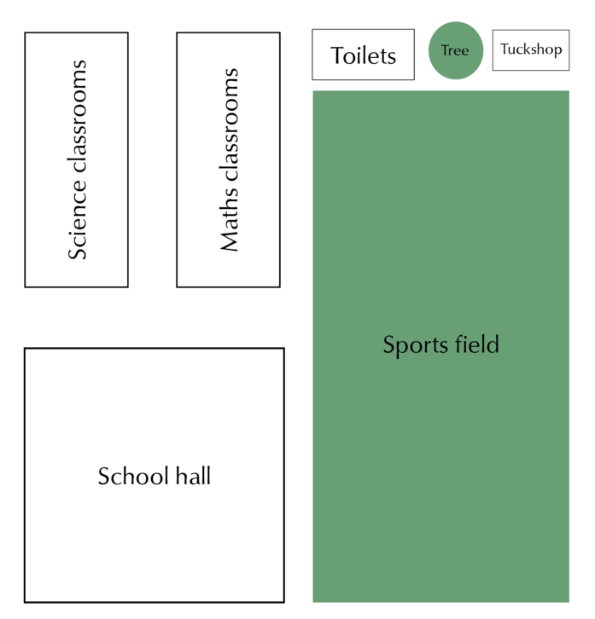
I do
Scale
6cm
2cm
1cm: 2m
1cm: 10m

Slide 9
We do
4cm
15cm
1cm: 10m
1cm: 5m

Slide 10
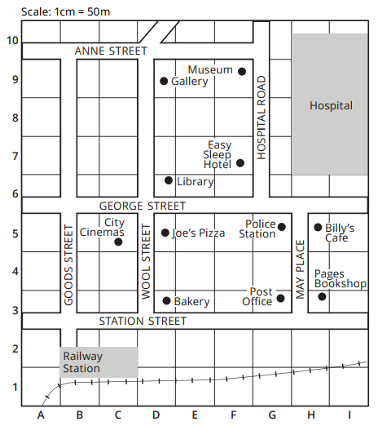
We do
Scale 1cm = 5m
Scale 1cm = 5m
3cm
5cm
4cm
8cm

Slide 11
Scale 1cm = 8m
Scale 1cm = 10m
You do
5cm
7cm
2cm
9cm

Slide 12
You do
Scale 1cm = 5m
Scale 1cm = 8m
4cm
4m
3cm
6cm
1cm
1cm

Slide 13
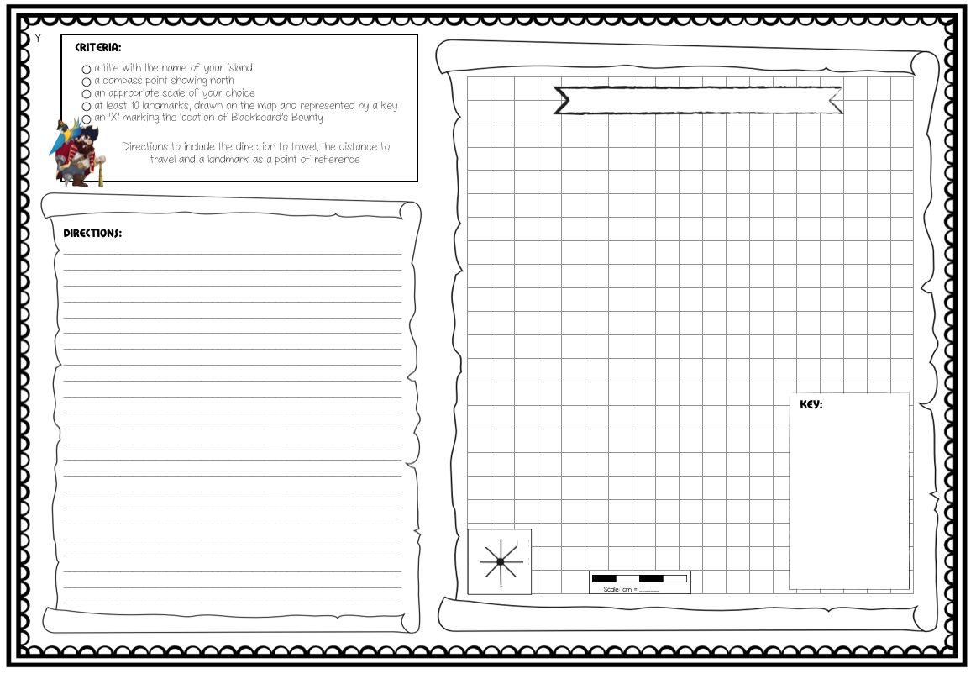
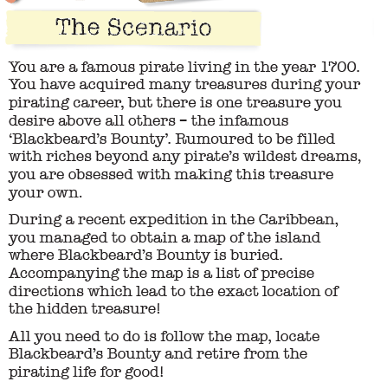
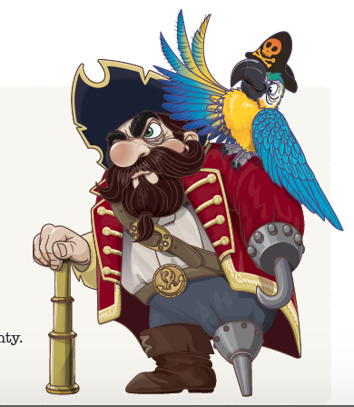
Activity

Slide 14
