Slide 1
5
Location and Direction
WALT:
Use scale to measure the distance between points on a map
WILF:
Interpret a scale
Locate the scale on a map
Use scale to determine distances

Slide 2
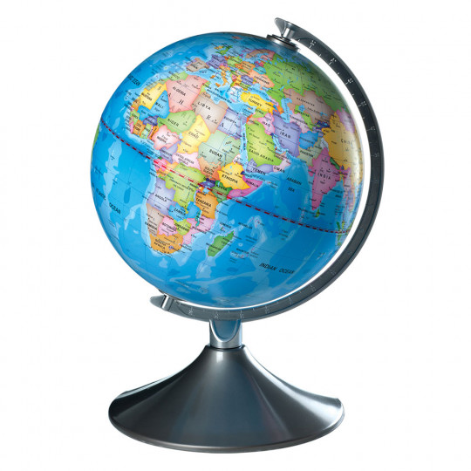
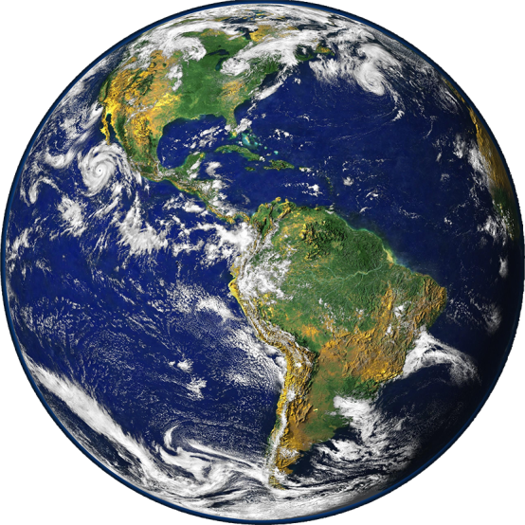
Scales on a Map
What is a Globe?
A globe is a scaled down version of the Earth.

Slide 3
Scales on a Map
Remember that a map is a visual representation of a much larger area of land.
In order to be useful, a map must by necessity be small enough to be handled by an individual.
Imagine drawing a map of the Earth that was full-size.
Of course this is ridiculous!
A full-size map of the Earth would not only be too large to be useful, but it would also be impractical to make.
Maps are scaled down so that they fit on the available paper or screen.

Slide 4
Scales on a Map
On many maps you may see something like this.
This is a map scale.
Map scale is the relationship between distance on the map and distance in real life.
Map scales use a ratio where the distance on the map represents a distance in real life.
So if 1cm on the map is equal to 1km in real life, what would 5cm be?
5km

Slide 5
Scales on a Map
When scaling down a map, every part of the map is scaled by the same amount.
This ensures that every object on the map is the same proportion as everything else on the map.
If a city is twice as large as a neighbouring town, an accurate scaled map will show the same relationship on paper.
The drawn city will be twice as large as the drawn town.
Let’s work through some examples of scales on a map.

Slide 6
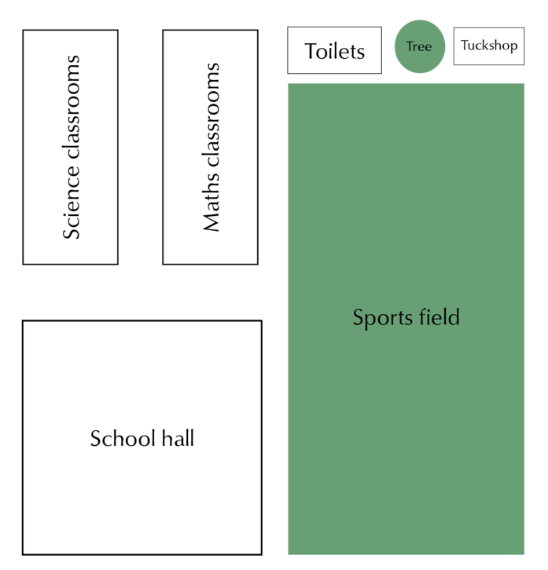
5cm
2cm
1cm: 10m
1cm: 10m
10m
20m
10m
20m

Slide 7
4cm
10cm
1cm: 10m
1cm: 10m
10m
20m
10m
20m

Slide 8
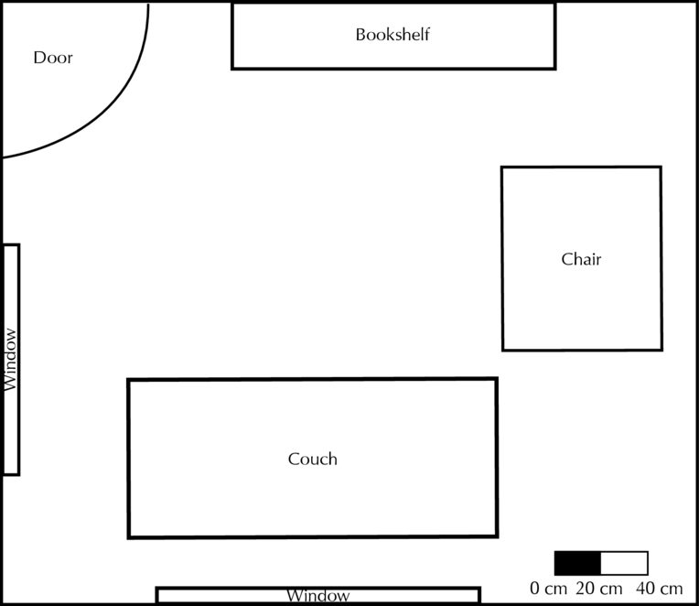
4cm
1cm: 20cm

Slide 9
2cm
1cm: 20cm

Slide 10
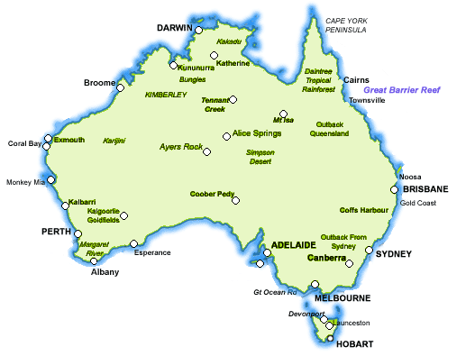
6cm
1cm: 100km
0km 100km 200km

Slide 11
10cm
1cm: 100km
0km 100km 200km

Slide 12
12cm
1cm: 100km
0km 100km 200km

Slide 13
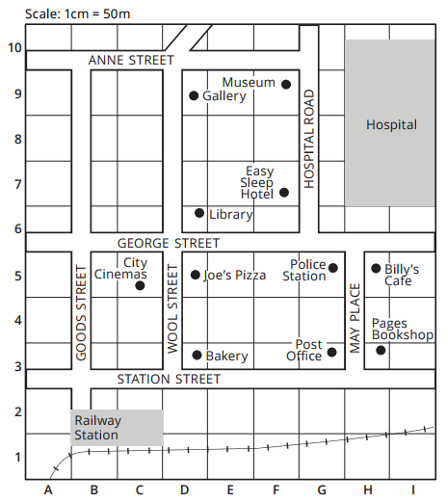
2cm
4cm

Slide 14
3cm
2cm

Slide 15
6cm
3cm

Slide 16
4cm
3cm
0.5cm

Slide 17
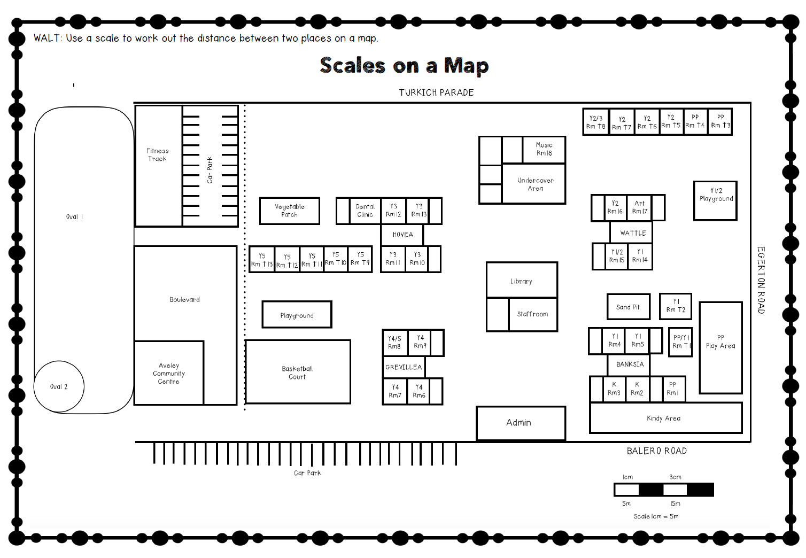
Scales on a Primary School Map
Using a map of the Primary School, answer some map scales questions to find the distance between two places.
Use a ruler to measure the distances in cm and then use the scale to find the answer.
Measure the distance to the closest cm.

