Slide 1
4
Location and Direction
WALT:
Read coordinates
WILF:
Know how to read coordinates correctly
Write coordinates correctly
Use coordinates to create a mystery monster

Slide 2
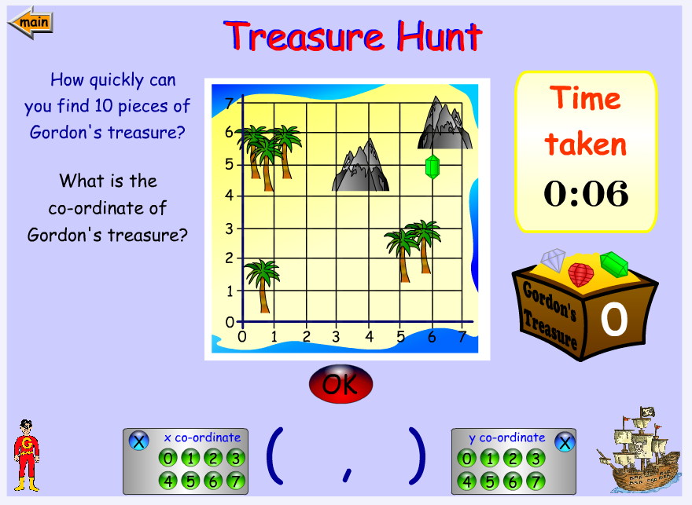
https://www.topmarks.co.uk/Flash.aspx?f=coordinates

Slide 3
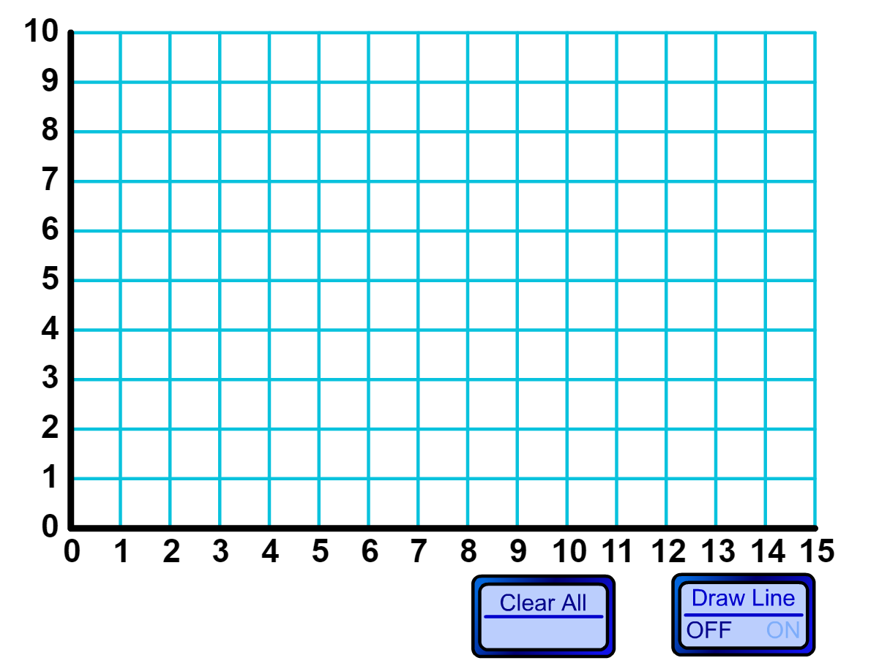
http://www.teacherled.com/resources/onequadgraph/onequadload.html

Slide 4
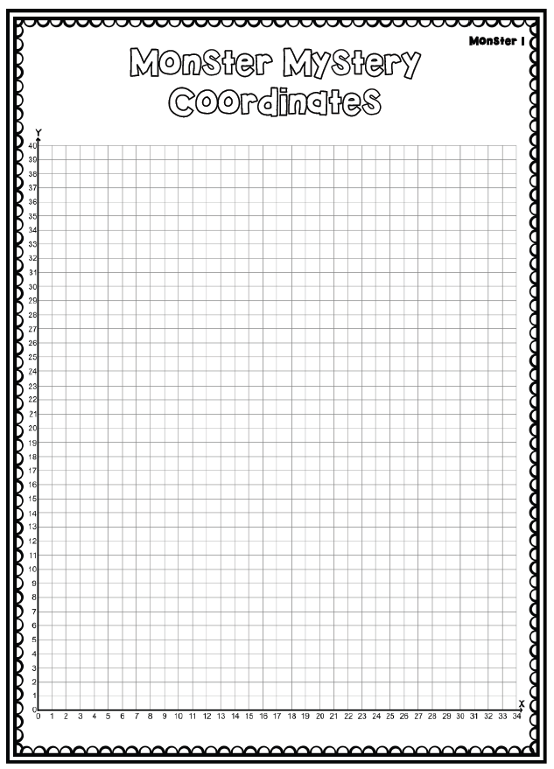
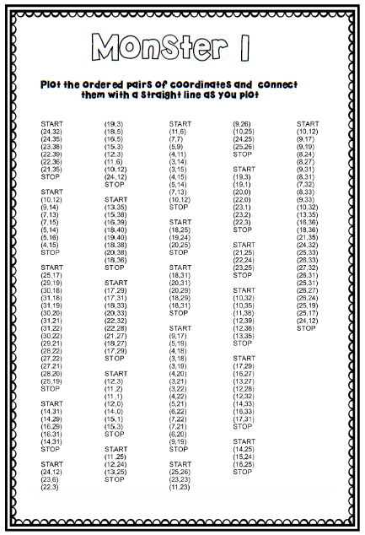
Activity

Slide 5
Complete these symmetrical patterns:

Slide 6
Solve the elapsed time problems
Katie went to Time Zone for her friend’s birthday party. The party began at 2:35 and ended 1 hour and 57 minutes later. When did the party end?
Jose went to the park at. 7:33 He played for 32 minutes. When did he leave the park?

Slide 7
Use the grid method to multiply:
84 x 4 =
29 x 3 =
75 x 5 =

