Slide 1
3
Location and Direction
WALT:
Read coordinates
WILF:
Know how to read coordinates correctly
Write coordinates correctly
Use coordinates to answer questions

Slide 2
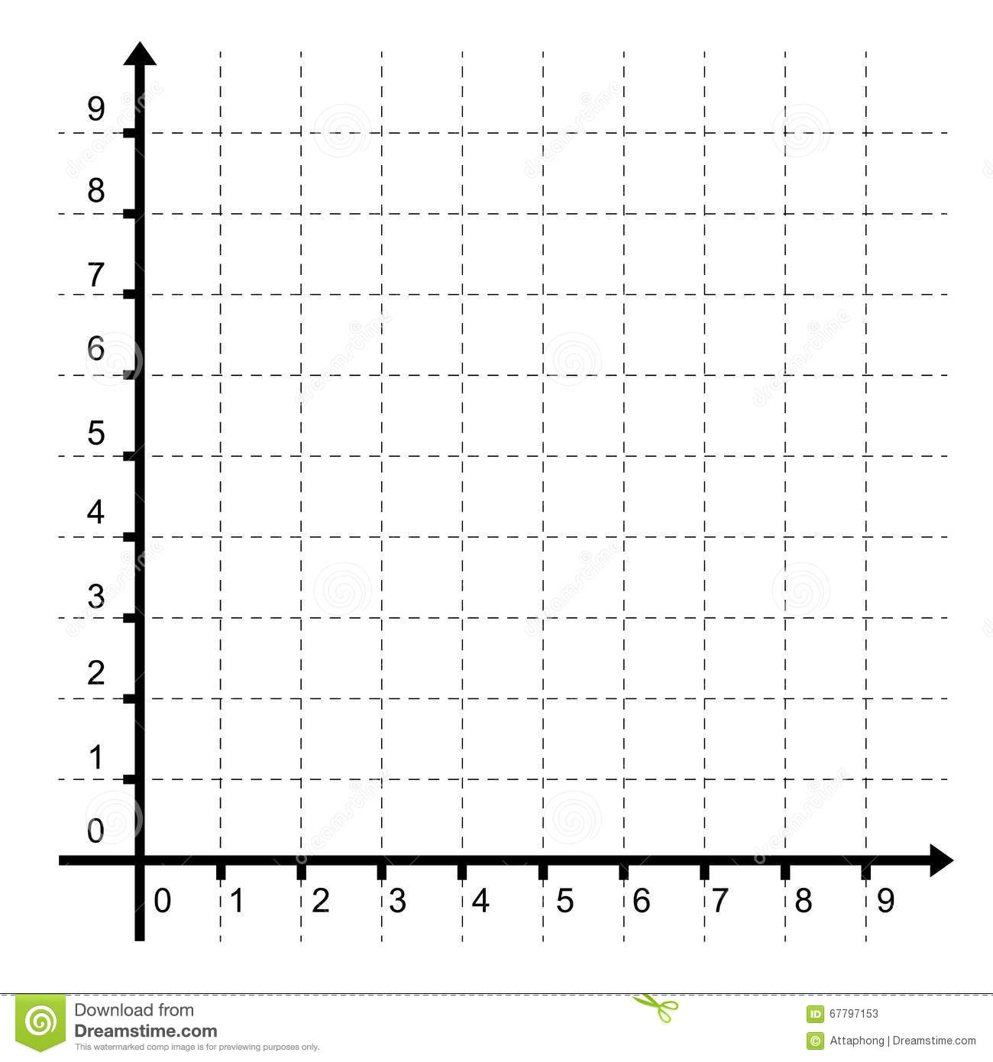
Grid References
Y
Maps are often use grid references which help us to read them accurately.
The x axis is along the bottom and the y axis runs up the side. You always read the x axis first before the y.
Remember: Along the corridor then up the stairs.
How do we record grid references?
Always in brackets and a comma between. (x,y)
Have a look at the on the grid. What would the coordinates be?
(4,2)
X

Slide 3
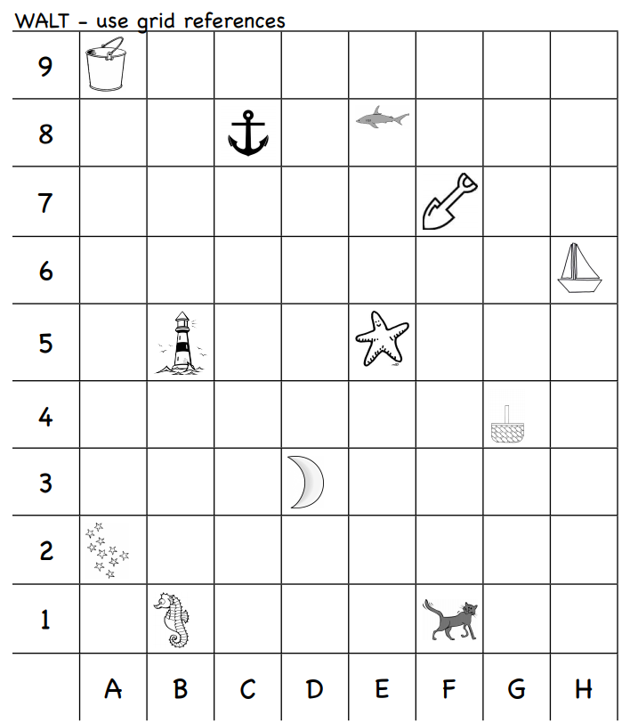
(B,5)
(B,1)
(D,3)
(E,8)
(A,2)
(A,9)
(G,4)
(F,7)
(F,1)
(C,8)
(E,5)
(H,6)

Slide 4
Grid References

Slide 5
Activity

Slide 6
Find the area of these shapes:
b
a
c
d
e

Slide 7
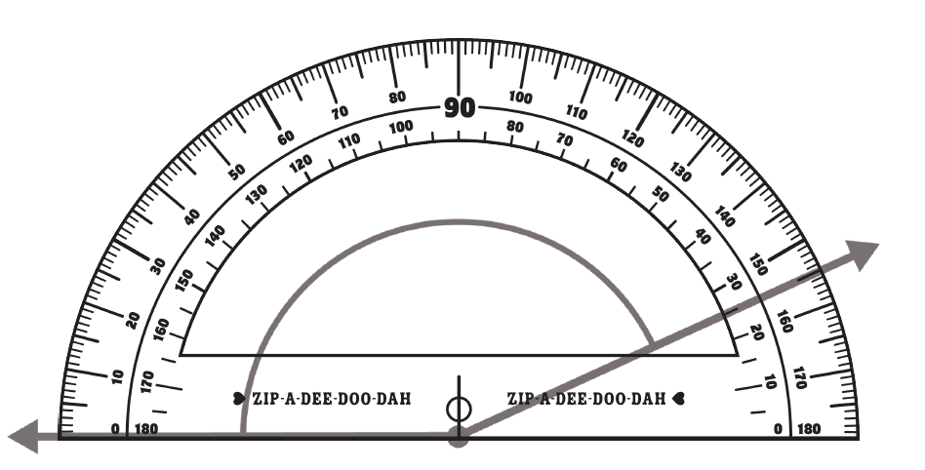
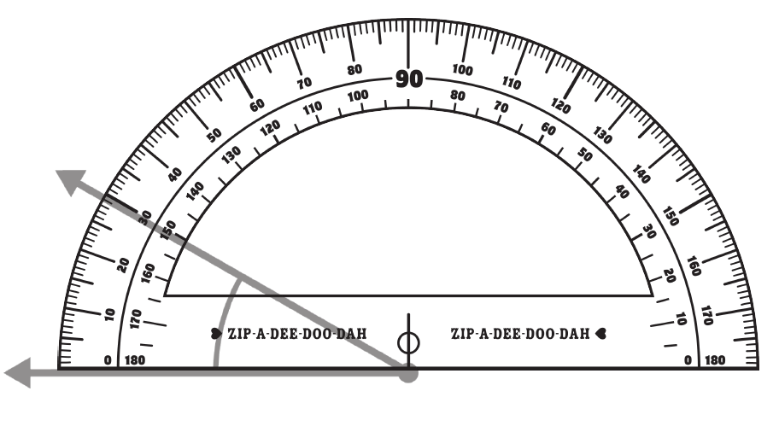
Read the angle measurement:

Slide 8
Which of these shapes of have correct lines of symmetry?
f
d
a
b
e
c

