Slide 1
Created By:

Slide 3
Outline your findings here:
?

Slide 4
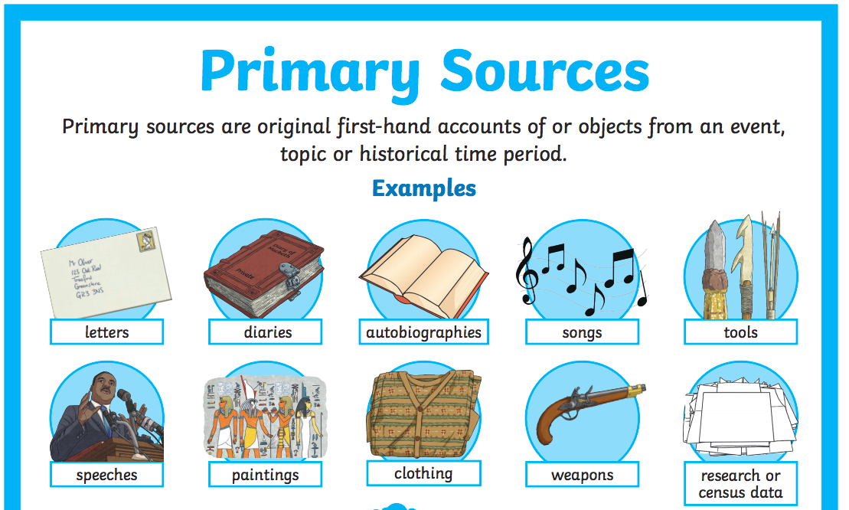
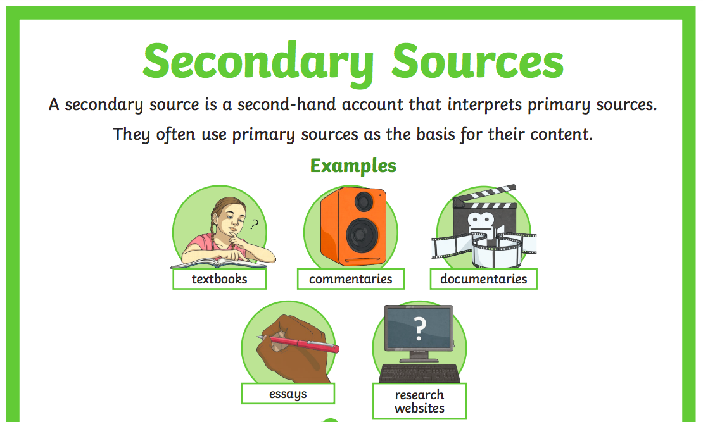
How do you know?

Slide 6
Outline your findings here:

Slide 7
How do you know?
Museum website

Slide 8
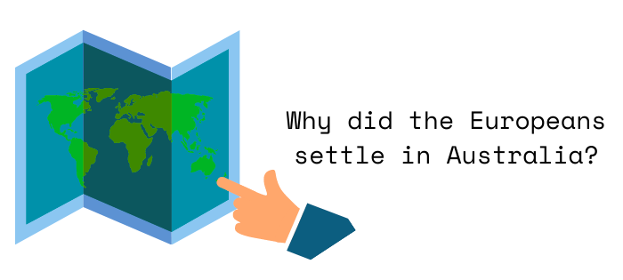

Slide 9
Outline your findings here:
?

Slide 10
How do you know?

Slide 12
Outline your findings here:
?

Slide 13
How do you know?

