Slide 1
HEALTH

Slide 2
Why Do We Need Food?
Food keeps us healthy and help us grow.
Food gives us energy to be able to do things during the day.
Without proper nutrition, your body can’t survive.
When you eat a balanced diet, your body obtains the fuel and nutrients it needs to function properly.
For example:
Your body needs minerals to make hormones, build bones and regulate your heartbeat.

Slide 3
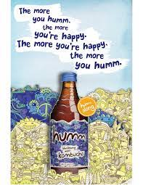
The importance
of advertising
Notes:
Eg. Rocks, concrete

Slide 4
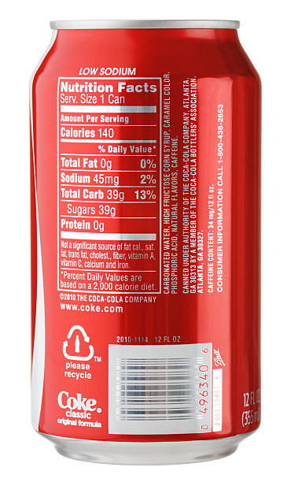
39 grams of sugar = 10 teaspoons of sugar
Notes:
Eg. Rocks, concrete

Slide 5
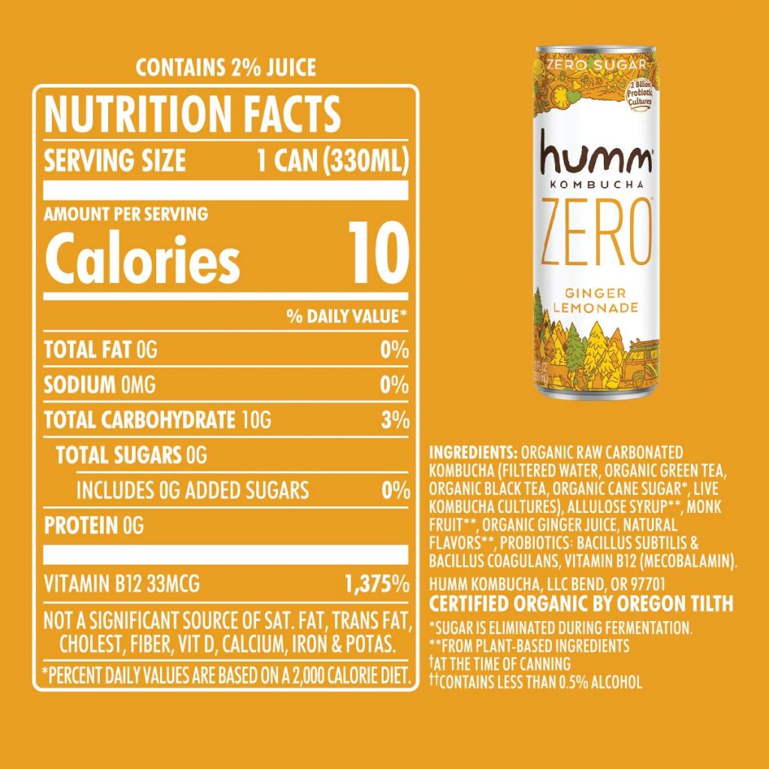

Slide 6
How does the information provided in the advertisements influence the customer’s decisions and behaviours?
Think pair share
Notes:
An angel, a nightmare etc

Slide 7
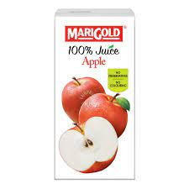
It is your turn to make an accurate advertisement for the following two products

Slide 8
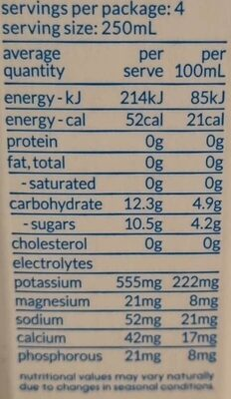
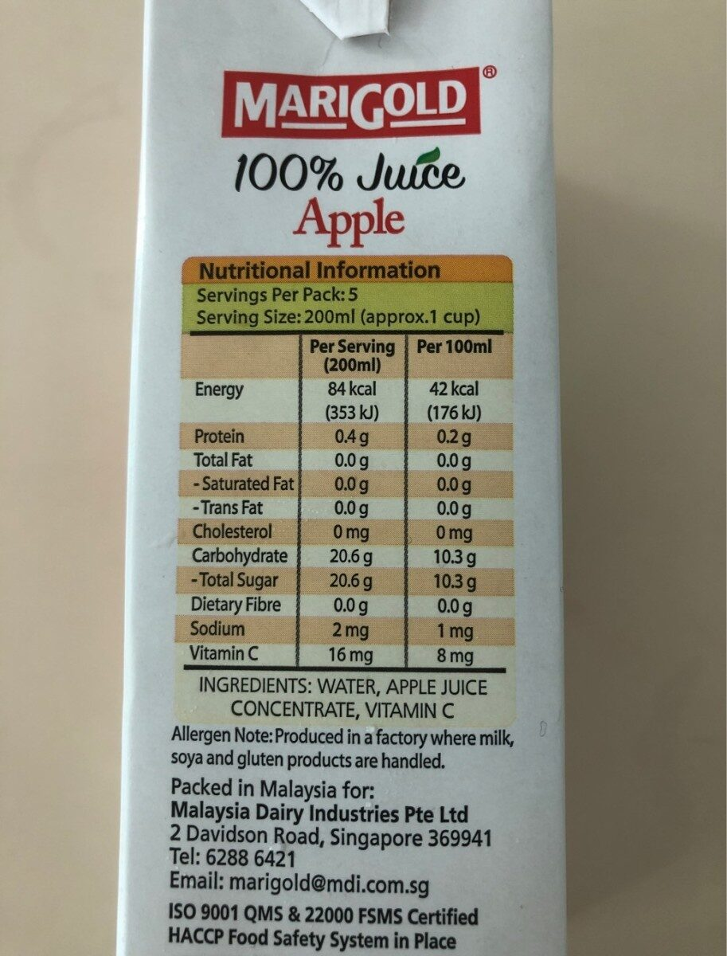
Apple juice
Coconut water
Notes:
Eg. Rocks, concrete

