Slide 1
Convicts
HaSS

Slide 2
BTN- First Fleet & Convicts
https://video.link/w/MnUNEkMsjfY#

Slide 3
Life in Britain during the 1700s
In the 1700s, Britain was the wealthiest country in the world.
Rich people could provide their children with food, nice clothes, a warm house and an education.
While some people were rich, others were poor.
Poor people had no money and no food.
They had to work as servants for the rich.
Poor children did not attend school.
When machines were invented, many people lost their jobs because workers were no longer needed.

Slide 4
Questions
What was life like in Britain during the late 1700s?
Why were there so many convicts?
What crimes do you think the convicts commited. Why do you think they commited these crimes?
What did the government decide to do with all the convicts?
Number 1 Collect 1 A3 paper
Number 2 fold paper in quarters (placemat)
Each member in the group write their corresponding number to the question number. E.g. number 1’s write down question number 1.

Slide 5
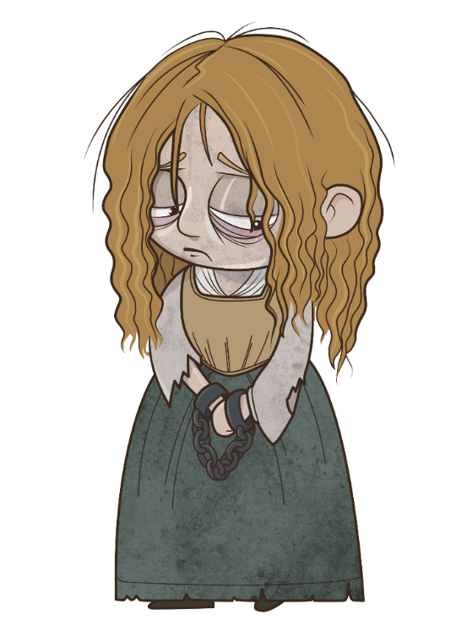
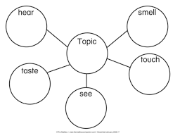
5 Senses of a Convict
Using Popplet create a graphic organiser to describe what you would:
See
Hear
Smell
Taste
touch (feel)
If you were a convict…

Slide 6
Exit Ticket
What are 2 questions you would ask a convict?

