Slide 1
Graduated scales

Slide 2
Graduated scales
To read and write measurements of length, mass, capacity and temperature shown on graduated scales.
Identifying and writing an accurate measurement when reading graduated scales.

Slide 3
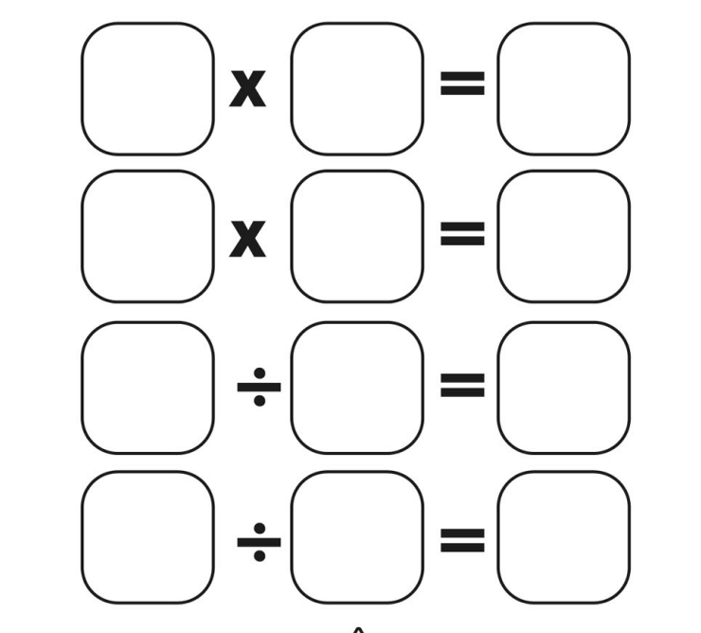
Fact family warm up
With your whiteboards
21
7
3
Notes:
editing

Slide 4
Vocabulary
scales
divide
value
graduations
Notes:
editing

Slide 5
A graduation
A graduation is a marking used to indicate points on a visual scale, which can be present on a container, a measuring device.
Notes:
editing

Slide 6
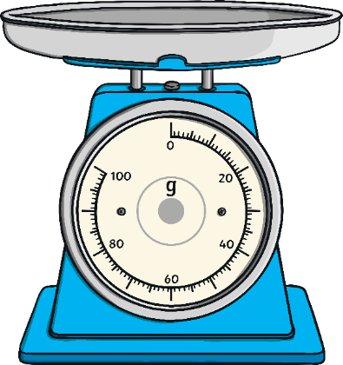
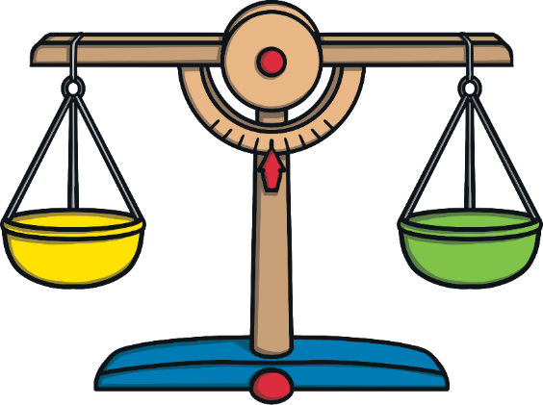
Where would you see scales?

Slide 7
Notes:
An angel, a nightmare etc

Slide 8
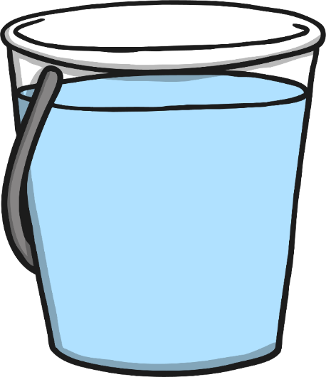
Reading Scales
5
4
3
2
1
Find zero
Look at the numbers
Do the numbers go up in ones?
This one is straightforward because all the lines are numbered.
How much water is in the bucket?

Slide 9
Reading Scales
Find zero
Look at the numbers
Do the numbers go up in ones?
Are there any extra lines between the numbers?
What do you think each extra line represents?
Test your theory by counting up the scale.
5
4
3
2
1

Slide 10
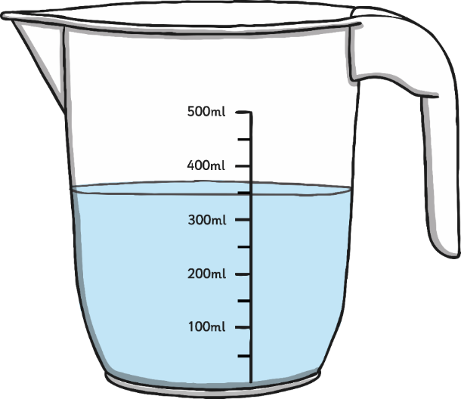
What Is the Same and What Is Different about These Scales?

Slide 11
Guess and check what would these increments increase by?
How many grams are the arrows pointing too?

Slide 12
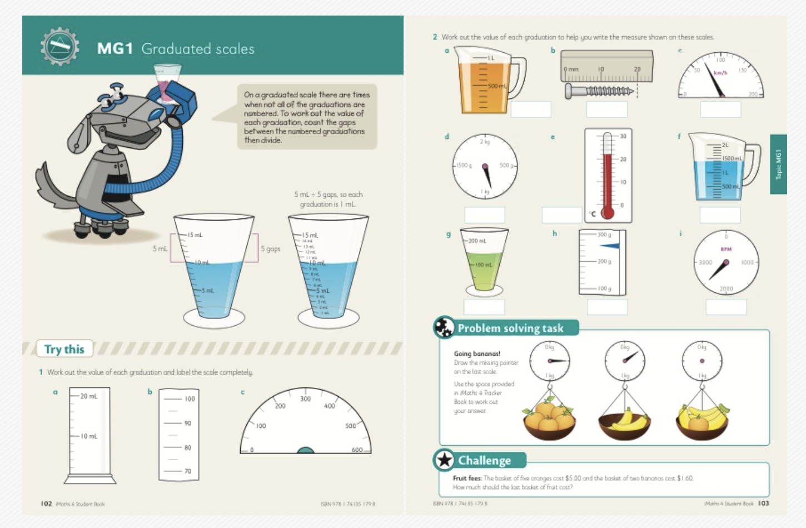
Notes:
editing

