Slide 1
Day 5

Slide 2
Order these numbers in descending order:
324 879 567 221
544 909 231 873
1123 8669 2567 2321

Slide 3
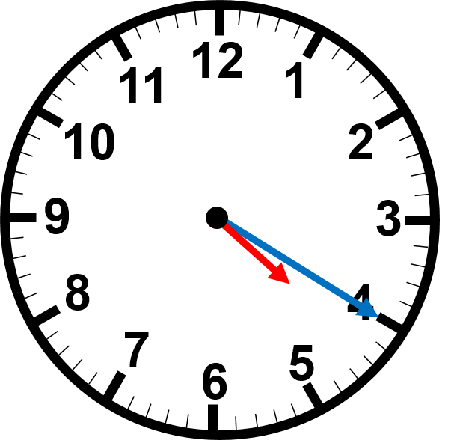
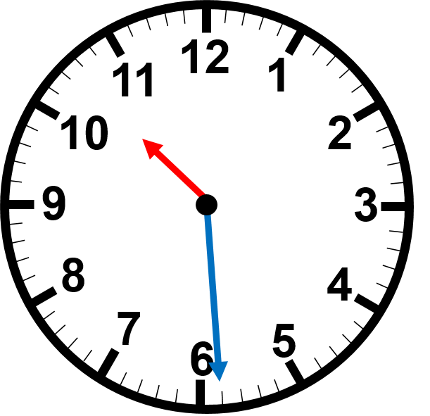
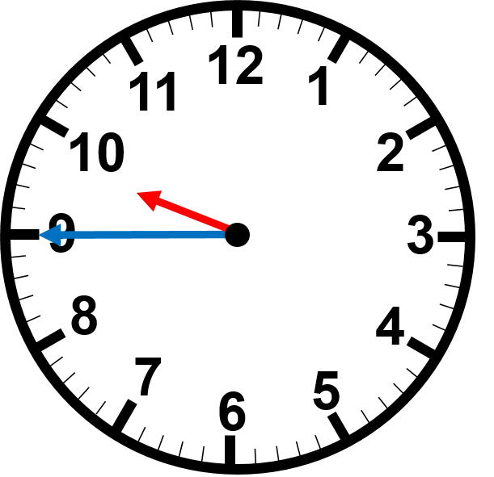
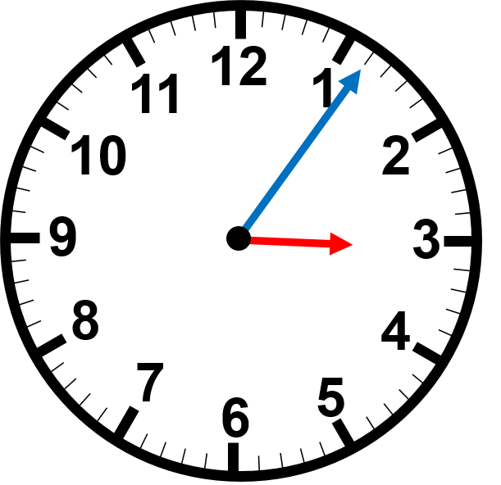
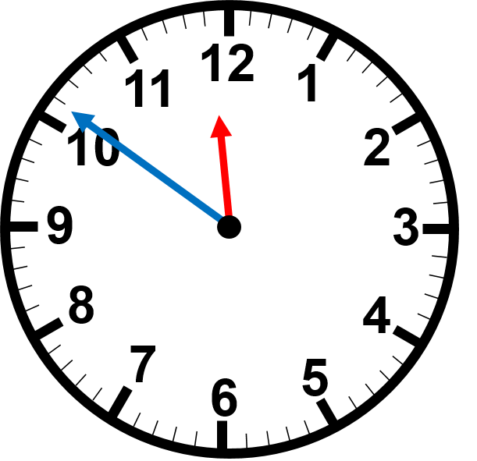
Read the time on the clocks
:
:
:
:
:

Slide 4
Solve the elapsed time:
START
FINISH
3:22 am
9:45 am

Slide 5
4
Fractions
WALT:
Identify equivalent fractions
WILF:
Identify equivalent fractions through multiplying
Sort fractions into their equivalent families
Identify equivalent fractions on a numberline

Slide 6
Equivalent Fractions
Equivalent fractions are fractions that look different but show exactly the same amount!
They just use different numerators and denominators!
For example:
=
2 slices
4 slices
1
=
2
2
4

Slide 7
Equivalent Fractions
So how do I create these equivalent fractions?
Remember the GOLDEN RULE: I need to multiply BOTH!!! The numerator and denominator by the SAME!!! amount
What did I multiply the first pizza fraction by to get ?
2
4
=
I multiplied both the numerator and denominator by 2!
2 slices
4 slices
x2
1
1
2
So I can say that
is equivalent to
2
=
2
4
2
4
x2

Slide 8
We do
Equivalent Fractions
1
Which block of chocolate shows:
2
1 out of 3 pieces are left
so this would make a fraction of
1 out of 2 pieces are left
so this would make a fraction of
1
1
3
2

Slide 9
We do
Equivalent Fractions
1
Let’s see if I can find another way to show:
Which picture below also shows ?
2
1
2
How would I write this fraction?
How did I get from
to ?
1
4
2
8
I used my Golden Rule and multiplied the top and bottom number by 4!
x4
1
=
4
2
8
So I can say that
is equivalent to
1
4
x4
2
8

Slide 10
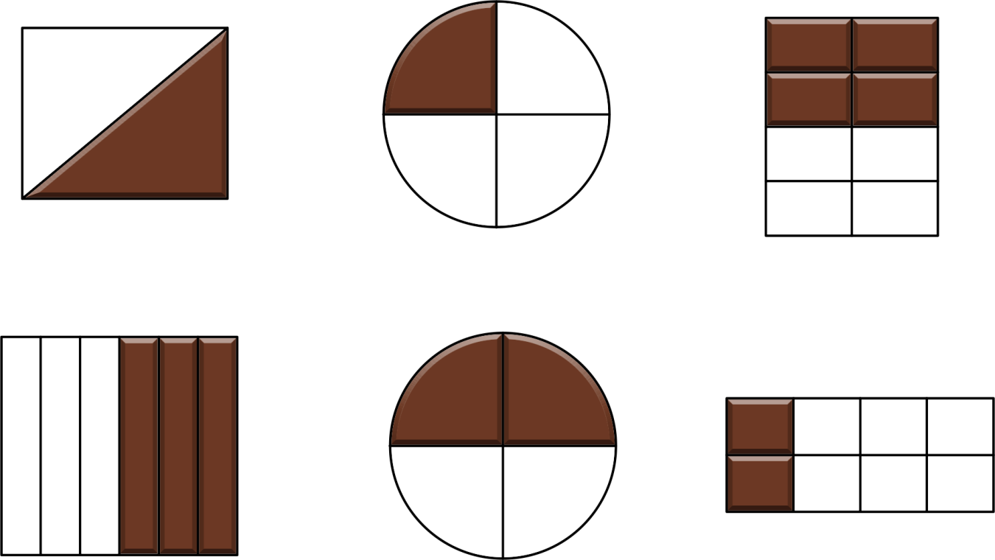
Equivalent Fractions
You do
1
Use your mini-whiteboards to tell me which chocolate bars show
2
A
B
C
D
E
F

Slide 11
Equivalent Fractions
You do
Use your mini-whiteboards to write the fraction for C, D and E.
A
B
C
4
8
D
3
E
2
F
6
4

Slide 12
I do
Equivalent Fractions
Using our Golden Rule:
1
2

Slide 13
You do
Equivalent Fractions
Using our Golden Rule:
1
3
1
4

Slide 14
We do
Equivalent Fractions Sort
1
1
2
4

Slide 15
We do
Equivalent Fractions Sort
1
1
2
4

Slide 16
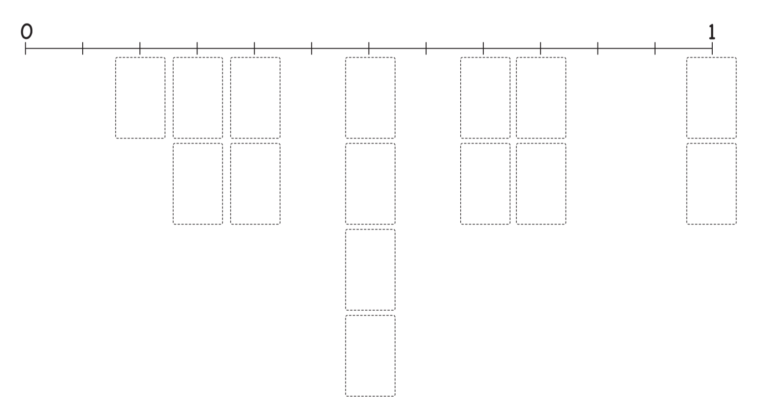
Equivalent Fractions Sort
Place the fractions on the numberline with your SP.

Slide 17
Rotations
There will be a range of different fraction rotations

