Slide 1
Expanded Notation

Slide 2
expanded notation
To use expanded notation to read, write, compare and order numbers up to and beyond ten thousands.
Identifying and writing numbers using standard notation with number up to and beyond ten thousands.

Slide 3
expanded Notation
Expanded notation is writing a number to show the value of each digit.

Slide 4
For the next three questions you will need your whiteboards. Write and chin the correct answer.

Slide 5
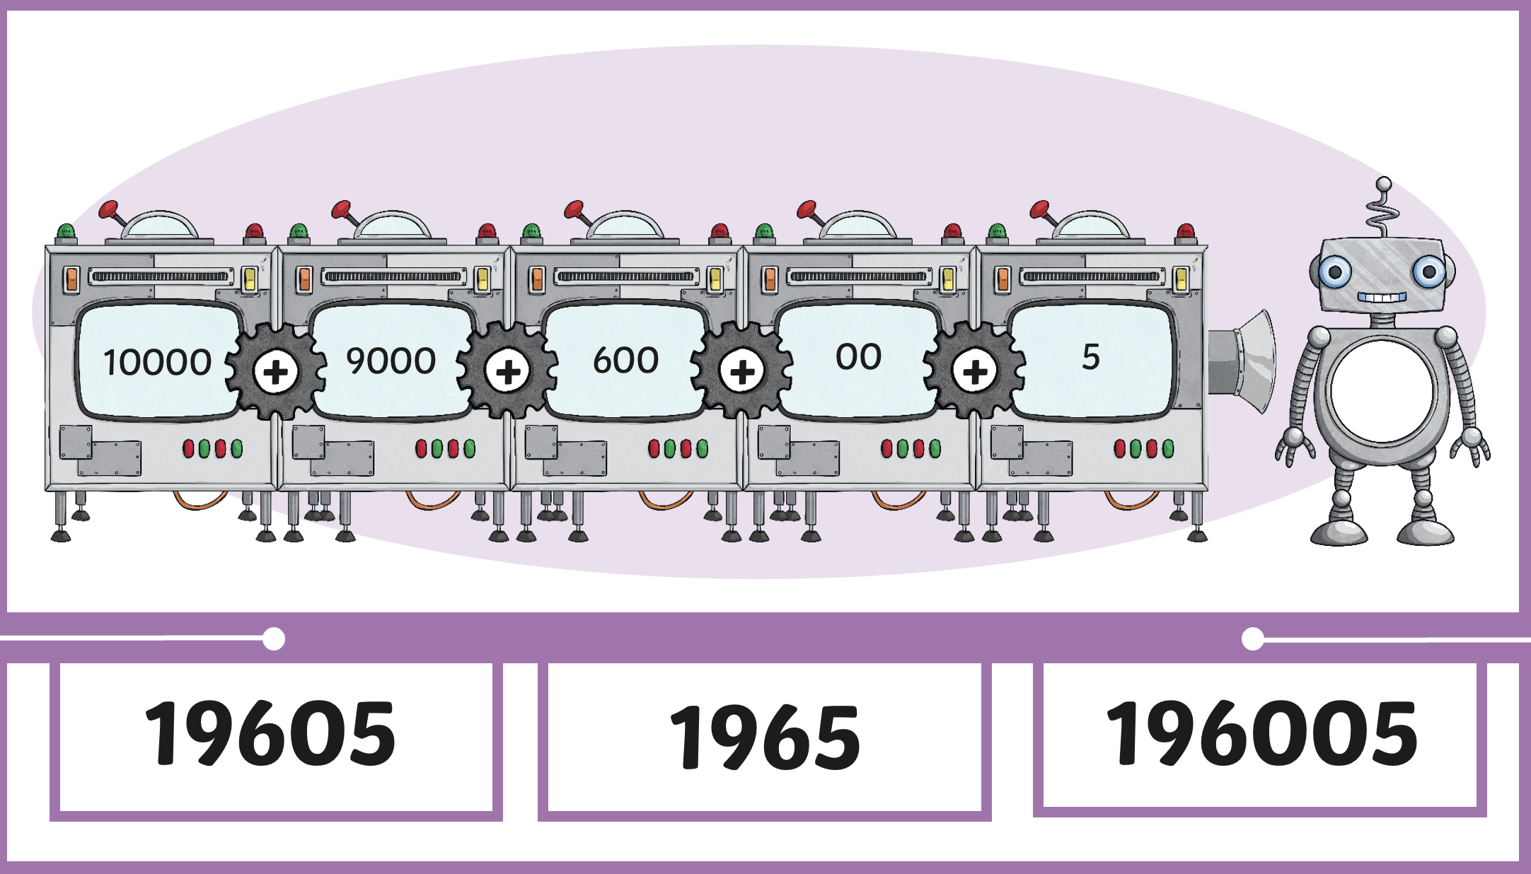
Notes:
editing

Slide 6
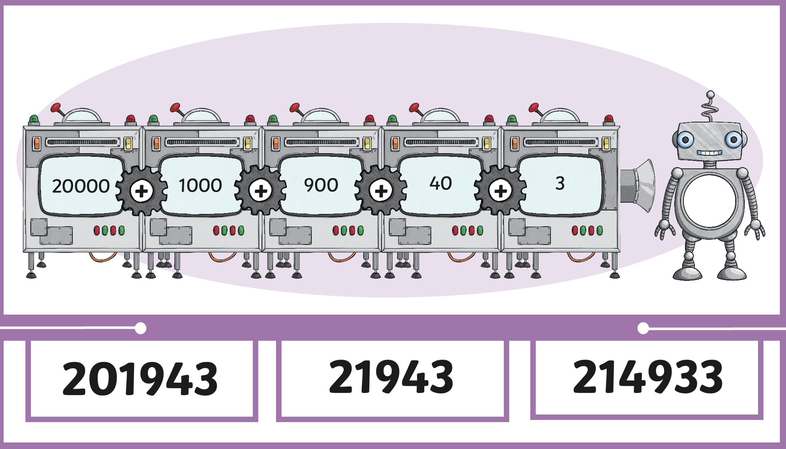
Notes:
editing

Slide 7
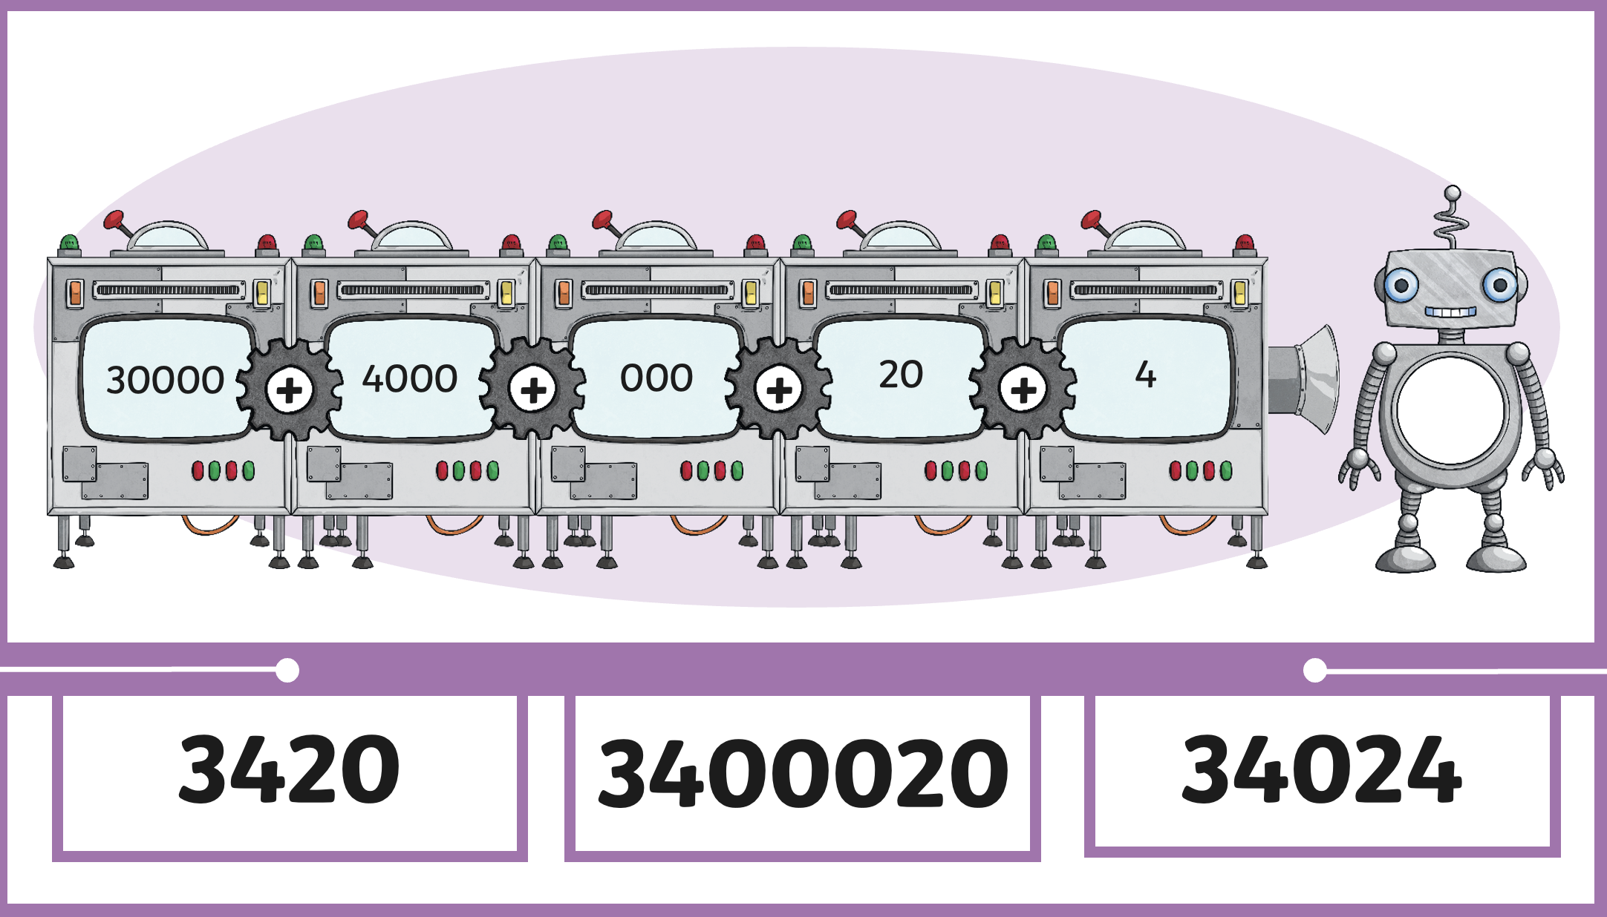

Slide 8
It’s time to play. Please make a circle for the demonstration.
80 000 + 1000+ 600 + 90 + 1= 81 691

Slide 9
Here are three ways to show the number 86 725.

Slide 10
Now I am going to show you three ways to write the number 78 328
Now it’s your turn. Divide your whiteboard in to thirds and show me three ways to make the number 24 354

Slide 11
Now it’s your turn. Show me three ways to make the number 24 354

Slide 12
