Slide 1
Day 6

Slide 2
Partition the following numbers
232
387
2768
1459
7205
73,217
30,213
42,981

Slide 3
Write down the even numbers:
306 29 24 402 500
650 61 23 94 207
Write down 6 other even numbers:

Slide 4
Add these numbers using the column method
23 + 45 =
336 + 176 =
2134 + 2249 =

Slide 5
6
Fractions
WALT:
Revise fractions
WILF:
Identify fractional values by creating a Fraction Sundae

Slide 6
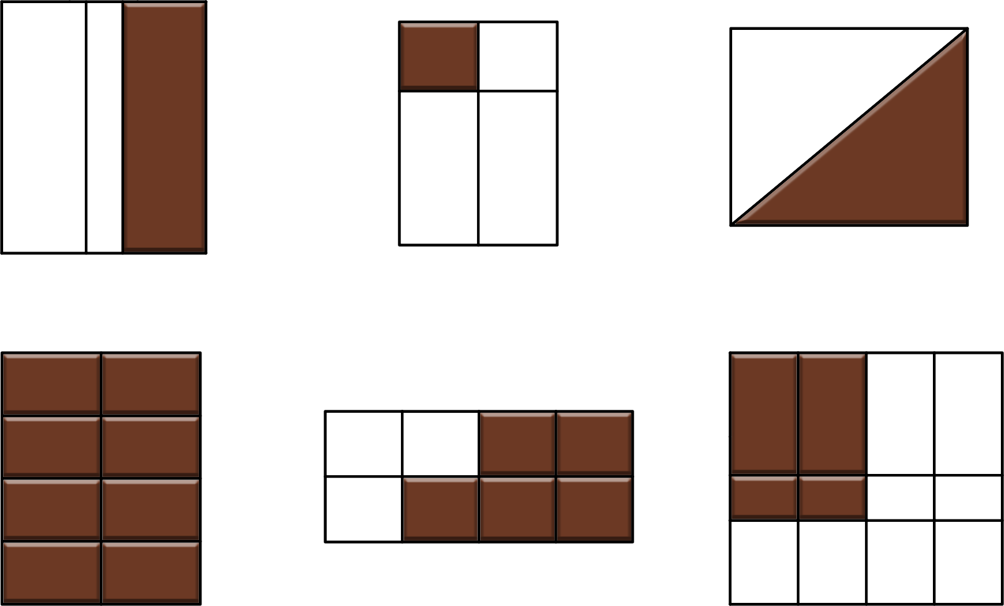
We do
Fractions
Which of the shapes below have equal parts and can therefore be written as a fraction:
A
B
C
D
E
F

Slide 7
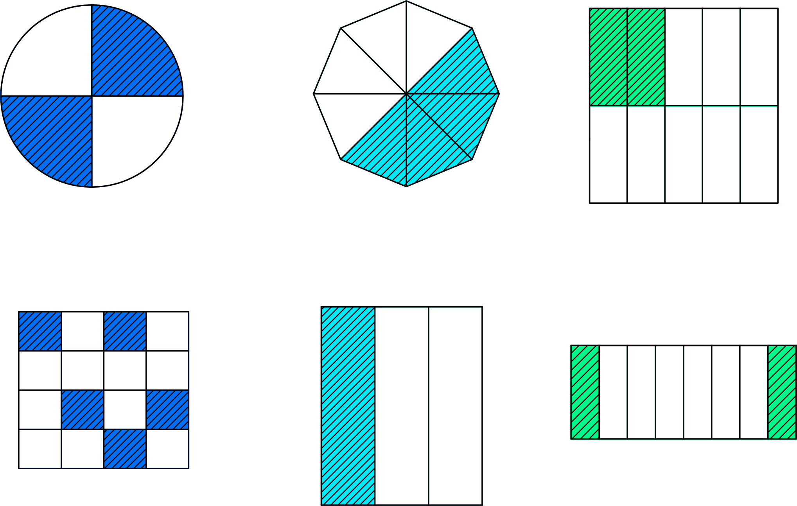
Fractions
You do
What fraction of the shape is shaded?
2
4
2
A
B
C
4
8
10
5
1
2
D
E
F
16
3
8

Slide 8
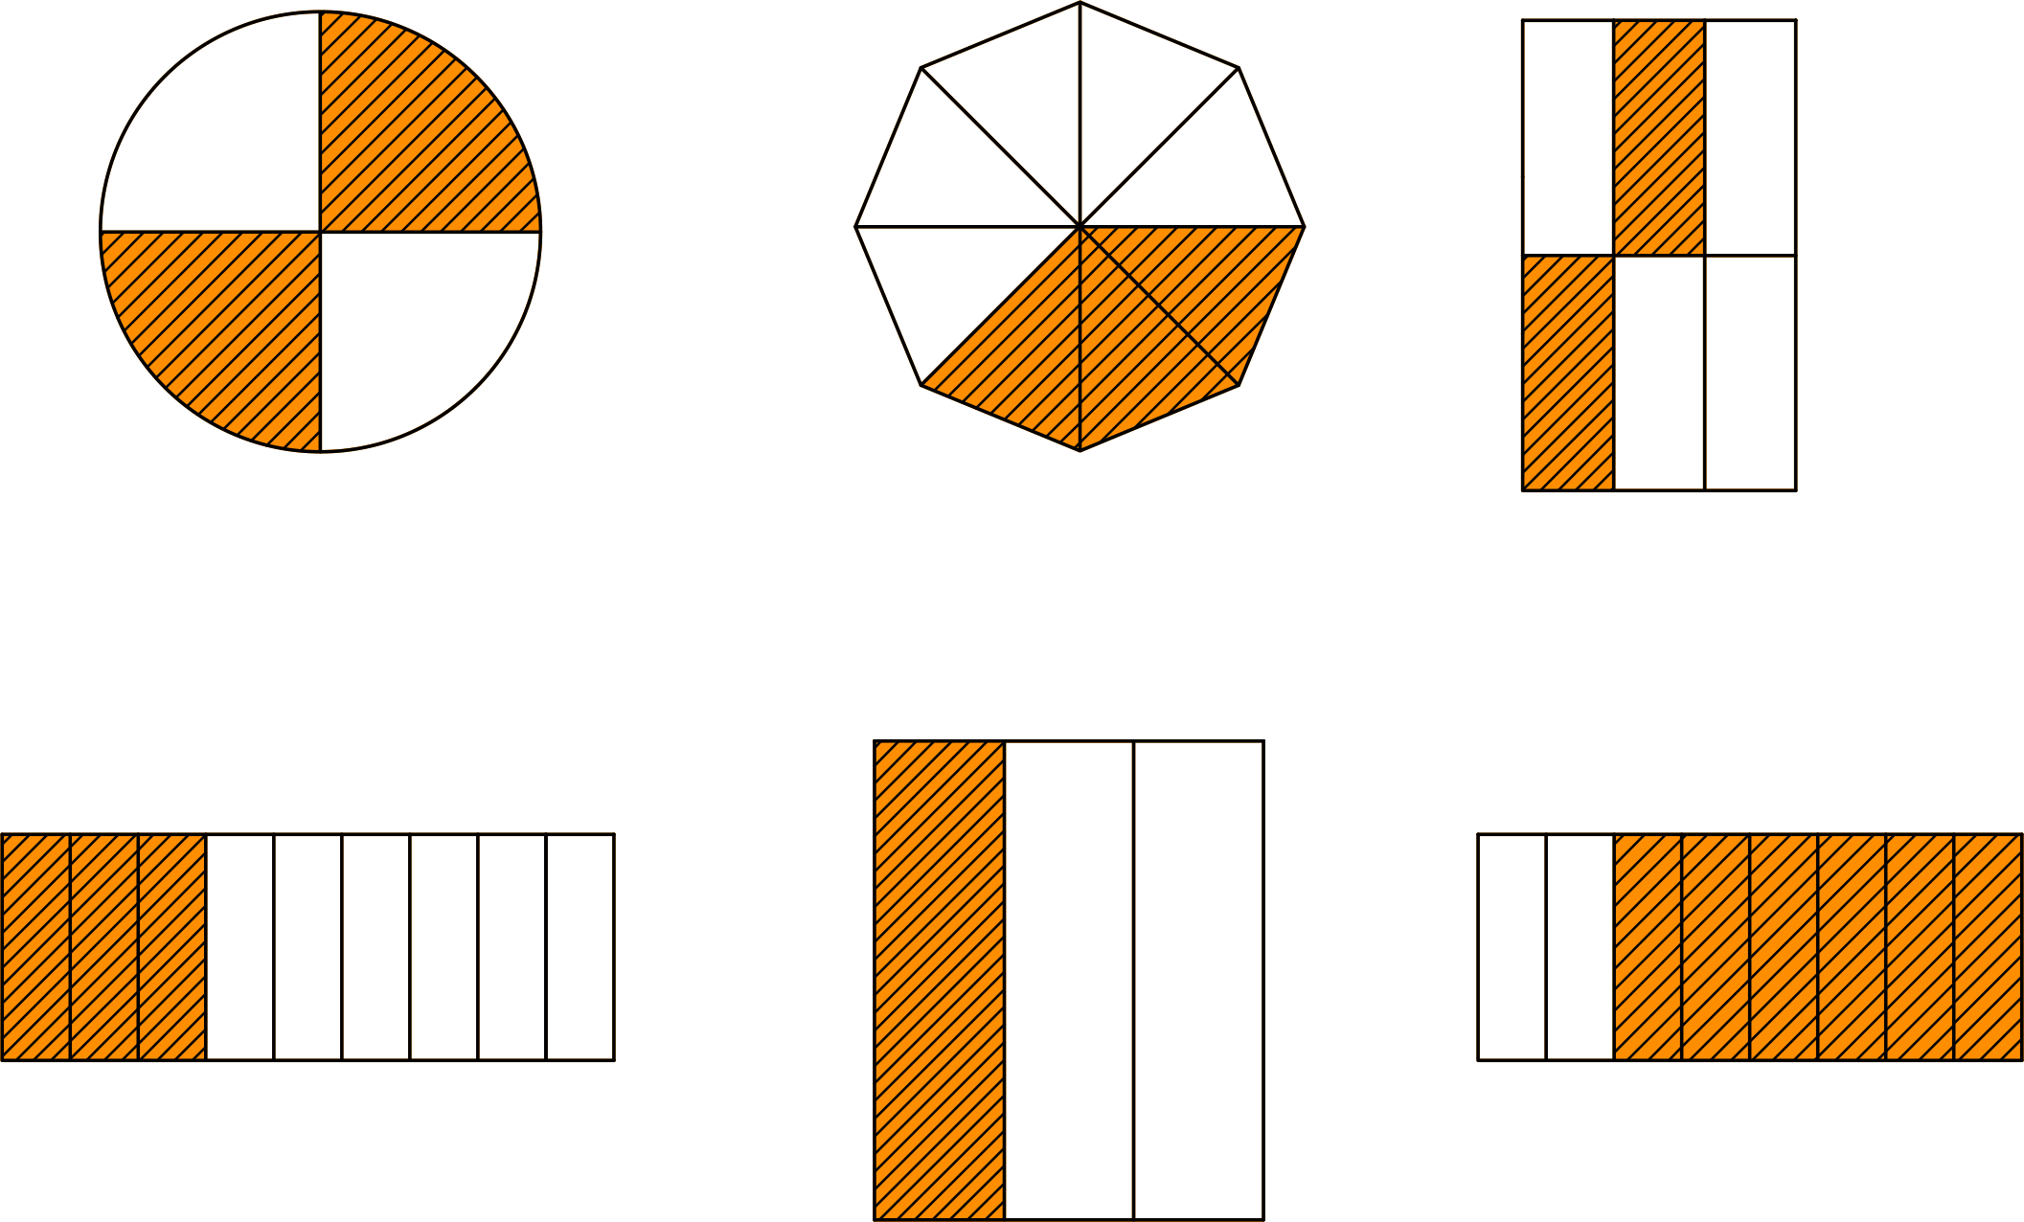
Equivalent Fractions
You do
1
Which fractions shows:
3
A
B
C
D
E
F

Slide 9
Equivalent Fractions
We do
Use the Golden Rule to find 3 equivalent fractions for these fractions:
4
2
__
__
6
3
2
3
__
__
4
4
2
2
__
__
5
8

Slide 10
Equivalent Fractions
We do
0
1
1
1
8
4
3
6
3
4
1
2
4
12
8
4
8
4
6
6

Slide 11
Equivalent Fractions
We do
1
1
1
3
4
1
0
6
4
2
4
6
6
8
3
8
12
4
4
8

