Slide 1
6
Angles
WALT:
Apply understanding of shape and angles
WILF:
- Meet differentiated criteria
- Include set shapes and angles
- Include various types of lines

Slide 2
Lets Recap…
Name these shapes and their properties:

Slide 3
Circle

Slide 4
Hexagon

Slide 5
Octagon

Slide 6
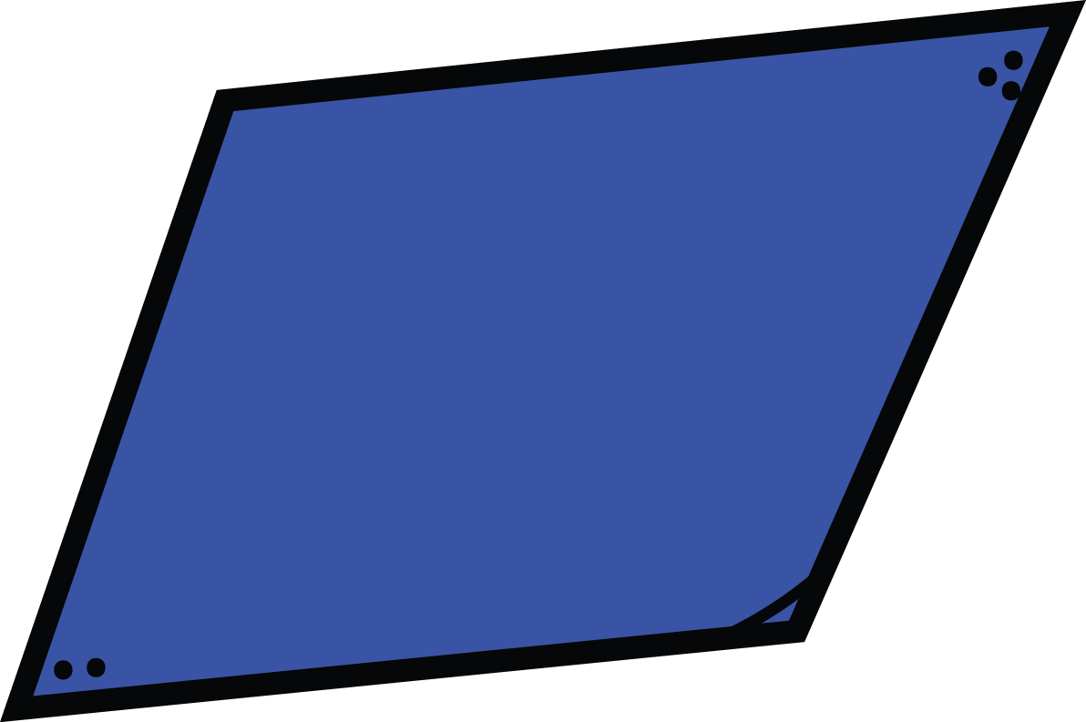
Parallelogram

Slide 7
Oval

Slide 8
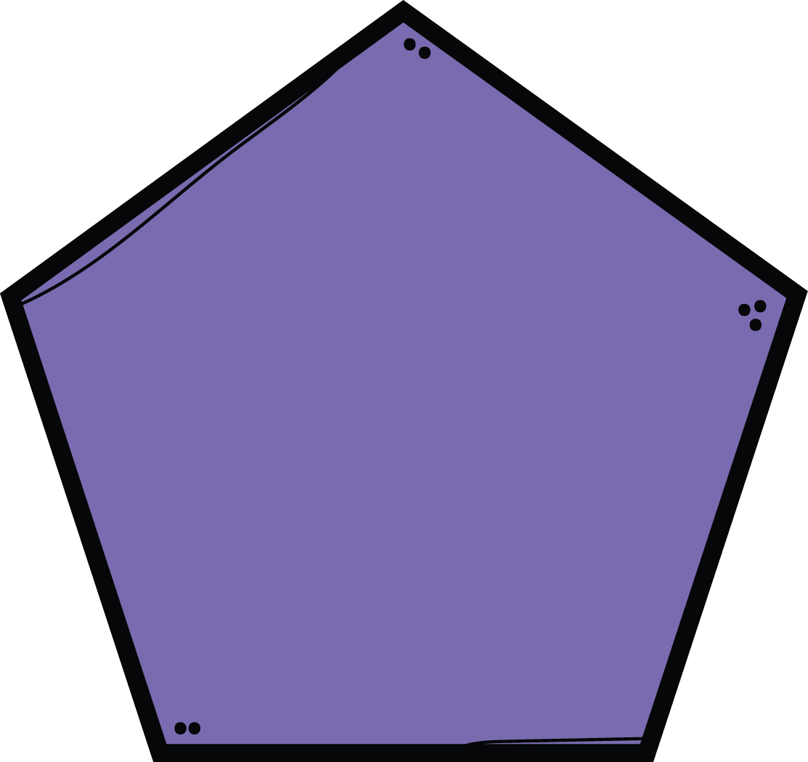
Pentagon

Slide 9
Rectangle

Slide 10
Rhombus

Slide 11
Square

Slide 12
Trapezium

Slide 13
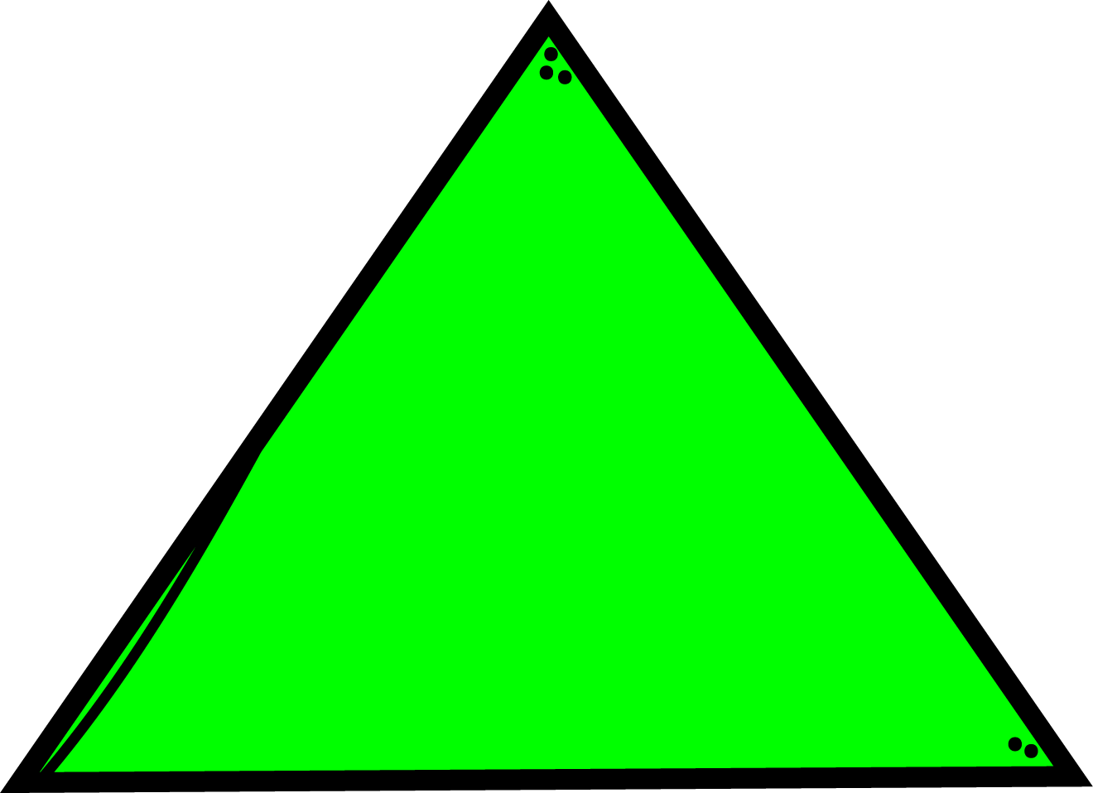
Triangle

Slide 14
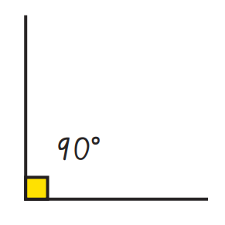
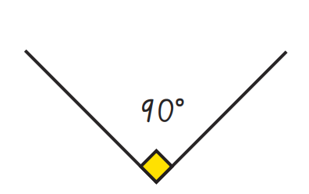
What are these angles?
Right Angles

Slide 15
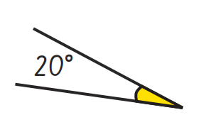
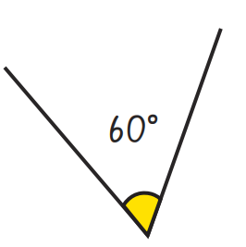
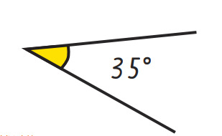
What are these angles?
Acute Angles

Slide 16
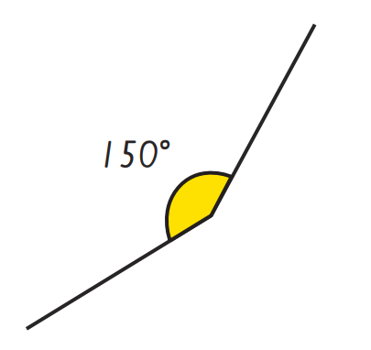
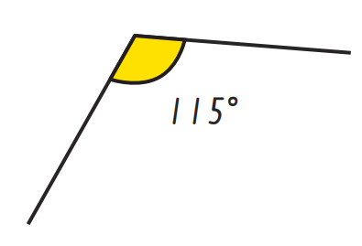
What are these angles?
Obtuse Angles

Slide 17
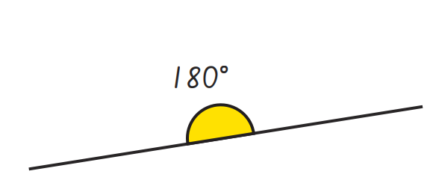
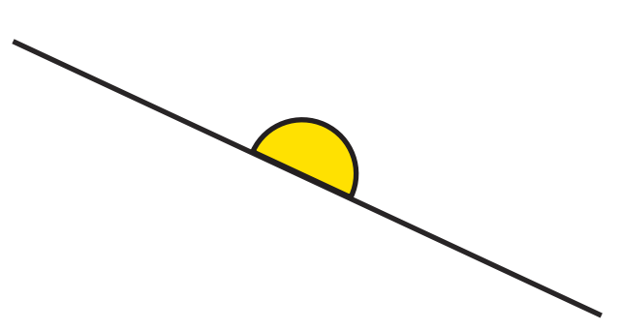
What are these angles?
Straight Angles

Slide 18
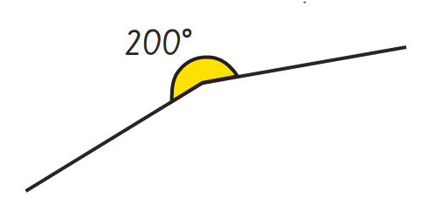
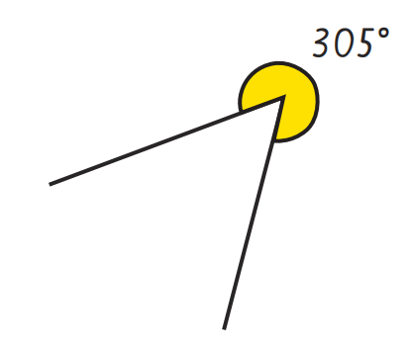
What are these angles?
Reflex Angles

Slide 19
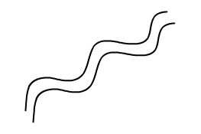
Types of Line
Shapes are made up of different types of line and these can be used when describing their properties.
Perpendicular Lines
Parallel Lines
Parallel lines are always the same distance apart
They never meet
They can be any length
They don't have to be straight
They can go in any direction
Perpendicular lines meet at right angles
Sometimes they intersect (cross over)
https://www.studyladder.com.au/games/activity/identifying-lines-21336?lc_set=

Slide 20
Geometry Town
Now we have completed a recap, let’s take a look at what we are doing today.
You are going to be designing a new town using your knowledge or 2D shapes and angles.
There are specific shapes and angles you must include in your town.

Slide 21
Here is what you need to include.
Yellow and Orange | Red | Green
2 right angles 2 acute angles 2 obtuse angles At least 2 streets that are parallel At least 2 streets that are perpendicular 5 buildings that are the shape of a quadrilateral 1 building that is a pentagon A park that is the shape of a hexagon An ice cream parlour the shape of a triangle 1 shape with no lines of symmetry 2 shapes with lines of symmetry | 2 right angles 2 acute angles 2 obtuse angles At least 2 streets that are parallel At least 2 streets that are perpendicular 1 square 1 rectangle 1 trapezium 1 pentagon A park that is the shape of a hexagon An ice cream parlour the shape of a triangle | 2 right angles 2 acute angles 2 obtuse angles 1 square 1 rectangle 1 trapezium 1 pentagon A park that is the shape of a hexagon An ice cream parlour the shape of a triangle

Slide 22
Examples:

