Slide 1
5
Angles
WALT:
Identify different types of angles
WILF:
Identify angles in shapes
Use mathematical vocabulary
Measure angles using a protractor

Slide 2
Name these shapes and their properties:

Slide 3
Circle

Slide 4
Hexagon

Slide 5
Octagon

Slide 6
Parallelogram

Slide 7
Oval

Slide 8
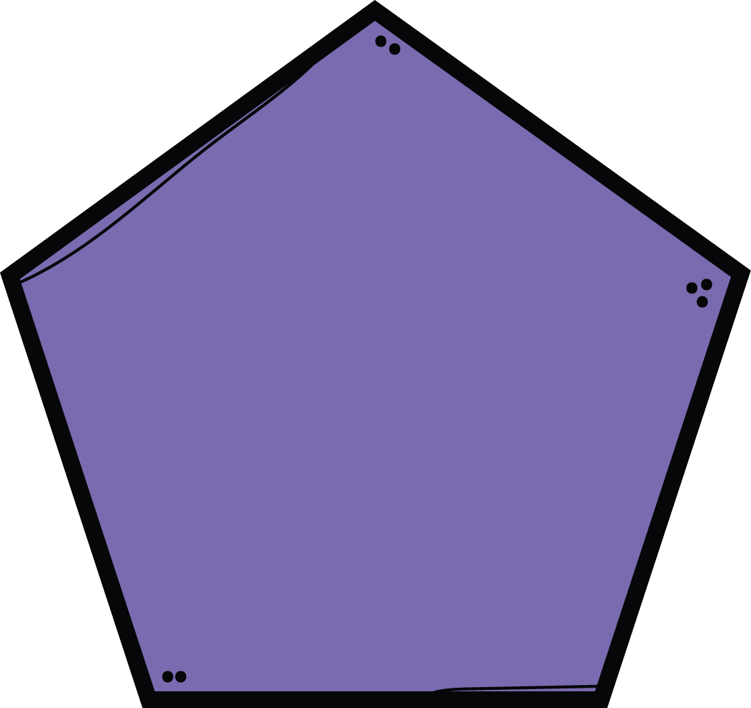
Pentagon

Slide 9
Rectangle

Slide 10
Rhombus

Slide 11
Square

Slide 12
Trapezium

Slide 13
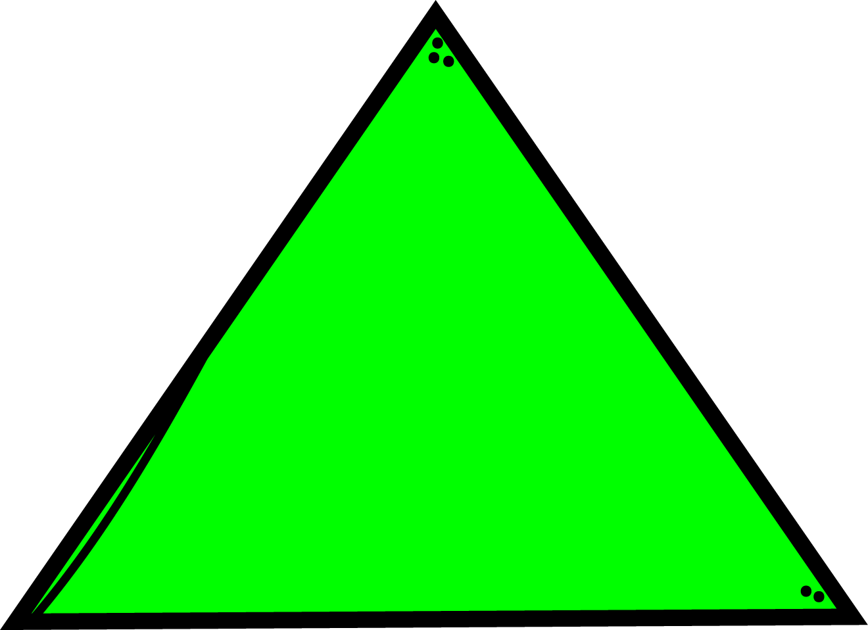
Triangle

Slide 14
You do
Angles in Shapes
___ acute angles
___ right angles
___ obtuse angles
___ acute angles
___ right angles
___ obtuse angles
___ acute angles
___ right angles
___ obtuse angles

Slide 15
Measuring Angles
We use a protractor to measure angles.
We measure angles in degrees
We use the ° symbol to record the size of the angle

Slide 16
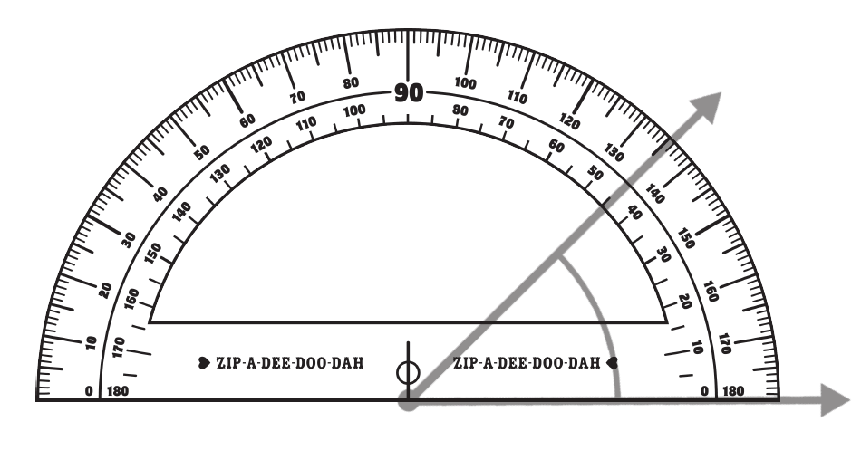
I/we do
Measuring Angles

Slide 17
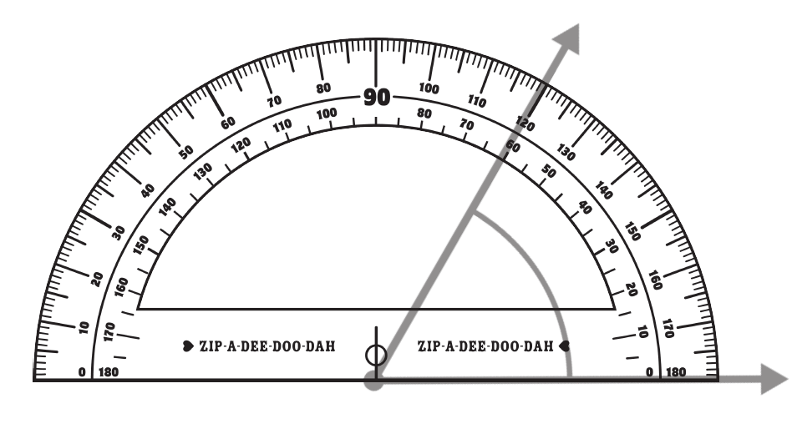
I/we do
Measuring Angles

Slide 18
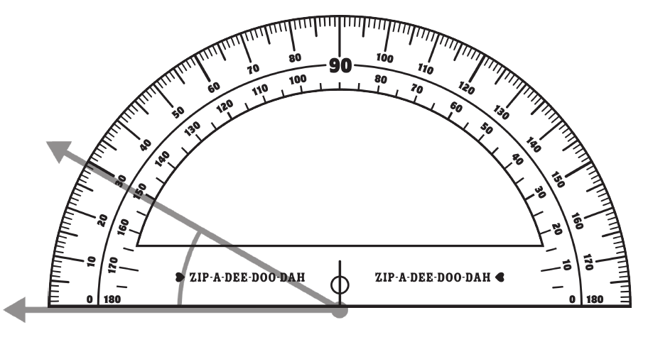
I/we do
Measuring Angles

Slide 19
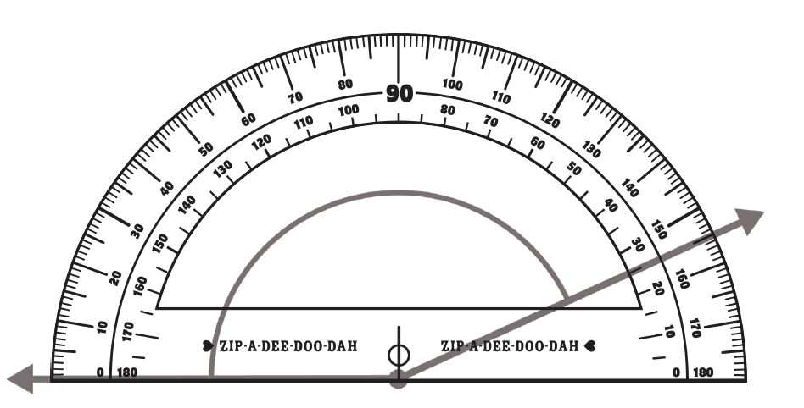
I/we do
Measuring Angles

Slide 20
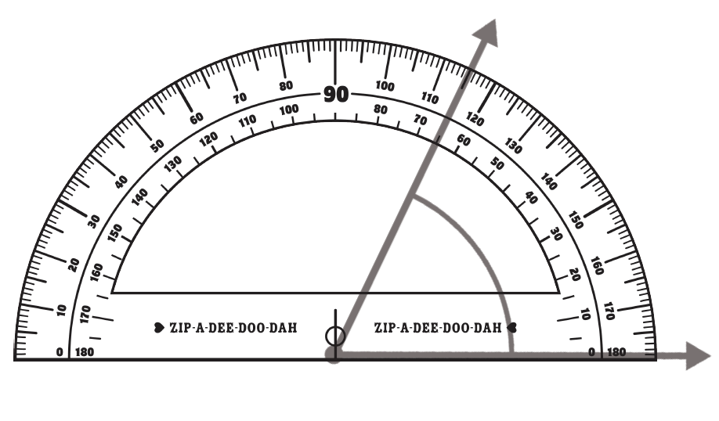
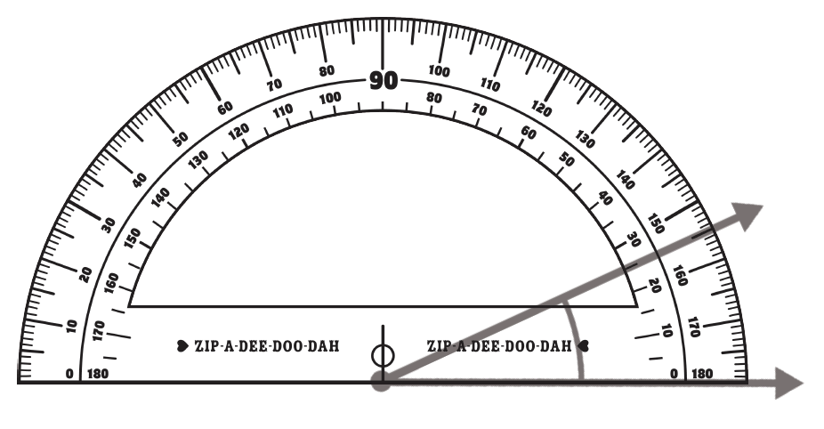
You do
Measuring Angles

Slide 21
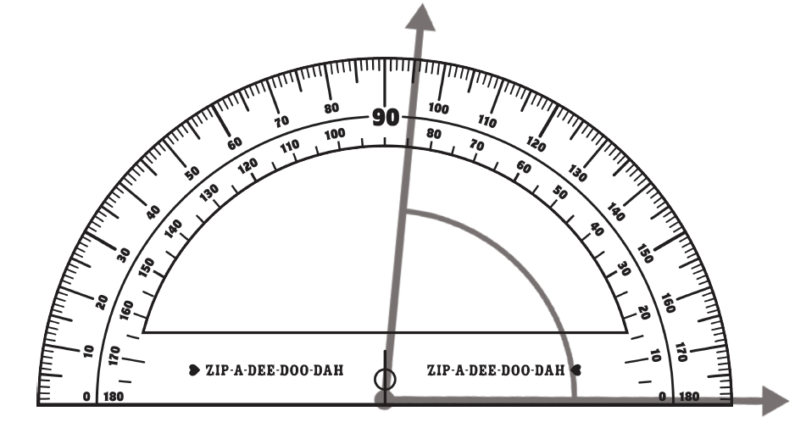
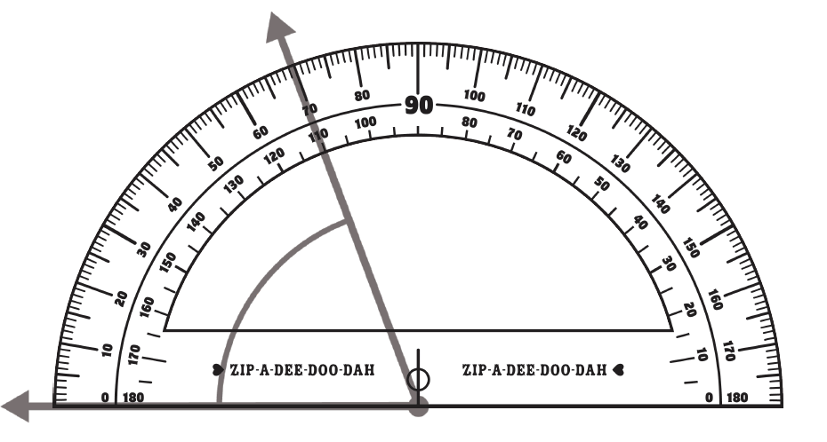
You do
Measuring Angles

Slide 22
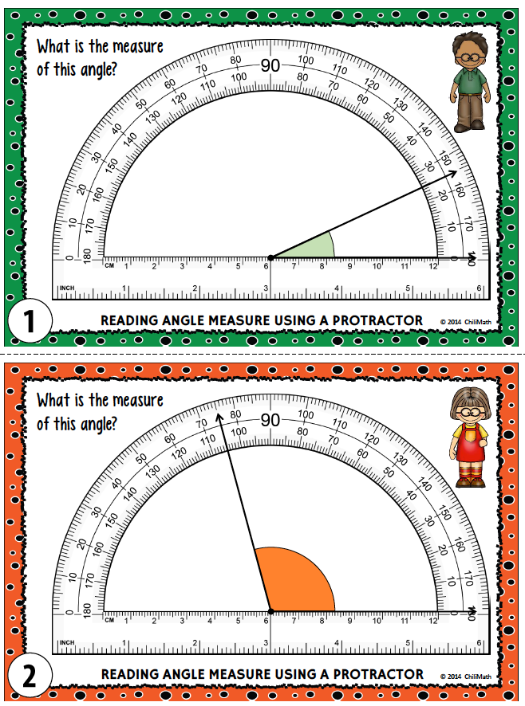
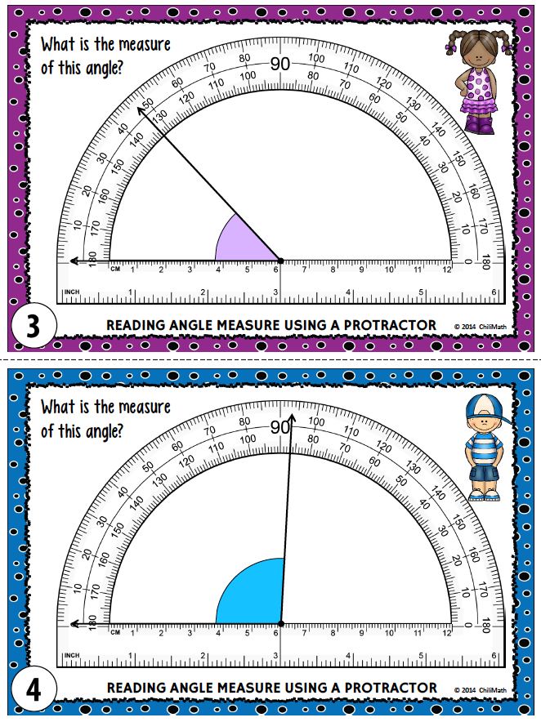
Task Cards

Slide 23
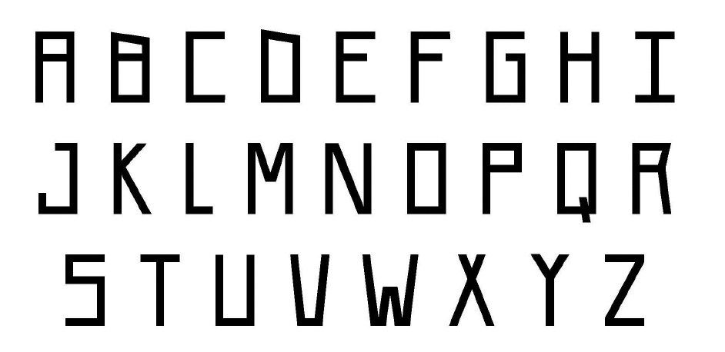
You do
Plenary
What angles are in the letters of your name?

Slide 24
Use smile multiplication to multiply
20 x 40 =
60 x 50 =
30 x 70 =
200 x 800 =
300 x 900 =
6000 x 400 =

Slide 25
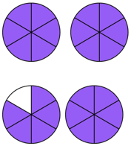
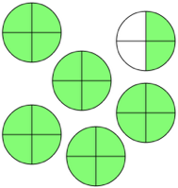
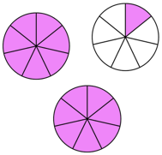
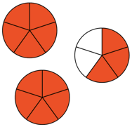
Write the mixed fractions:

Slide 26
Place these decimals on the numberline
2.8
0.2
1.4
3.6
2.0
0
1.0
2.0
3.0
4.0

