Slide 1
4
Angles
WALT:
Identify different types of angles
WILF:
Categorising angles appropriately
Identify angles in shapes
Use mathematical vocabulary

Slide 2
Name these shapes:

Slide 3
Circle

Slide 4
Hexagon

Slide 5
Octagon

Slide 6
Parallelogram

Slide 7
Oval

Slide 8
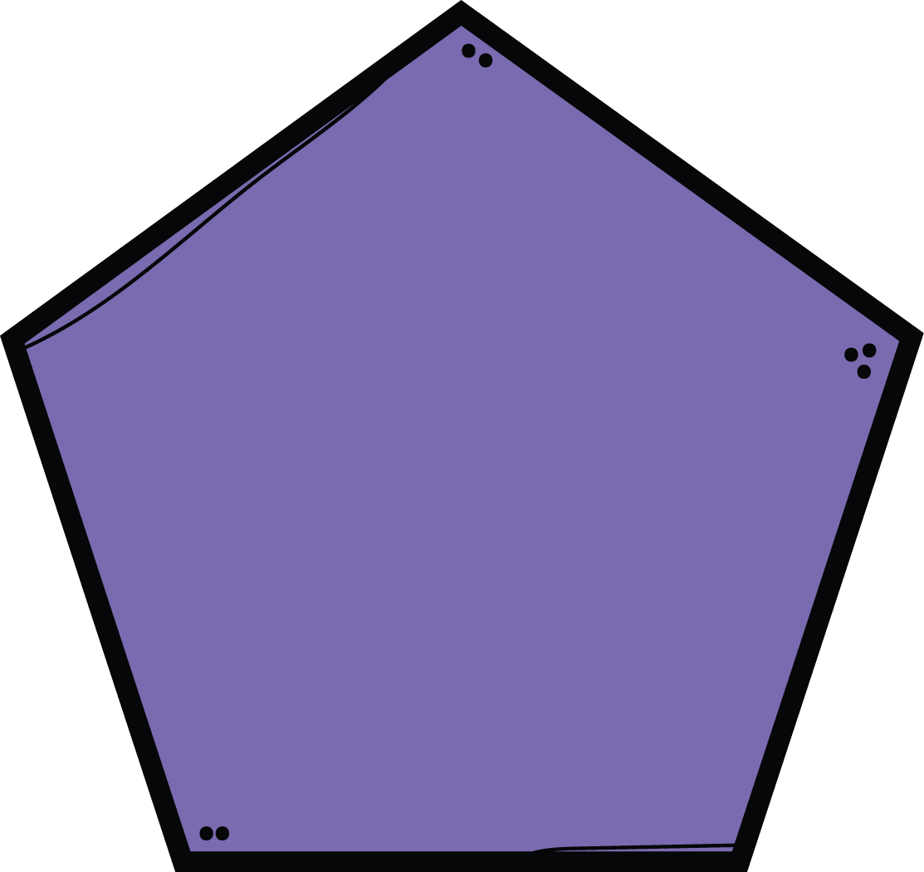
Pentagon

Slide 9
Rectangle

Slide 10
Rhombus

Slide 11
Square

Slide 12
Trapezium

Slide 13
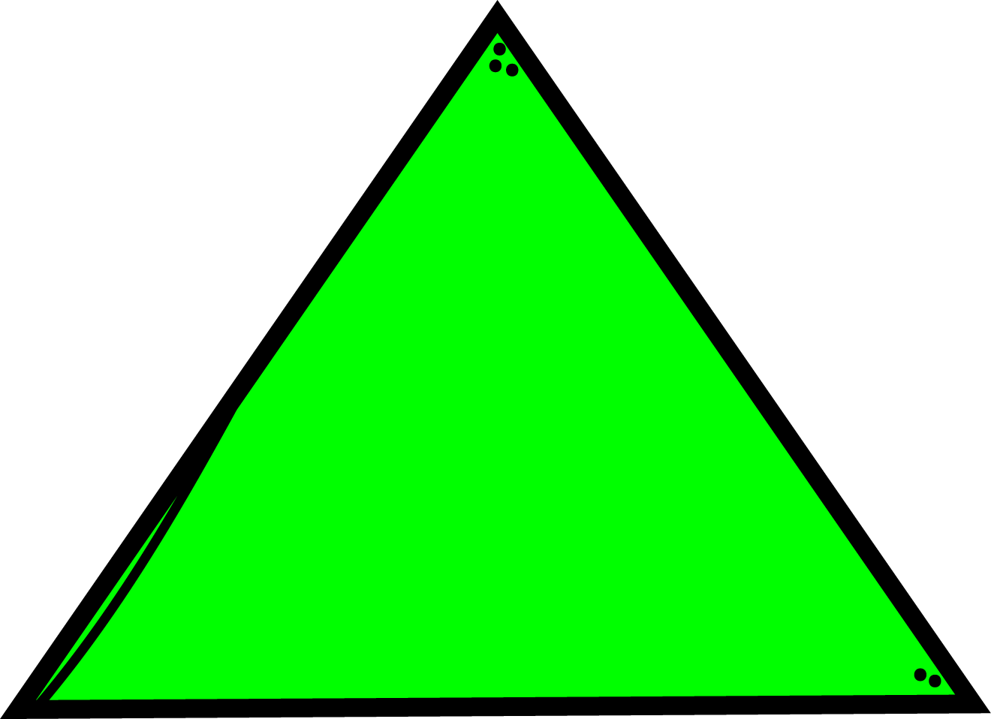
Triangle

Slide 14
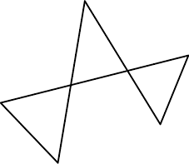
What is a
Polygon?
A polygon is any closed 2 dimensional shape with 3 or more sides.
Find the polygons:
7
12
3
5
11
1
10
8
2
6
4
9

Slide 15
I do
Angles in Shapes
___ acute angles
___ right angles
___ obtuse angles
___ acute angles
___ right angles
___ obtuse angles
___ acute angles
___ right angles
___ obtuse angles

Slide 16
You do
Angles in Shapes
Identify the types of angles in these shapes…

Slide 17
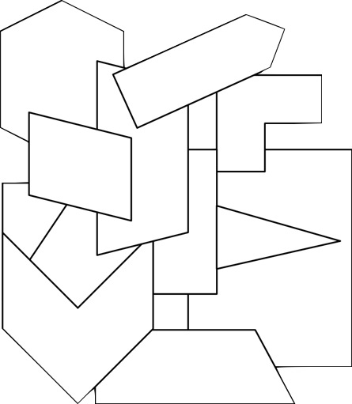
We do
Angles in
Geometric Shapes
Acute Angles
Obtuse Angles
Right Angles
Reflex Angles

Slide 18
Use the grid method to multiply:
23 x 4 =
87 x 3 =
63 x 5 =

Slide 19
Solve the word problem using RUCSAC
Martha had 48 pencils. She equally put them into 6 pencil cases. How many pencils were in each pencil case?

Slide 20
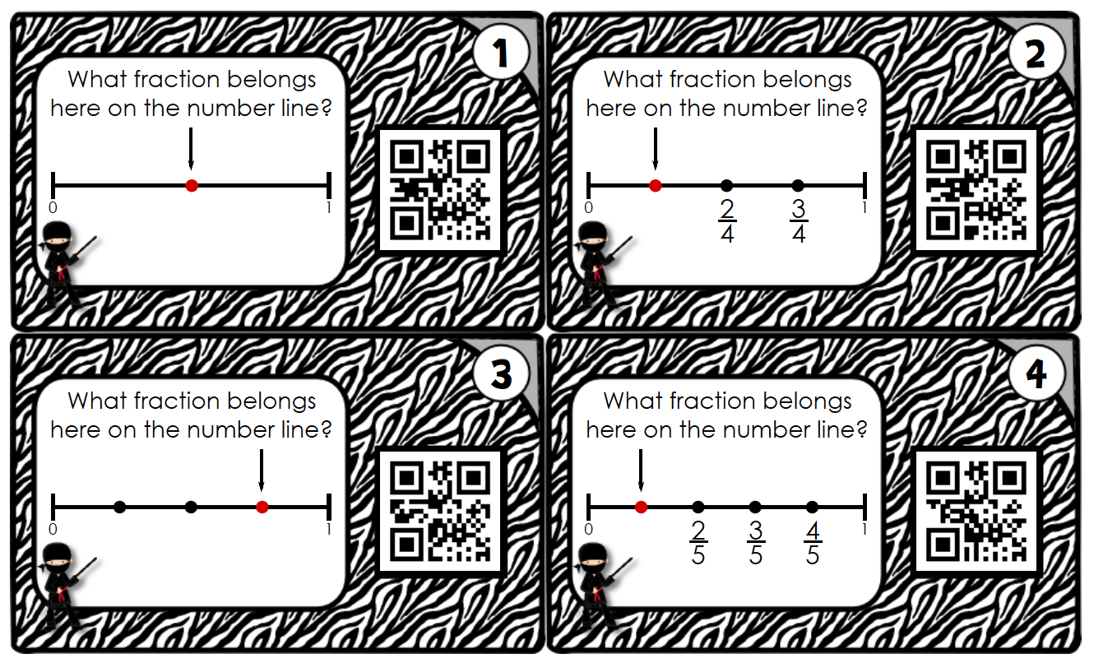
What fraction is missing on the number line?

