Slide 1
3
Angles
WALT:
Identify different types of angles
WILF:
Categorising angles appropriately
Identify angles on a map
Use mathematical vocabulary

Slide 2
Acute Angles
RECAP
Acute angles are small angles, measured internally between two straight lines.
An acute angle is more than O° but less than 90°.
All the angles below are acute angles.
75°
50°
20°
35°

Slide 3
Right Angles
RECAP
Right angles have a special box-like symbol.
A right angle is equal to 90°.
All the angles below are right angles.
90°
90°
90°
90°

Slide 4
Obtuse Angles
RECAP
Obtuse angles are larger than right angles. They are measured internally between two straight lines.
An obtuse angle is more than 90° but less than 180°.
All the angles below are obtuse angles.
105°
100°
150°
120°

Slide 5
Straight Angles
RECAP
A straight angle looks like one straight line.
A straight angle is equal to 180°.
All the angles below are straight angles.
180°
180°
180°
180°

Slide 6
Reflex Angles
RECAP
Reflex angles are large angles, measured externally between two straight lines.
A reflex angle is more than 180° but less than 360°.
All the angles below are reflex angles.
245°
300°
285°
253°

Slide 7
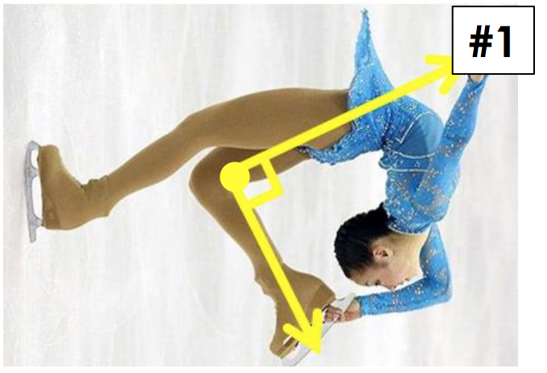
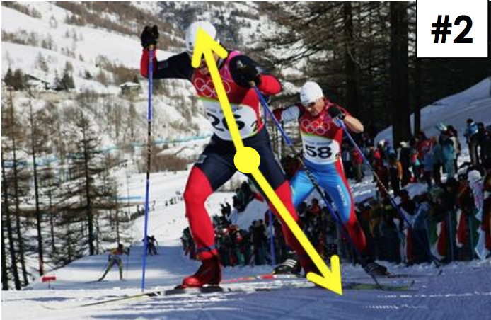
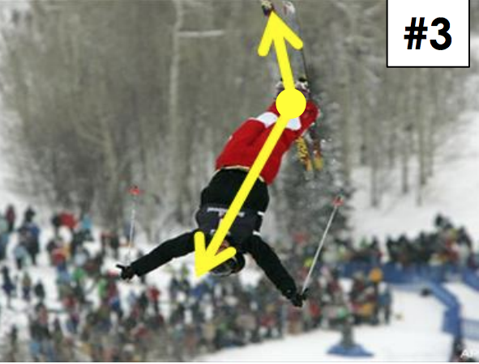
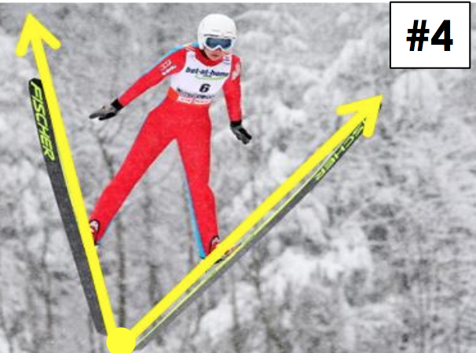
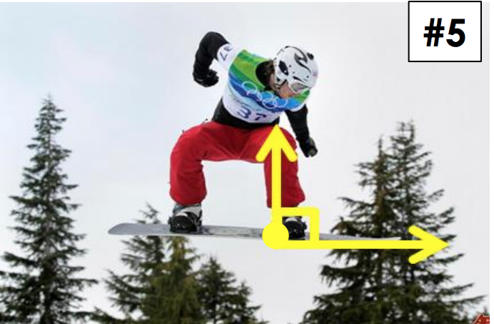
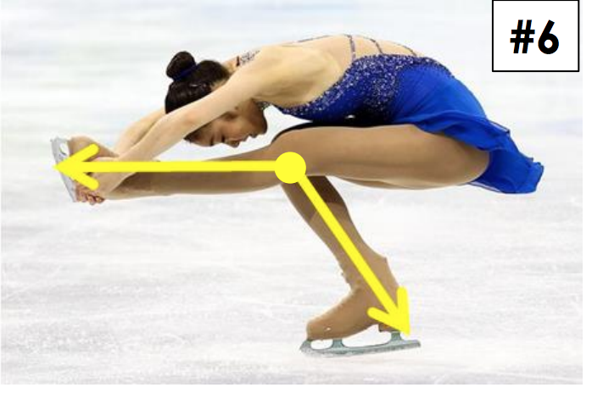
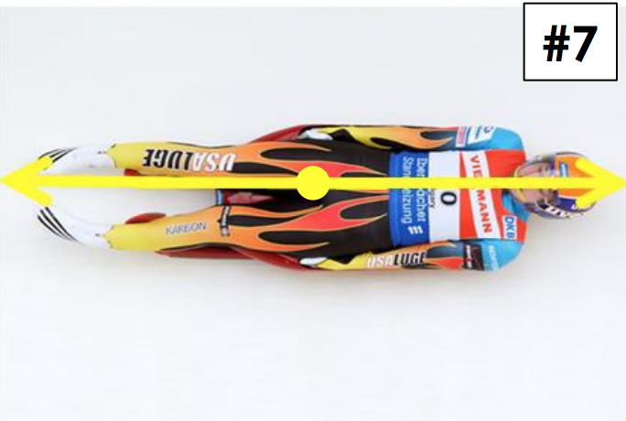
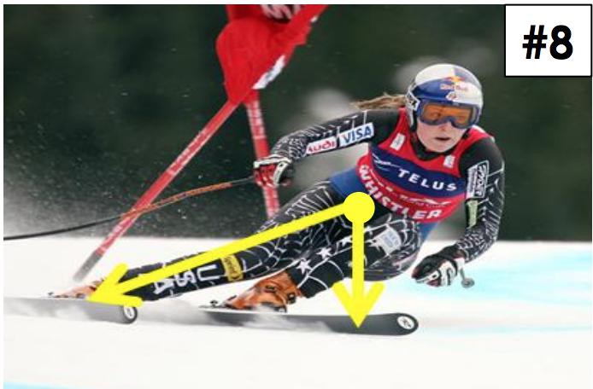
Name the angle…

Slide 8
we do
Ordering Angles
Put these angles in order from smallest to largest.

Slide 9
we do
Ordering Angles
Put these angles in order from smallest to largest.

Slide 10
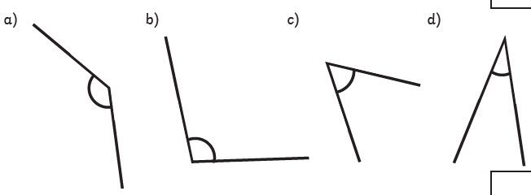
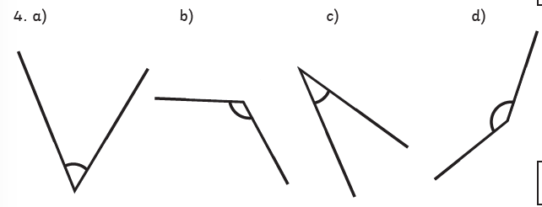
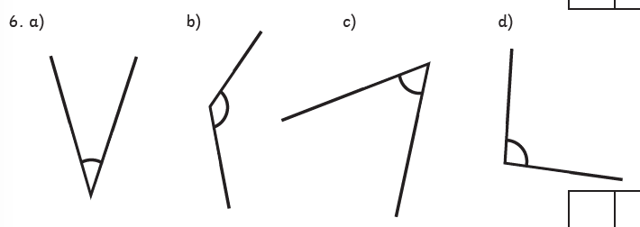
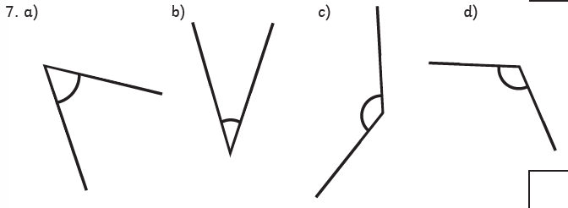
You do
Ordering Angles
Put these angles in order from smallest to largest.
1
2
3
4

Slide 11
Angles in Real life
Lines and angles are involved in nearly every aspect of our daily lives.
FOR EXAMPLE:
In the construction industry, angles make the difference of whether a building is safe or not. Architects and contractors need to calculate angles very precisely to create a structure which stands upright. Furthermore, without ensuring all structures are built with straight lines, construction workers cannot guarantee that windows and doors will fit. If these angles and lines are calculated incorrectly, or they are not built accurately, the structure could collapse.

Slide 12
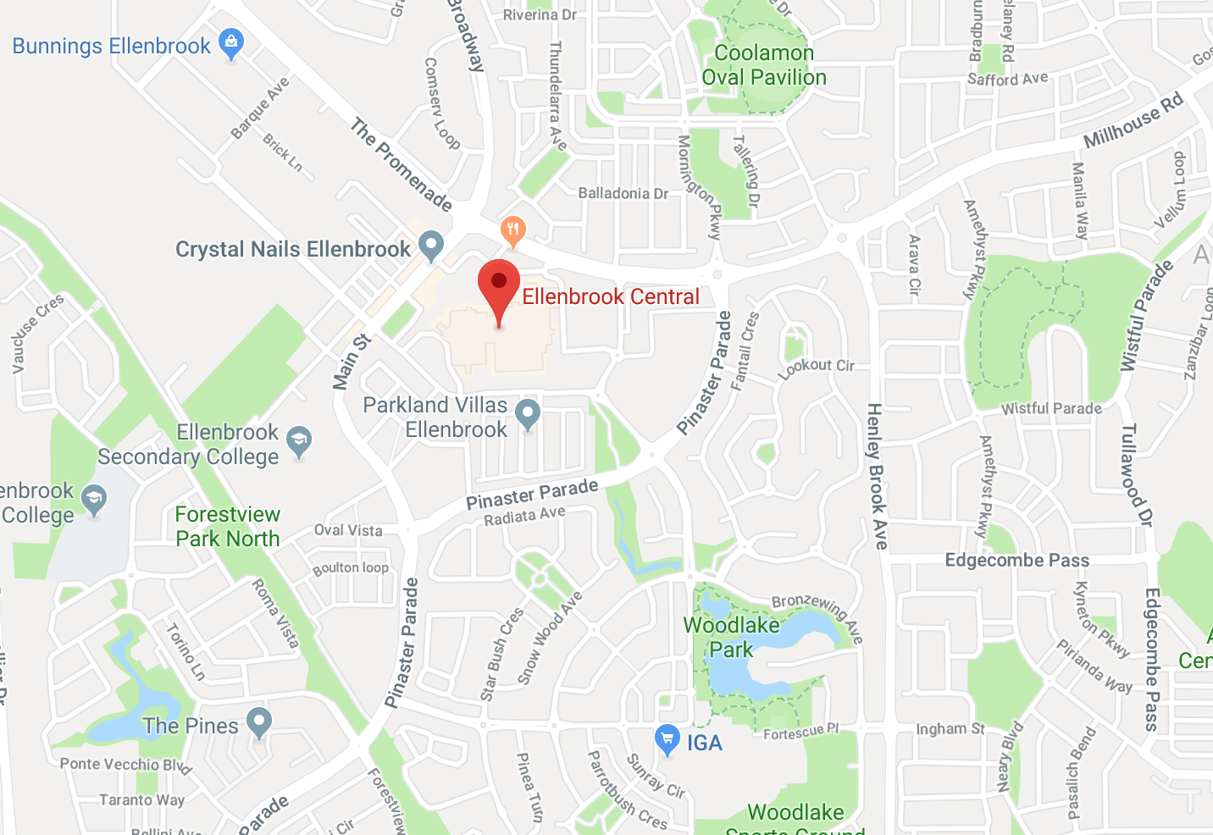
Identifying Angles
Acute Angles
Obtuse Angles
Right Angles
Reflex Angles

Slide 13
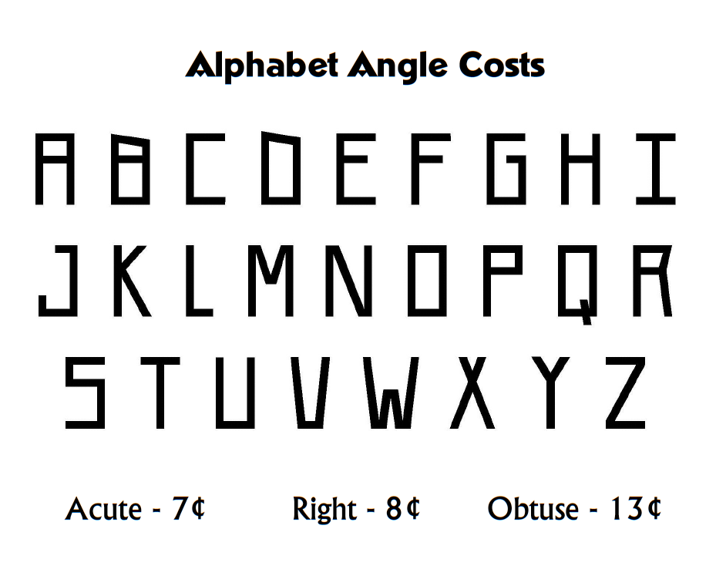
Plenary

Slide 14
Use the column method to subtract:
56 – 29 =
432 – 128 =
5463 – 2321 =

Slide 15
Order these numbers in descending order:
32.4 87.9 5.67 2.21
54.4 90.9 23.1 8.73
23.23 23.69 23.67 23.21

Slide 16
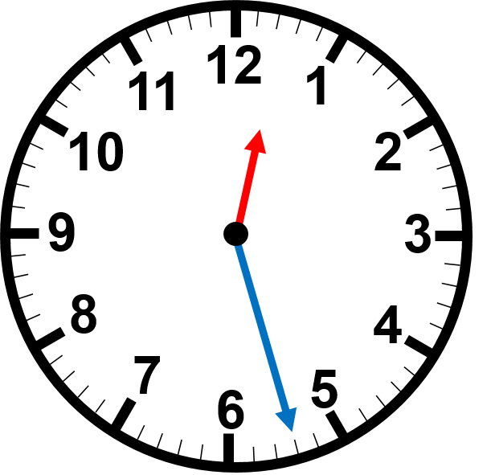
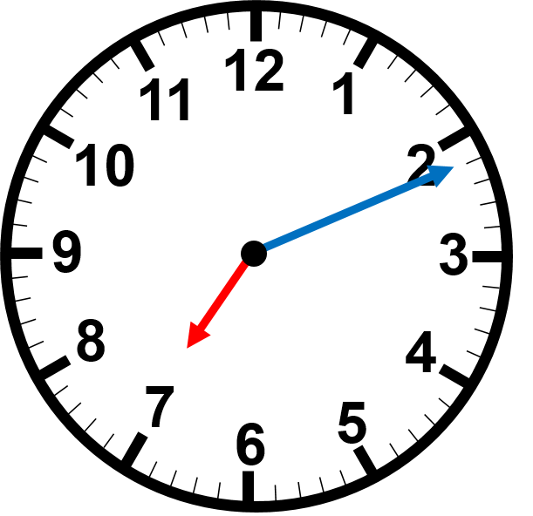
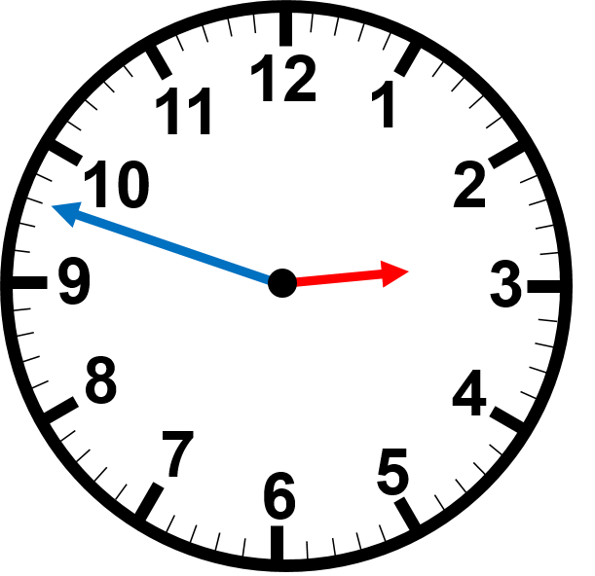
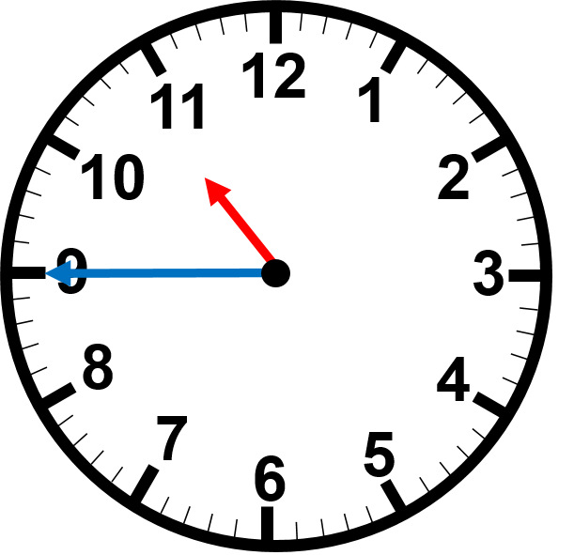
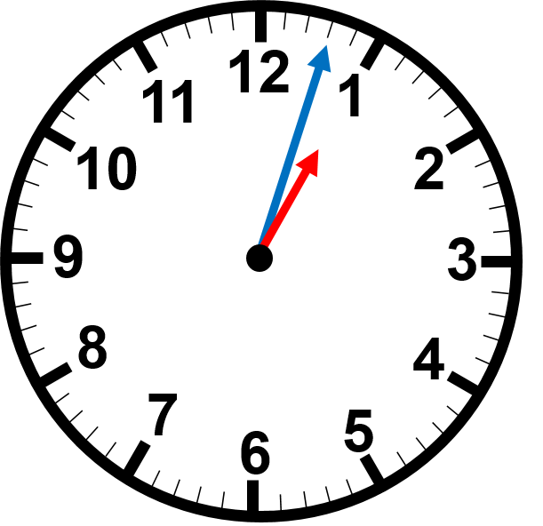
Read the time on the clocks
:
:
:
:
:

