Slide 1
2
Angles
WALT:
Identify different types of angles
WILF:
Categorising angles appropriately
Identify angles in an image
Use mathematical vocabulary

Slide 2
What Are Angles?
RECAP
Two straight lines (also known as rays) that share the same endpoint form an angle.
line 1
The space between the two lines is called the angle.
The angle size changes, depending on the amount of turn of each line.
The point where two straight lines intersect is called the vertex.
angle
45°
vertex
(intersecting
endpoint of each ray)
line 2
The size of an angle is measured in degrees (°).
The two lines form the sides of the angle.

Slide 3
Acute Angles
RECAP
Acute angles are small angles, measured internally between two straight lines.
An acute angle is more than O° but less than 90°.
All the angles below are acute angles.
75°
50°
20°
35°

Slide 4
Right Angles
RECAP
Right angles have a special box-like symbol.
A right angle is equal to 90°.
All the angles below are right angles.
90°
90°
90°
90°

Slide 5
Obtuse Angles
RECAP
Obtuse angles are larger than right angles. They are measured internally between two straight lines.
An obtuse angle is more than 90° but less than 180°.
All the angles below are obtuse angles.
105°
100°
150°
120°

Slide 6
Straight Angles
RECAP
A straight angle looks like one straight line.
A straight angle is equal to 180°.
All the angles below are straight angles.
180°
180°
180°
180°

Slide 7
Reflex Angles
RECAP
Reflex angles are large angles, measured externally between two straight lines.
A reflex angle is more than 180° but less than 360°.
All the angles below are reflex angles.
245°
300°
285°
253°

Slide 8
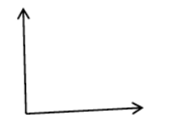
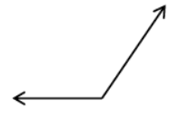
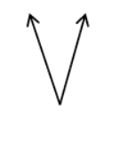
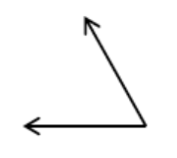
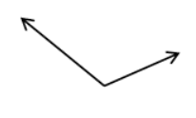
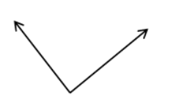
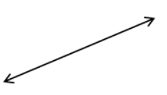
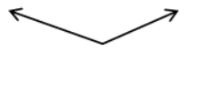
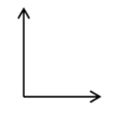
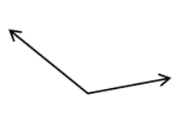
You do
Angle Sort
ACUTE ANGLE | RIGHT ANGLE | OBTUSE ANGLE | STRAIGHT ANGLE
c
a
b
f
e
d
j
h
g
k
i

Slide 9
I do
Ordering Angles
Put these angles in order from smallest to largest.

Slide 10
we do
Ordering Angles
Put these angles in order from smallest to largest.

Slide 11
we do
Ordering Angles
Put these angles in order from smallest to largest.

Slide 12
You do
Ordering Angles
Put these angles in order from smallest to largest.
1
2
3
4

Slide 13
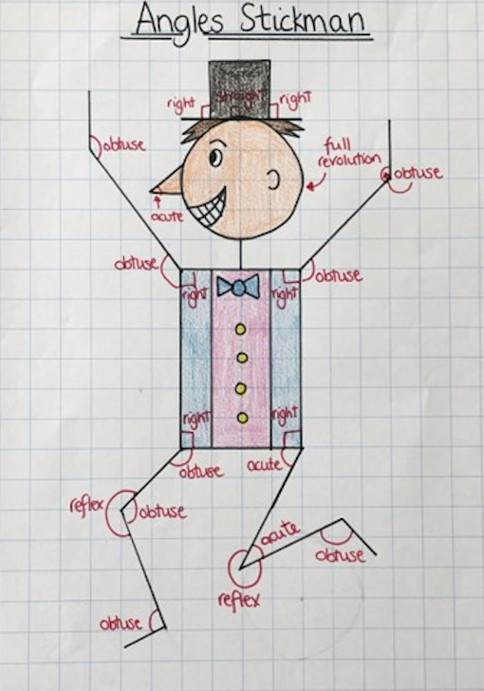
Activity
Angles Stickman

Slide 14
Plenary

Slide 15
Add these numbers using the column method
23 + 45 =
336 + 176 =
2134 + 2249 =

Slide 16
Write down the number sentences:
x
=
21
x
=
33
x
x
6
=
15
=
x
x
27
=
18
=
x
=
3
x
=
9
x
30
x
24
=
=

Slide 17
Solve the elapsed time problems
George began reading at 4:43. He finished 28 minutes later. When did he finish?
Emma’s soccer game began at 6:11. Her team played for a total of 2 hours and 23 minutes. When did they stop playing?

