Slide 1
Round these numbers to the nearest 10…
67 98 33 45 71
123 165 219 413

Slide 2
Complete the times tables
2 X 6 = 8 X 6=
5 X 3 = 2 X 8 =
7 X 5 = 7 X 6 =
9 X 8 = 7 X 9 =

Slide 3
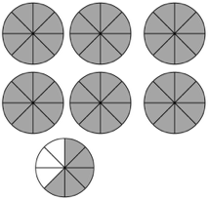
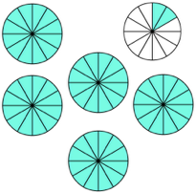
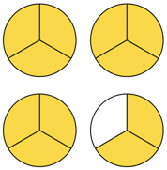
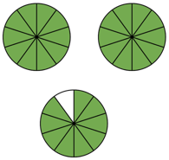
Write the mixed fractions:

Slide 4
1
Angles
WALT:
Identify different types of angles
WILF:
Categorising angles appropriately
Identify the measurement of angles
Use mathematical vocabulary

Slide 5
What Are Angles?
Two straight lines (also known as rays) that share the same endpoint form an angle.
line 1
The space between the two lines is called the angle.
The angle size changes, depending on the amount of turn of each line.
The point where two straight lines intersect is called the vertex.
angle
45°
vertex
(intersecting
endpoint of each ray)
line 2
The size of an angle is measured in degrees (°).
The two lines form the sides of the angle.

Slide 6
Acute Angles
Acute angles are small angles, measured internally between two straight lines.
An acute angle is more than O° but less than 90°.
All the angles below are acute angles.
75°
50°
20°
35°

Slide 7
Acute Angles
Which of the following angles are acute angles?
b)
90°
d)
a)
180°
c)
105°
25°
e)
30°
g)
135°
f)
85°

Slide 8
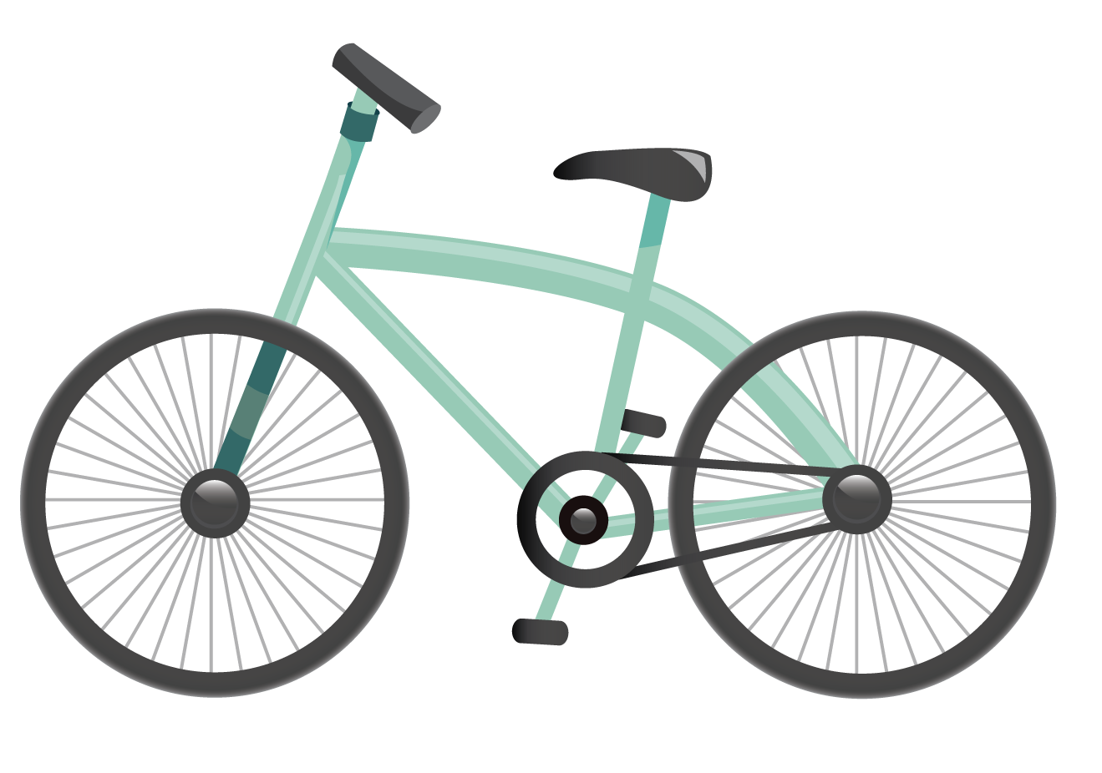
Acute Angles
Can you see the acute angles on this bike?

Slide 9
Right Angles
Right angles have a special box-like symbol.
A right angle is equal to 90°.
All the angles below are right angles.
90°
90°
90°
90°

Slide 10
Right Angles
Which of the following angles are right angles?
a)
d)
90°
105°
b)
90°
c)
180°
30°
e)
g)
135°
f)
90°

Slide 11
Right Angles
Can you see the right angles on these blocks?

Slide 12
Obtuse Angles
Obtuse angles are larger than right angles. They are measured internally between two straight lines.
An obtuse angle is more than 90° but less than 180°.
All the angles below are obtuse angles.
105°
100°
150°
120°

Slide 13
Obtuse Angles
Which of the following angles are obtuse angles?
250°
a)
b)
100°
30°
c)
d)
90°
e)
160°
f)
g)
95°
180°

Slide 14
Obtuse Angles
Can you see the obtuse angles on this telescope?

Slide 15
Straight Angles
A straight angle looks like one straight line.
A straight angle is equal to 180°.
All the angles below are straight angles.
180°
180°
180°
180°

Slide 16
Straight Angles
Which of the following angles are straight angles?
a)
30°
b)
c)
d)
180°
90°
180°
e)
180°
f)
160°
g)
255°

Slide 17
Straight Angles
Can you see the straight angles on this cot?

Slide 18
Reflex Angles
Reflex angles are large angles, measured externally between two straight lines.
A reflex angle is more than 180° but less than 360°.
All the angles below are reflex angles.
245°
300°
285°
253°

Slide 19
Reflex Angles
Which of the following angles are reflex angles?
a)
b)
c)
255°
d)
30°
320°
180°
257°
e)
f)
160°
g)
90°

Slide 20
Reflex Angles
Can you see the reflex angle on this scooter?

Slide 21
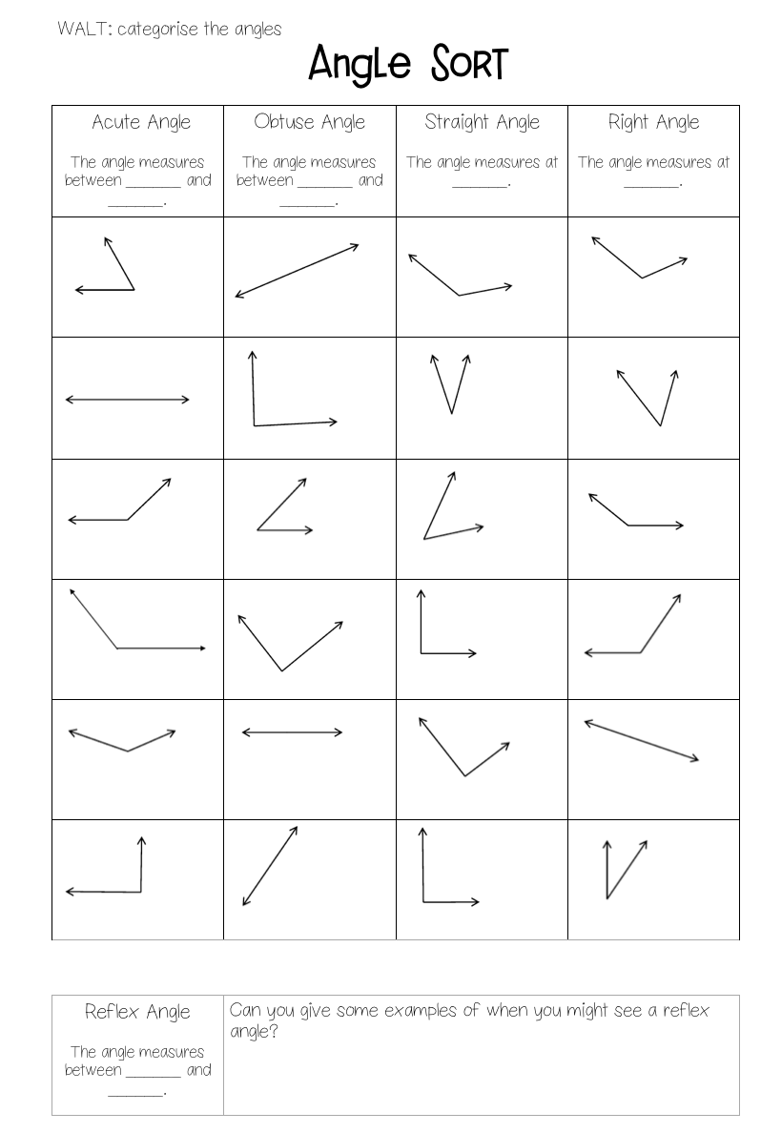
Activity
Cut and stick the headings into your book
Complete the measurements for each type angle
Sort the angles under the correct headings.

Slide 22
Plenary
https://www.mathgames.com/skill/4.1-acute-right-obtuse-and-straight-angles

Slide 23
Use smile multiplication to multiply
20 x 40 =
60 x 50 =
30 x 70 =
200 x 800 =
300 x 900 =
6000 x 400 =

Slide 24
Write 3 equivalent fractions for each:
1
2
1
4

Slide 25
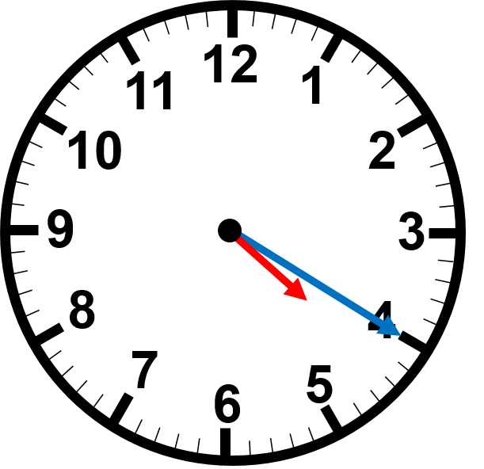
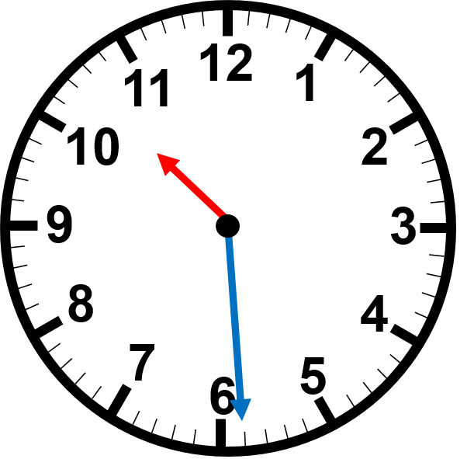
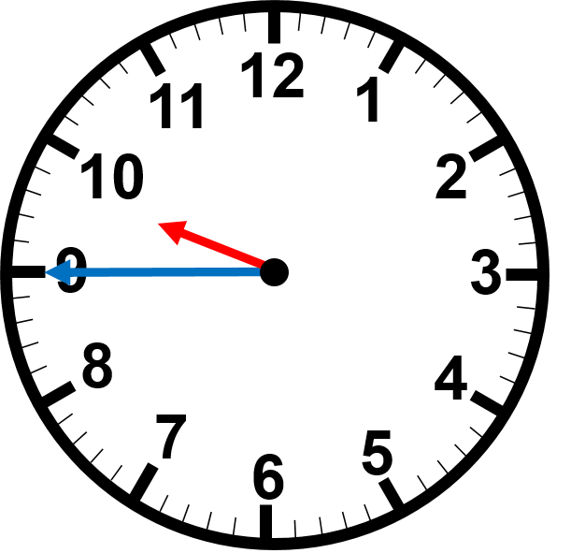
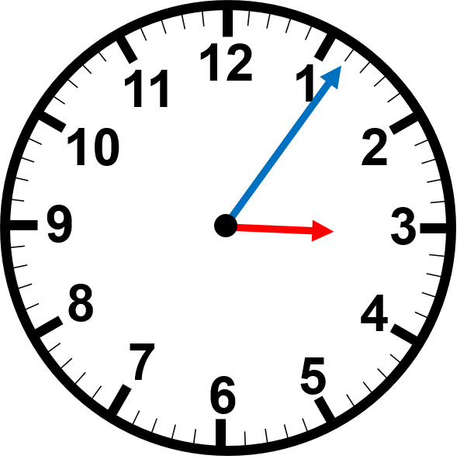
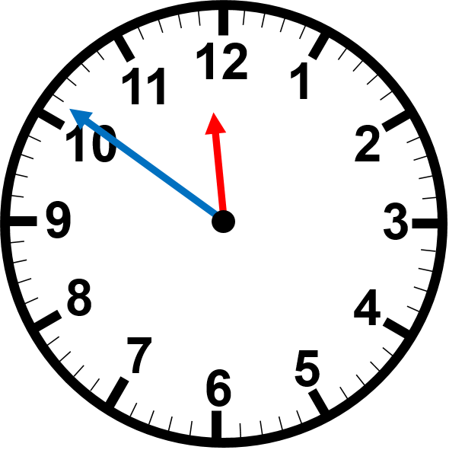
Read the time on the clocks
:
:
:
:
:

