Slide 1
Aboriginal & Torres Strait Islander Culture
Artwork: Shane Pickett
Rich Task Inquiry Journal By

Slide 3
Outline your findings here:
Here for at least 65 000 years according to Science
Here from the beginning of time according to Culture

Slide 4
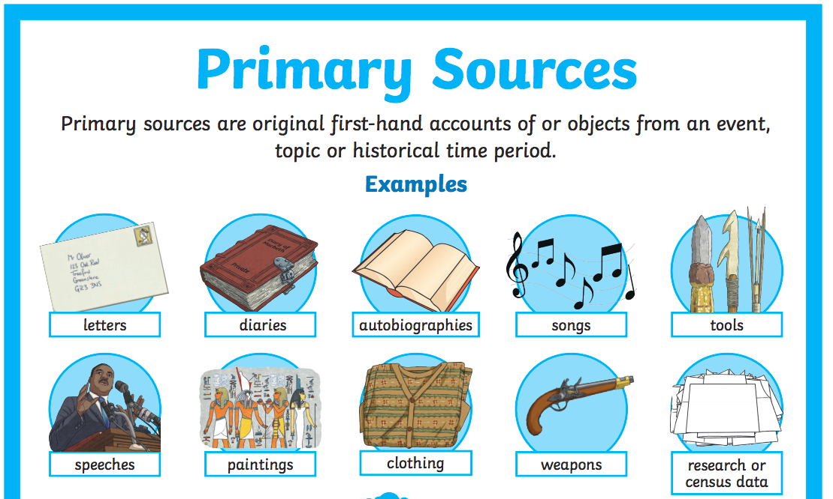
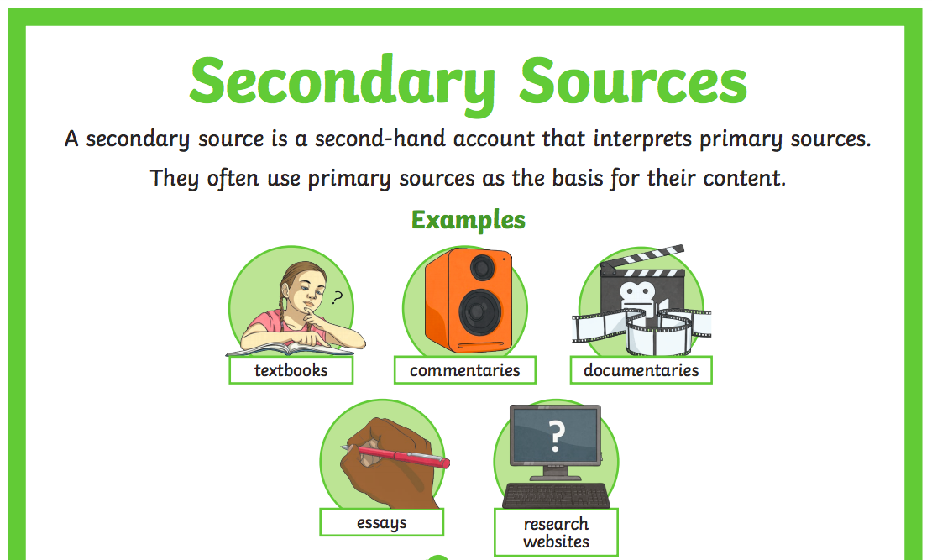
How do you know?
Museum website

Slide 6
Outline your findings here:
?

Slide 7
How do you know?

Slide 8
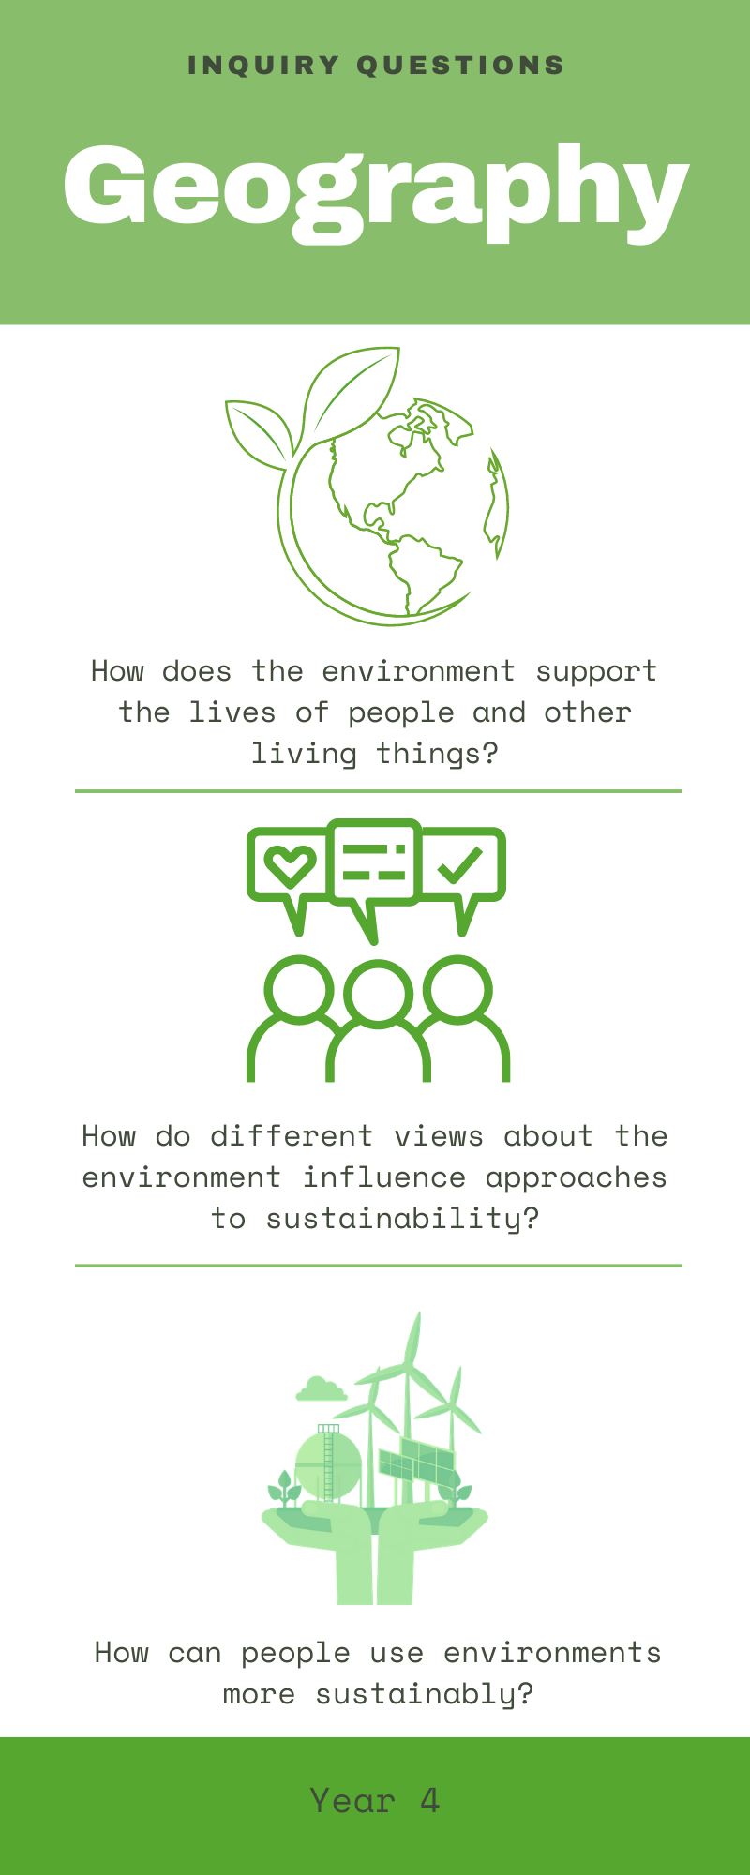
Year 4 Curriculum o The main characteristics (e.g. climate, natural vegetation, landforms, native animals) of the continents of Africa and Europe, and the location of their major countries in relation to Australia (ACHASSK087)
o The importance of environments to animals and people, and different views on how they can be protected (ACHASSK088)
o Aboriginal and Torres Strait Islander Peoples' ways of living were adapted to available resources and their connection to country/place has influenced their views on the sustainable use of these resources, before and after colonisation (ACHASSK089)
o The natural resources (e.g. water, timber, minerals) provided by the environment and different views on how they can be used sustainably (ACHASSK090)

Slide 9
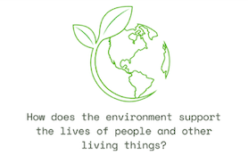
Outline your findings here:

Slide 10
How do you know?

Slide 11
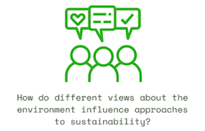
Outline your findings here:

Slide 12
How do you know?

Slide 13
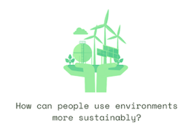
Outline your findings here:

Slide 14
How do you know?

Slide 15
Outline your findings here:

Slide 16
How do you know?

Slide 17
How were the Aboriginal and Torres Strait Islander Peoples' ways of living were adapted to available resources?
Outline your findings here:

Slide 18
How do you know?

Slide 19
How does the Aboriginal and Torres Strait Islander Peoples' connection to country/place influence their views on the sustainable use of these resources? (before and after colonisation)
Outline your findings here:

Slide 20
How do you know?

